Slide 1
LA Water Resources Commission Meeting
Patrick W. Forbes, P.E.
Executive Director
Office of Community Development
November 29, 2018

Slide 2
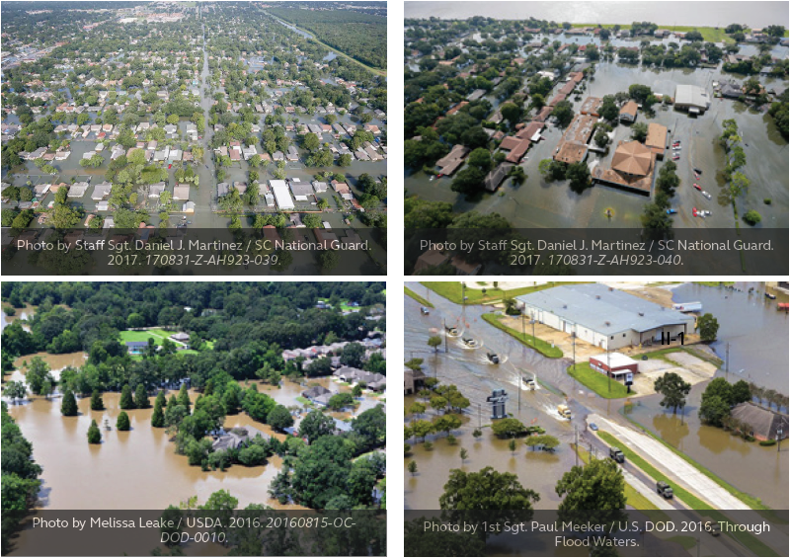
Why is the Louisiana Watershed Initiative necessary?
Over 75% of federally declared disasters are flood-related
Floods account for greater loss of life and property than all other hazards combined
Flood waters do not obey jurisdictional boundaries
Actions within a watershed can lead to increased or reduced flooding upstream, downstream, and sideways

Slide 3
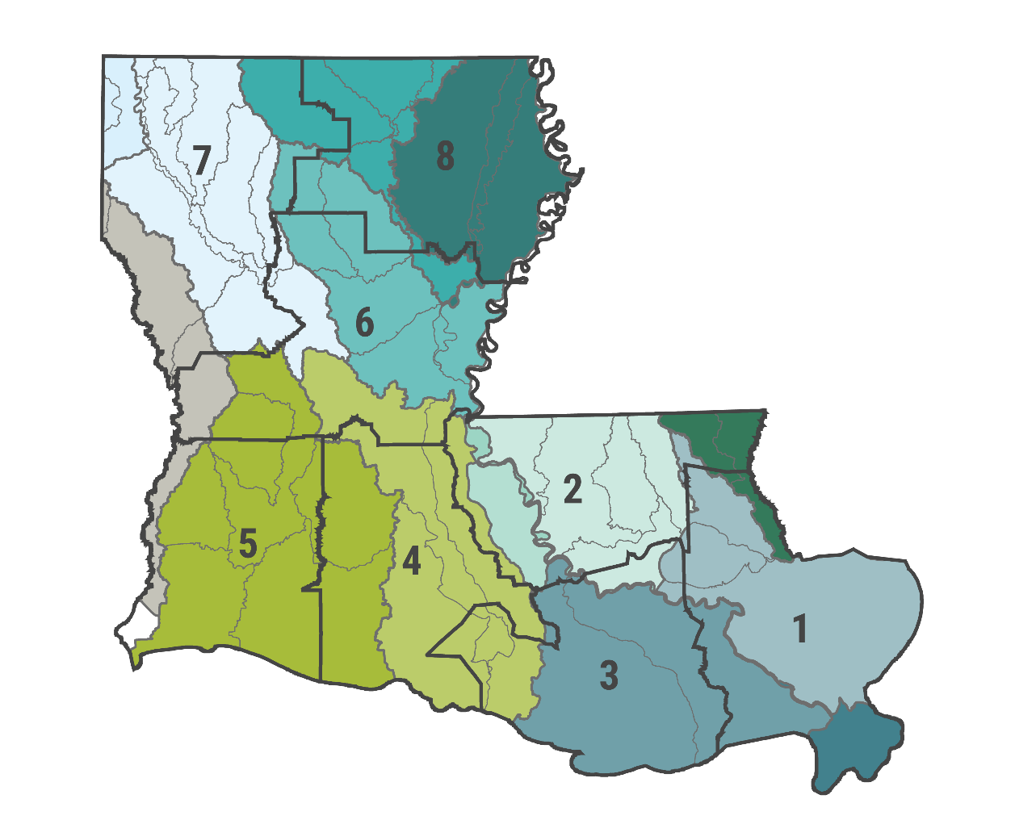
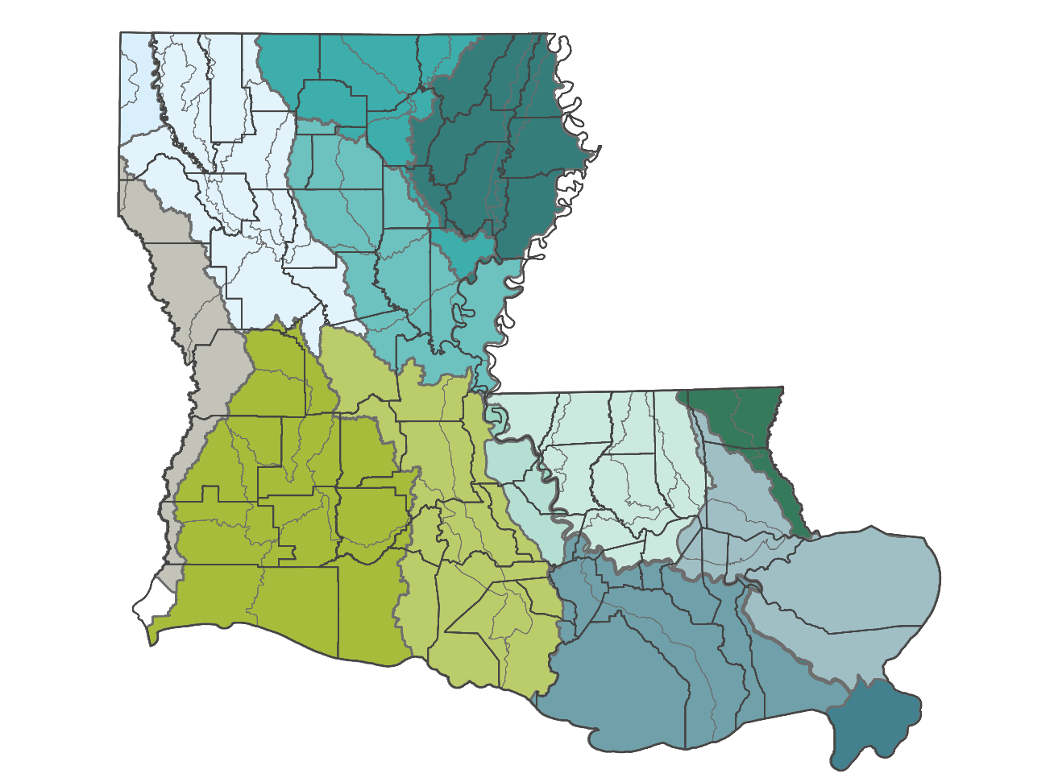
Watersheds don’t follow existing jurisdictional boundaries
Planning and Development District Boundaries vs. Watershed Boundaries
Parish Boundaries vs. Watershed Boundaries

Slide 4
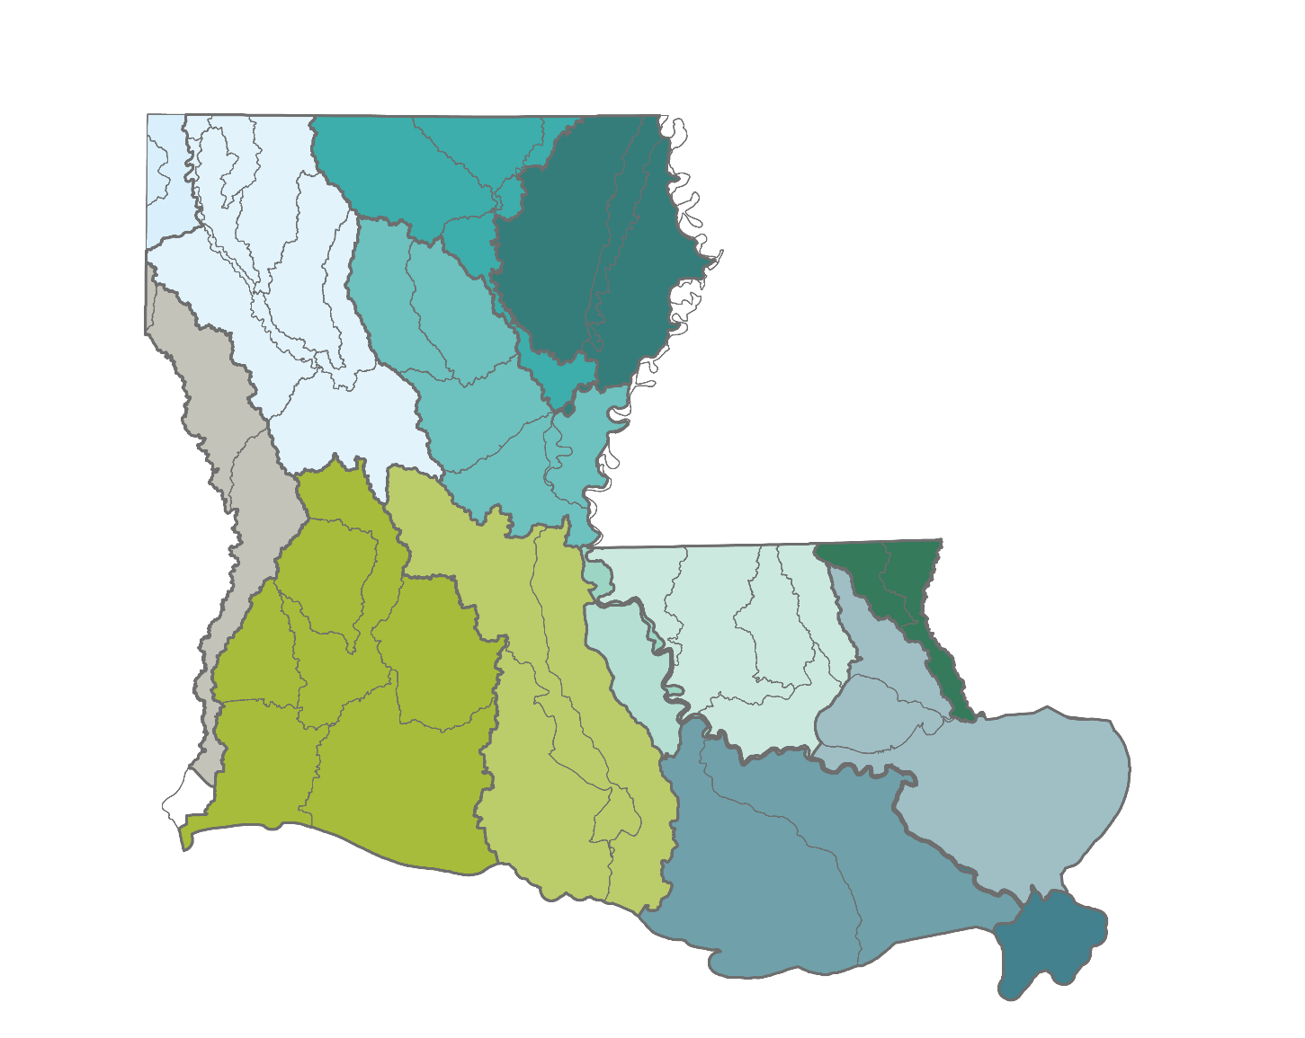





OUR MISSION
Reduce flood risk and improve floodplain management across the state, including through maximizing the natural and beneficial functions of the floodplain
LOUISIANA WATERSHED INITIATIVE

Slide 5
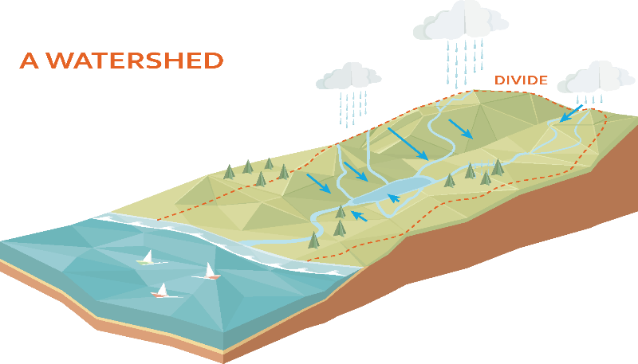
Dual approach
Align
Watershed-based floodplain management
Move toward
existing
Programs
Policies
Practices
with
Mission

Slide 6
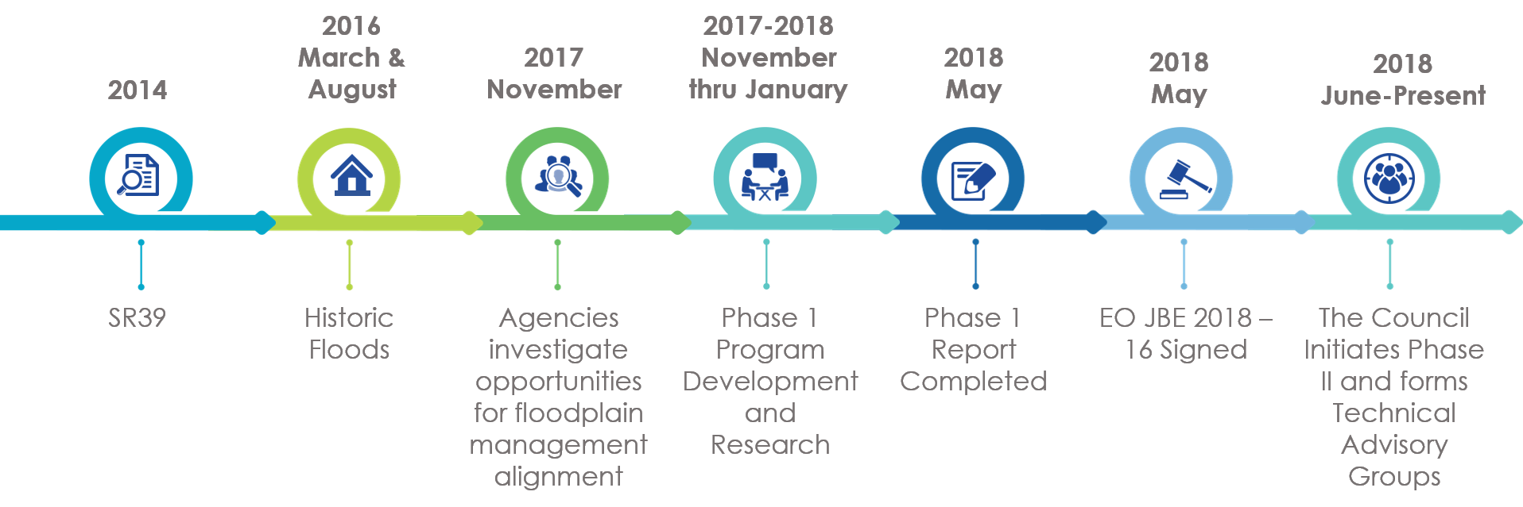
Timeline
Notes:
Let’s take a moment to see the steps that have been taken to get us to where we are today.
The floods of 2016 were historic events that effected all areas of our state. In Nov. 2017, CPRA, GOHSEP, OCD, and DOTD began an investigation to see where places for alignment of floodplain management existed. This resulted in a Phase 1 report being completed that is available on our website and we have a few copies to view today in the lobby area.
In May of this year – Governor Edwards issued an executive order that officially formed the Council on Watershed Management. This has led to the initiation of Phase II that we are currently in that is continuing to gather data and establish a coordinated decision-making process that can generate practical recommendations to the Council.
We expect, as we reach agreements through this process, that beyond 2019 we’ll realize a significant shift towards a full watershed based approach that is consistent with a long-term, holistic vision of floodplain management within the State of Louisiana.
Additional notes if needed:
2016
March and August 2016 flooding damages more than 145,000 homes
Gov. Edwards directs state agencies to coordinate programs and efforts toward future flood risk mitigation
2017
OCD and DOTD begin to develop a hydraulic and hydrologic model of the Amite Watershed
Cooperating agencies begin Phase I of a process to develop a statewide watershed-based floodplain management program
2018
Gov. Edwards issues EO JBE18-16 creating the Council on Watershed Management
Cooperating agencies release a multi-phased plan, early actions and initial framework for watershed-based floodplain management
2019
Final framework and full implementation to be initiated that is consistent with a long-term, holistic vision for floodplain management in Louisiana

Slide 7





Strategic Areas of Focus
$
FUNDING
INTEGRATED PLANNING
CAPABILITY & CAPACITY
DATA
ENGAGEMENT
STANDARDS
Notes:
Through the phase I process, 6 specific strategic areas of focus were called out:
Each of these areas coordinate together and create a foundation for sound floodplain management.
Data –
Standards –
Engagement
Planning
Funding
Capability and Capacity

Slide 8
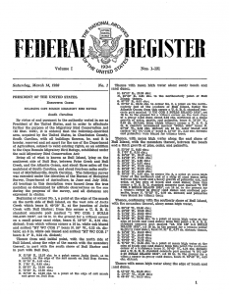
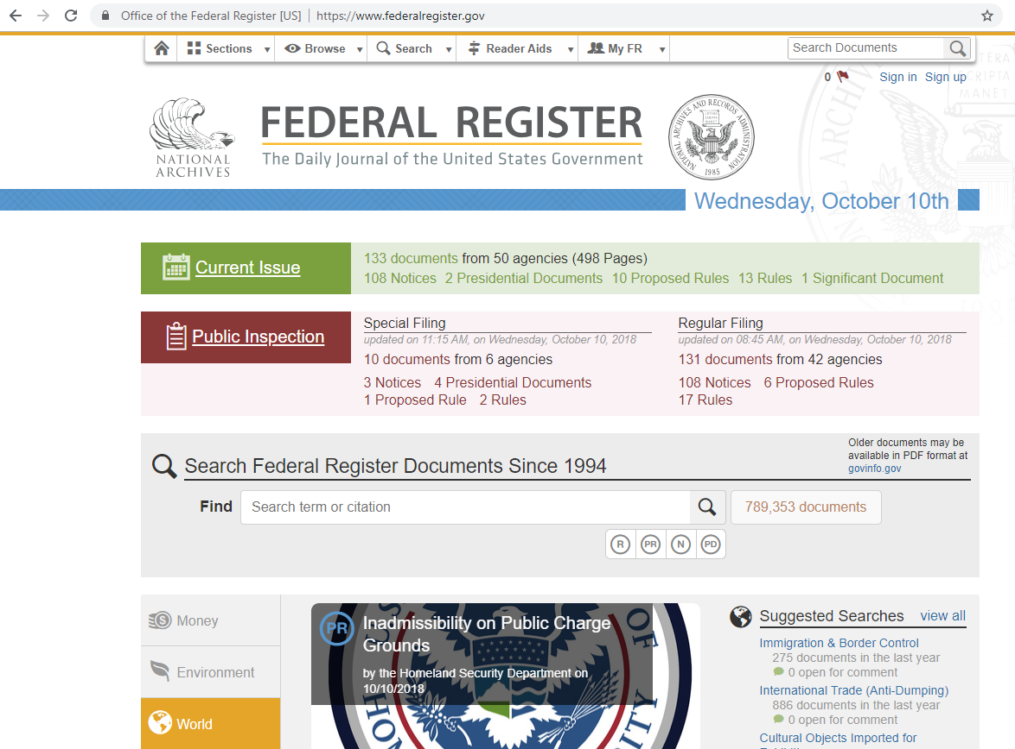
Existing Efforts Support Near Term Actions
PREPARING FOR FEDERAL REGISTER NOTICE to GUIDE $1.2B
Action plan
Low risk, high benefit projects
Statewide modeling
Data improvement
Engagement
PENDING
Notes:
HUD mitigation
Currently preparing for Federal Register Notice from the U.S. Department of Housing and Urban Development to serve as guidance for how congressional allocation of $1.2 billion in flood mitigation dollars can be expended
Working on the parameters of an action plan now to submit back to HUD once this Federal Register Notice has been published
Early focus will be on utilizing funds to advance statewide watershed modeling and mapping efforts to inform science-driven decision making for future planning and projects
The work of all of the TAGs in one way or another will be feeding into how these mitigation funds are used

Slide 9
Statewide Listening Tour
WHERE WE’VE BEEN
58
64
46
44
Lafayette
Monroe
Alexandria
Shreveport
LA BEOC
Informative
Research Center
West Monroe
Convention Center
Pineville
Community Center
Shreveport
Convention Center
60
80
77
126
Houma
Lake Charles
Hammond
Baton Rouge
South Central
Planning &
Development District
IMCAL (SEED
Center)
Tangipahoa
Parish Clausen
Conference Room
BREC Administration
555
engineers, planners, floodplain managers, public works staff, emergency responders, code enforcement staff, elected officials, and more

Slide 10
Technical Workshops and Listening Sessions
Date | Location | Topic
October 8 | Lafayette | National Hydrography Dataset, Watershed Boundary Dataset, and LiDAR
October 16 | Monroe | Historical flood data
October 17 | Alexandria | Water quality data, salinity, dissolved oxygen, point source discharges/OSDS
October 18 | Shreveport | River and Rain Gauges
October 23 | Houma / Thibodaux | Ecological and Biological Impacts
November 7 | Lake Charles | Modeling approaches: Transition zones
November 14 | Hammond | Conveyance and hydraulic structures
November 15 | Baton Rouge | Modeling approaches: Watershed modeling and Amite River basin model case study

Slide 11
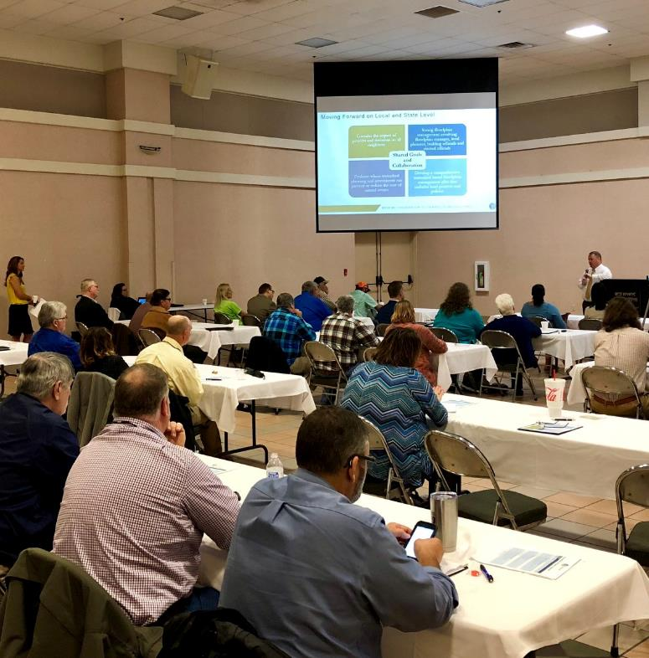
ENGAGEMENT
WHAT WE HEARD
Locals want to be involved
Need for technical assistance and improved capacity to fully participate
Many jurisdictions could benefit from resources already available
Local expertise varies
Need for more outreach on flood mitigation programs
Jurisdictions support outreach and education at the local level
Statewide Listening Tour

Slide 12
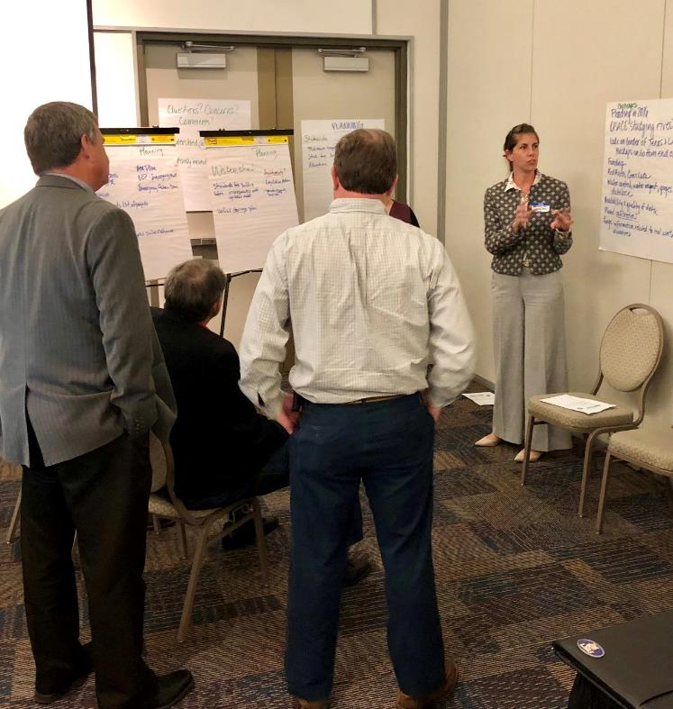
ENGAGEMENT
NEXT STEPS
Synthesize results in report form and within the work of technical advisory groups
Short-term early 2019 engagement needs: interstate summit, regional meetings to 'right size' capacity building program
Results to be shared at http://watershed.la.gov
Statewide Listening Tour

Slide 13

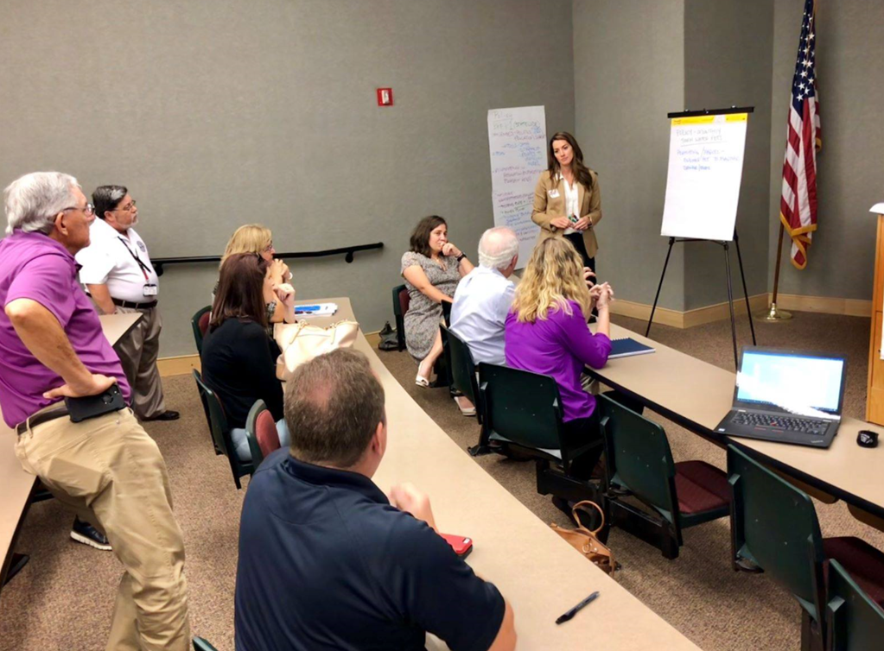
MODELING AND PROCUREMENT
WHAT WE HEARD
Strong desire for regional participation in modeling procurement
Economy of scale, efficiency, minimum standardization, local capacity
Lessons learned, re: stakeholder engagement Amite Modeling effort
NEXT STEPS: Draft a strategy that establishes the appropriate level of state/local partnership to achieve the best possible outcome
Estimated January 2019

Slide 14
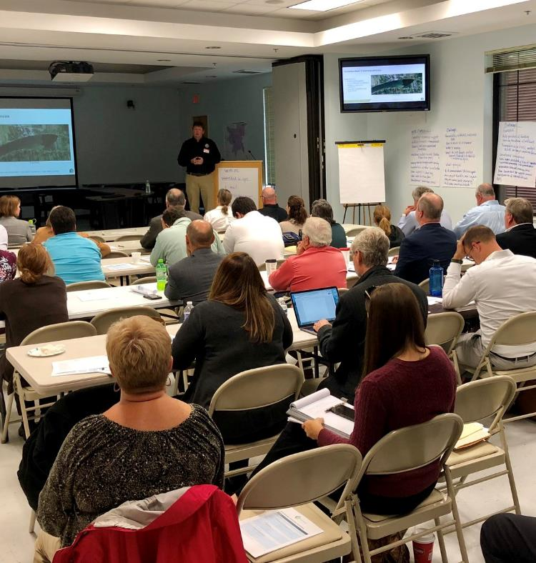
DATA
WHAT WE HEARD
Establish realistic base standards for data collection
Data needs to feed into a “living model” with a focus on calibration, QA/QC
Need to consider why data is needed and how it will be used when setting targets/standards
Focus on using funds efficiently
Statewide Listening Tour

Slide 15
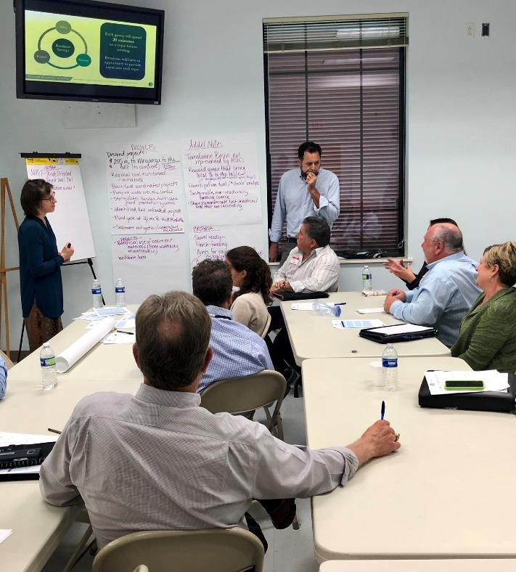
POLICY
WHAT WE HEARD
Statewide standards or guidance tied to funding will help ensure consistency across watersheds
Best practices and model ordinances are helpful
Account for enforcement needs for new policy
State needs to reinforce efforts of local jurisdictions
Statewide Listening Tour

Slide 16
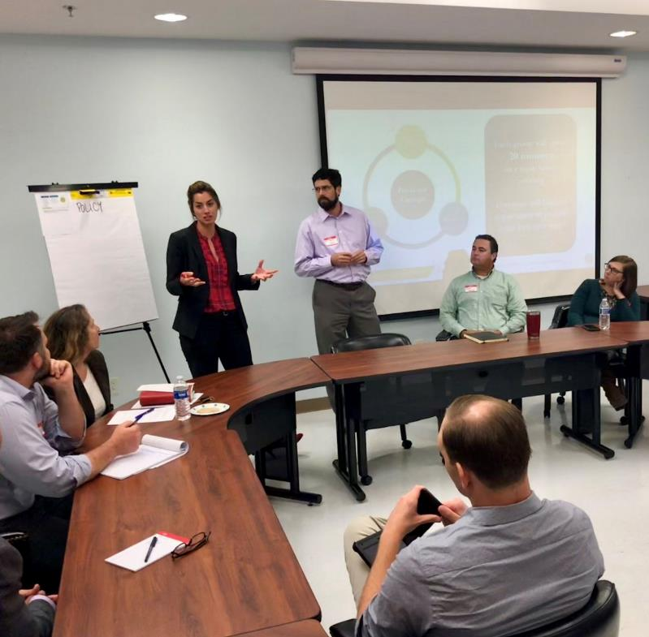
PLANNING
WHAT WE HEARD
Provide a minimum framework for watersheds to follow
Funding decisions, project authorization, and other decisions should be driven by floodplain management expertise not politics
Integrate local plans with regional/state plans, CRS model
Watershed specific pre-disaster planning
Statewide Listening Tour

Slide 17
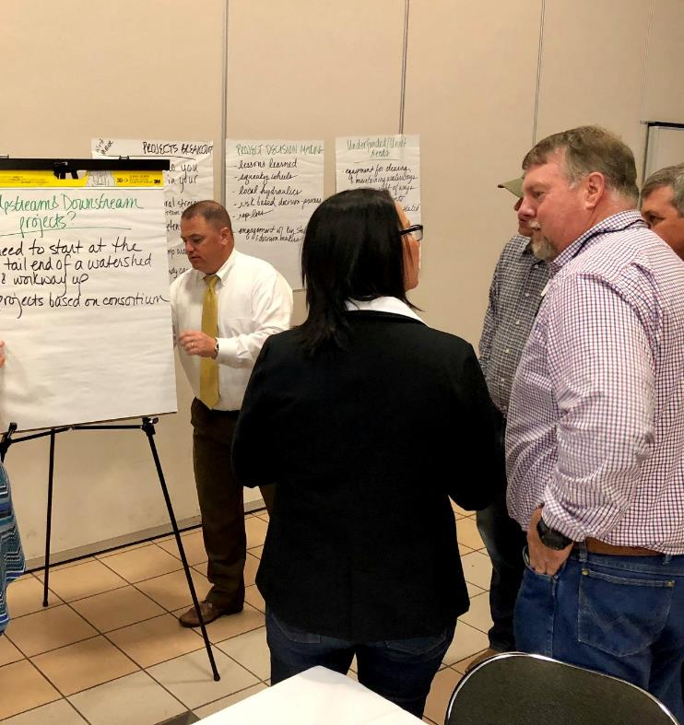
PROJECTS
WHAT WE HEARD
Prioritize continuous, historical impact areas
Reward proactive local jurisdictions/regions already investing in flood risk-reduction
Focus on projects that meet multiple community needs
Funding for staff and gauge projects
Statewide Listening Tour

Slide 18
Focus on funding through sound criteria
EVALUATION CRITERIA
APPLICATION PROCESS
  Recommended criteria weighting
  Refined individual criteria (coordinate with Policy & Data TAGs)
Rounds of funding
  Prior to models
  Vetted with watershed models
Phased Application
  Pre-application screening
  Application technical evaluation
  Verification of stated benefits through design and modeling
Criteria | Weight
Effectiveness (flood risk reduction) | 35%
Feasibility | 20%
Natural Functions | 15%
Affordability / Schedule | 10%
Social Considerations | 10%
Higher Standards | 10%
DRAFT

Slide 19
Next steps
Ongoing coordination with locals and the State to complete:
Statewide Modeling
Procurement
Strategy
2019 Engagement
Strategy
Project Evaluation Criteria & Round 1 Application

Slide 21
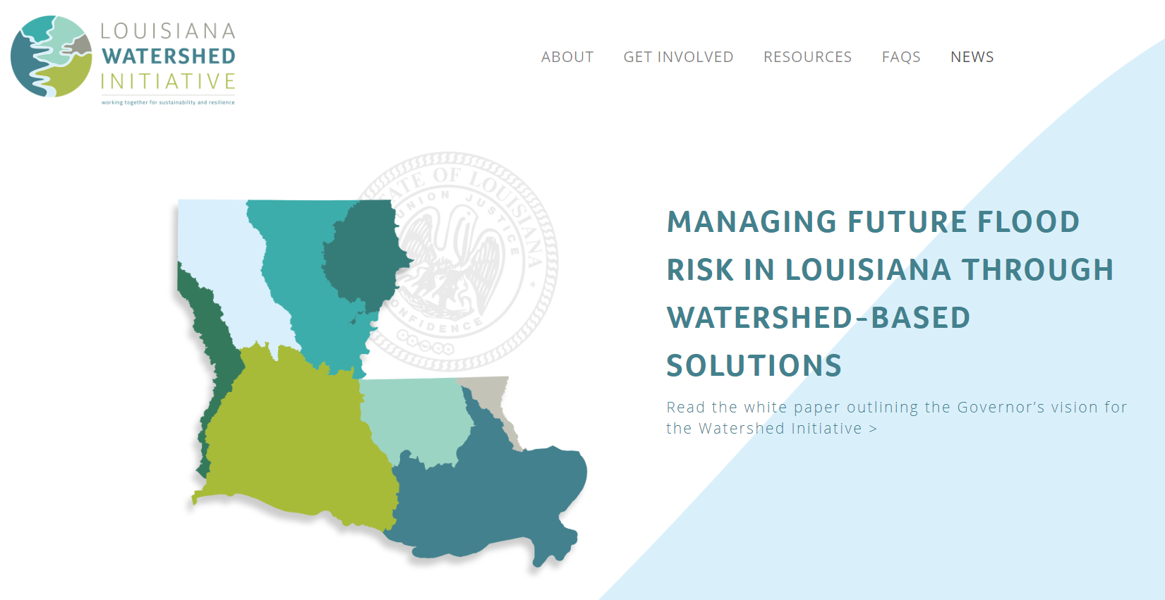

Slide 22
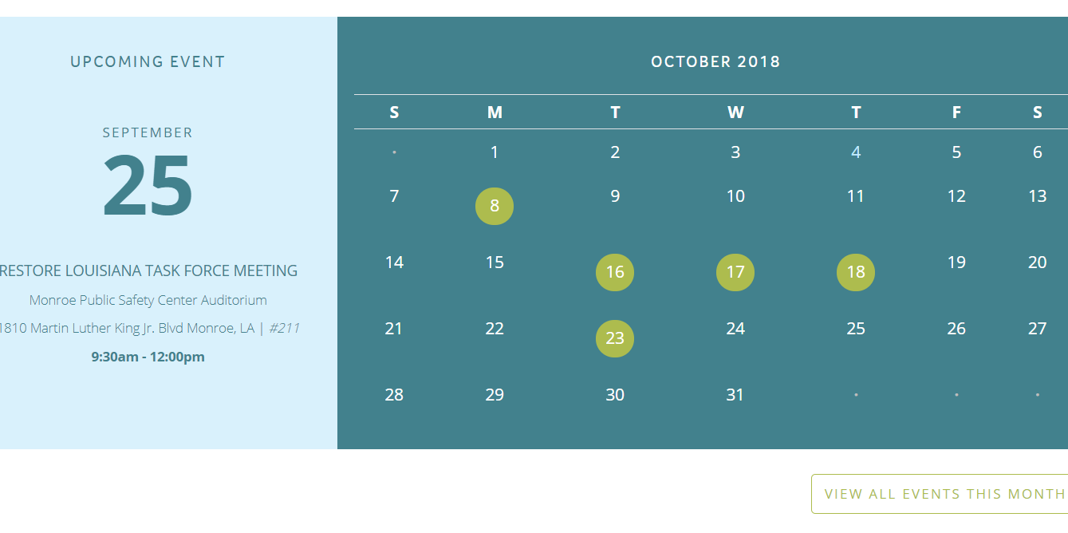

Slide 23
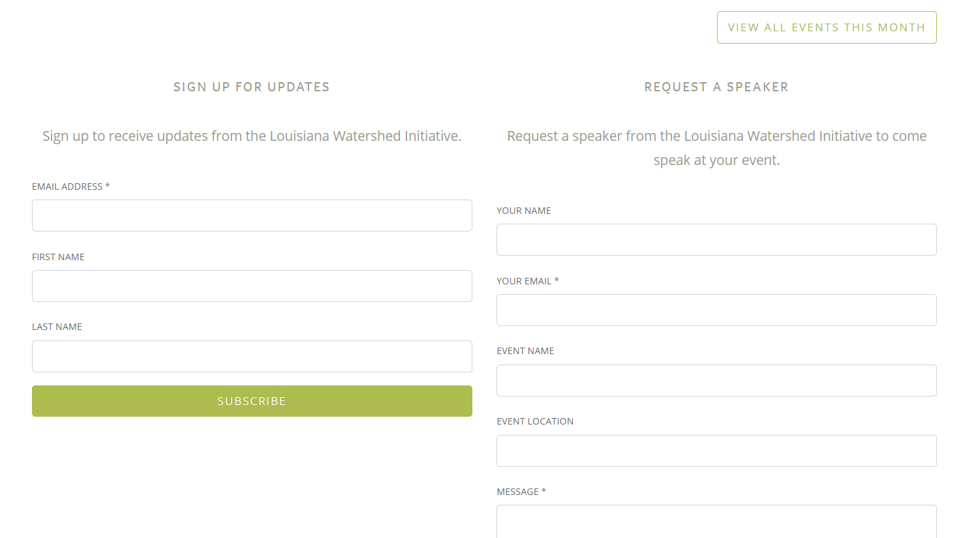

Slide 24



Stay engaged
watershed@la.gov

