Slide 1

USDW Search
Office of Conservation
Injection and Mining Division
Utilizing the DNR website and SONRIS
to perform an unofficial USDW search

Slide 2
Underground Source of Drinking Water
Definition
An Underground Source of Drinking Water is defined by the United States Environmental Protection Agency as:
An aquifer or its portion which supplies any public water system; or
An aquifer or its portion which contains a sufficient quantity of ground water to supply a public water system; and
  Currently supplies drinking water for human consumption; or
  Contains fewer than 10,000 mg/l total dissolved solids and which is not an exempted aquifer.

Slide 3
Determining the Base of the USDW
Using an Electric Log
The IMD typically uses the deep induction curve on an e-log to define the base of the USDW. The following guidelines are used:
  Ground surface to 1,000 feet: 3 ohms or greater is considered USDW;
  1,000 feet to 2,000 feet: 2 ½ ohms or greater is considered USDW; &
  2,000 feet and deeper: 2 ohms or greater is considered USDW
The base of the USDW is established at the base of the sand unit that contains the lowermost USDW with an isolating shale beneath it.
100 feet of net shale must exist between the top of the zone and the base of the USDW.

Slide 4
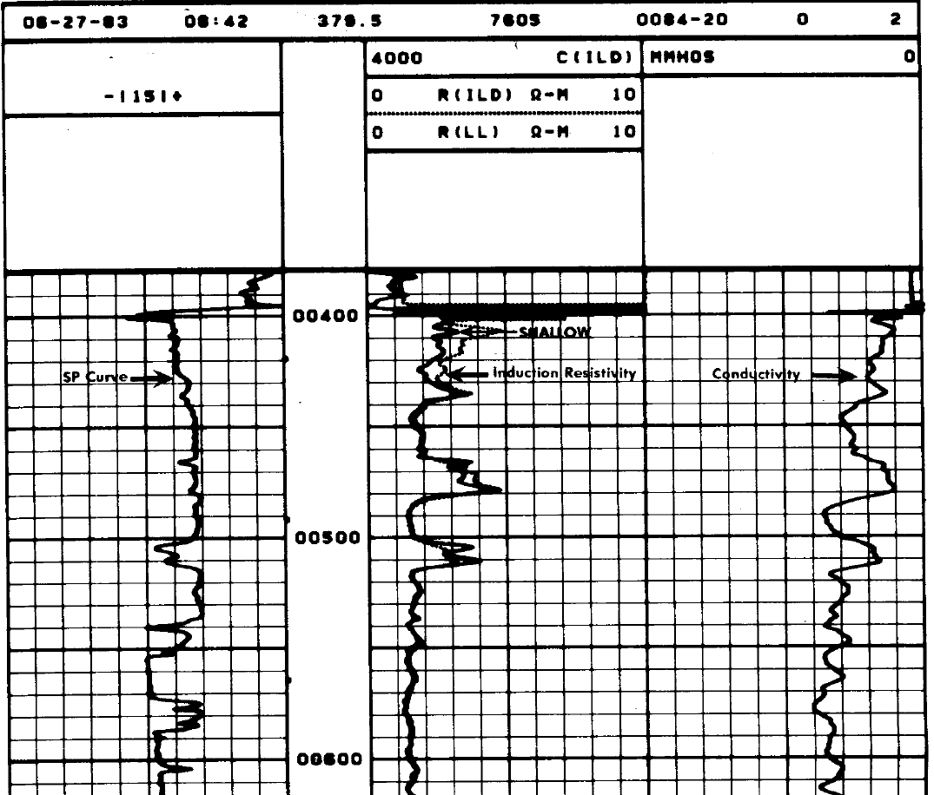
Determining USDW on Electric Logs – Example
Base of a Sand Unit Confined by
> 30 - 40’ of Shale
USDW ≥ 3 ohms
from 0’ – 1000’

Slide 5
Determining USDW on Electric Logs – Example #1
USDW at
515 FEET

Slide 6
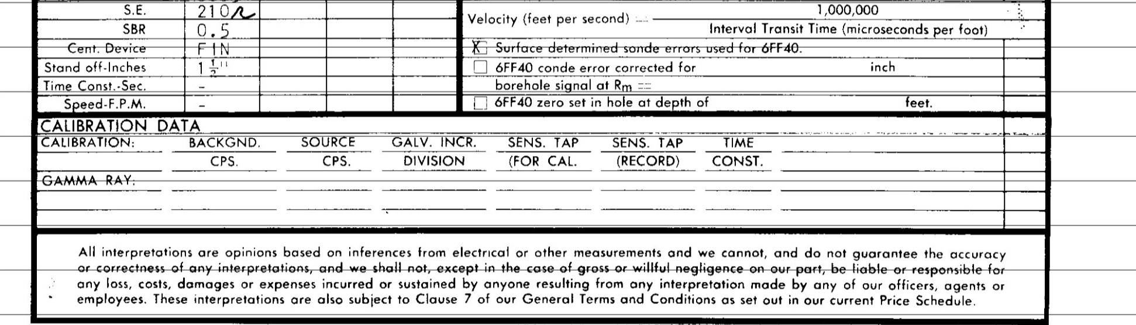
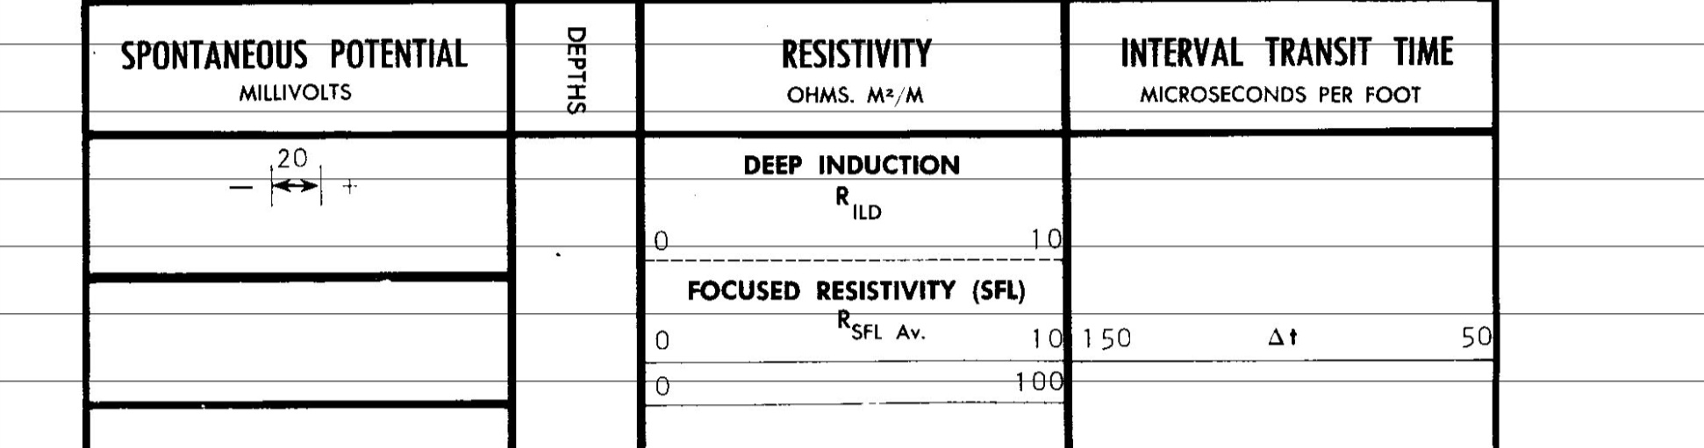
  Resistivity Curve
    Ground surface to 1,000 feet: 3 ohms or greater
    1,000 feet to 2,000 feet: 2 ½ ohms or greater
    2,000 feet and deeper: 2 ohms or greater
  Establish at the base of the sand unit
  100 feet of net shale between USDW & Top of Zone

Slide 7
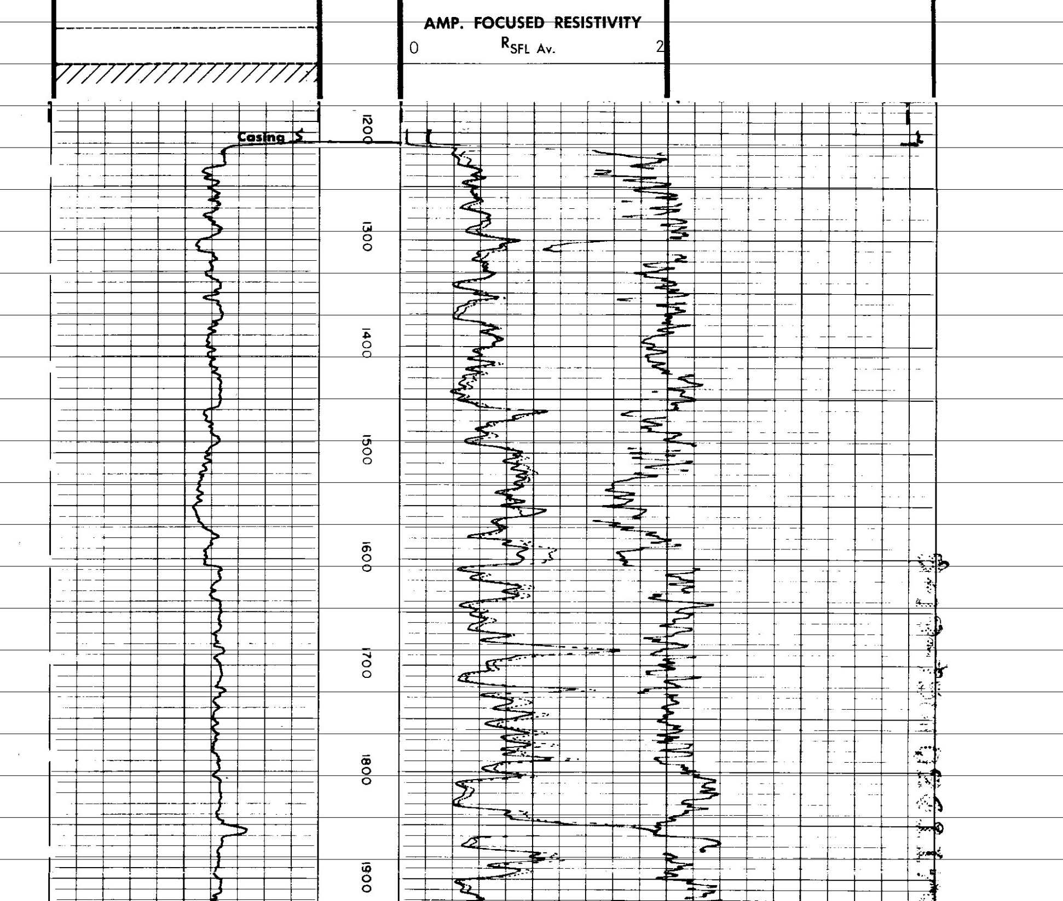
USDW ≥ 2 ½ ohms
from 1000’ – 2000’

Slide 8
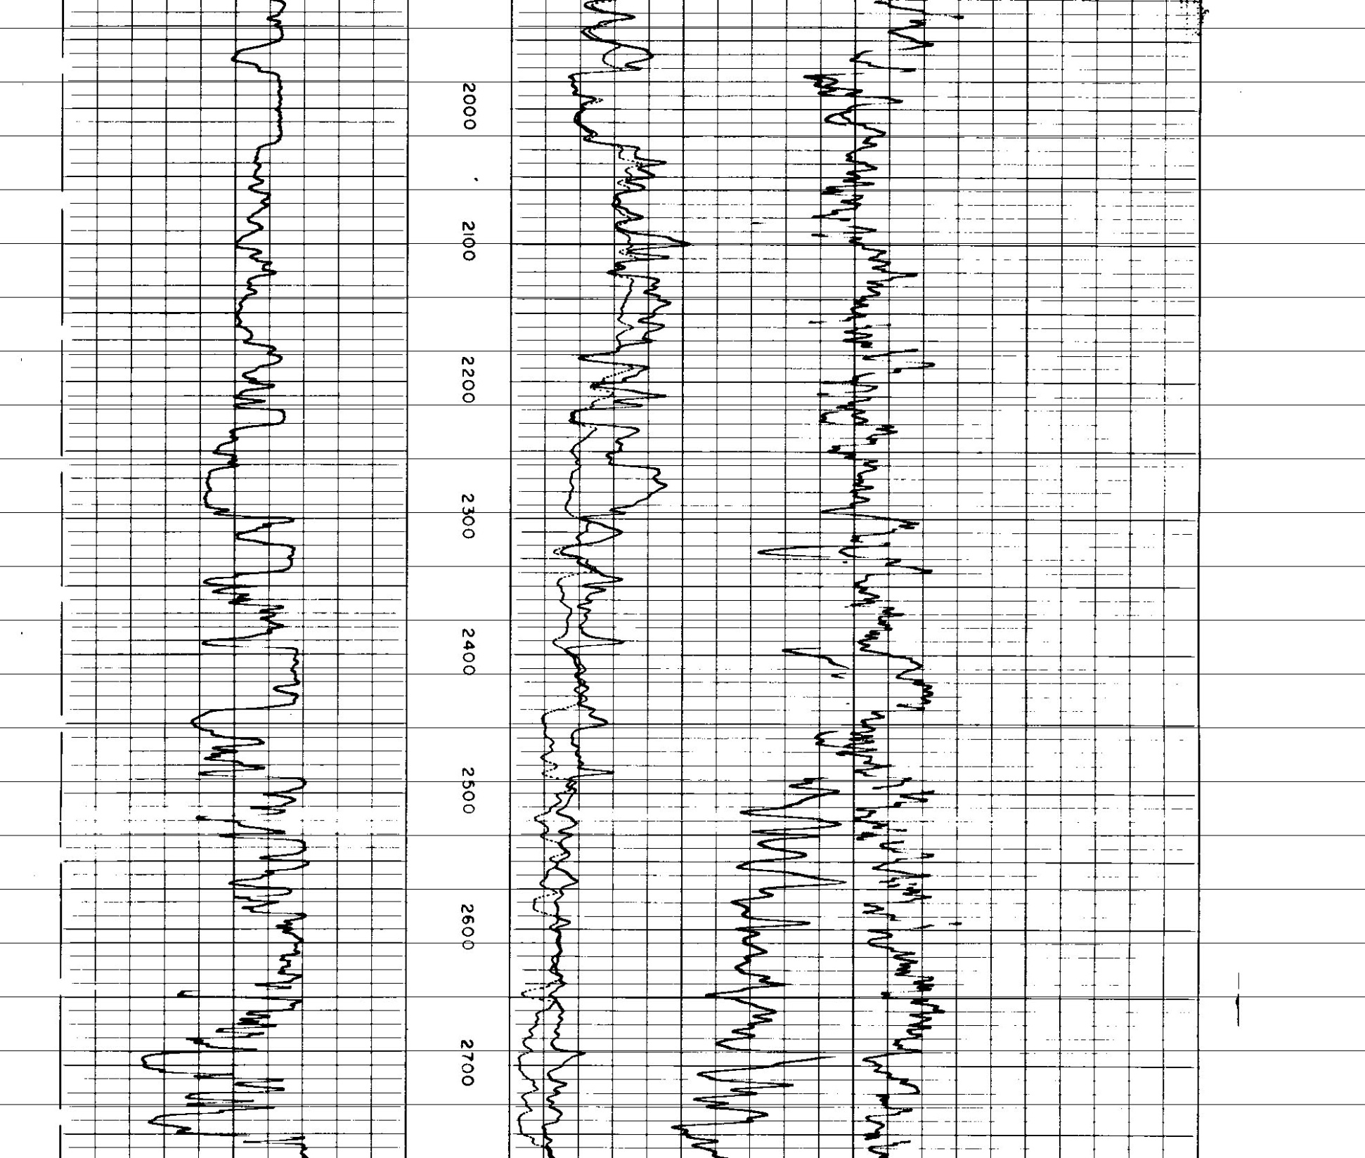
2000’
USDW ≥ 2 ohms
2000’ and Deeper

Slide 9
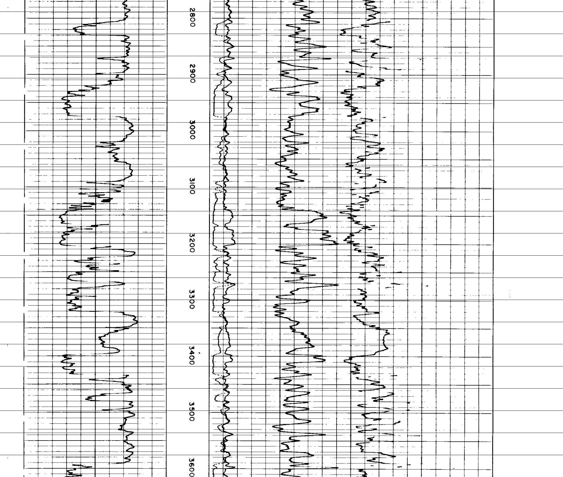

Slide 10
USDW ≥ 2 ohms
2000’ and Deeper

Slide 12
BASE OF THE USDW AT 2320’

Slide 13
  100 feet of Net Shale between USDW & Top of Zone
20’ (20’ OF NET SHALE)
40’ (60’ OF NET SHALE)
10’ (70’ OF NET SHALE)
15’ (85’ OF NET SHALE)
50’ (135’ OF NET SHALE)

Slide 14
BASE OF THE USDW AT 2320’
325 ft.
SHALLOWEST POSSIBLE TOP OF ZONE

Slide 15
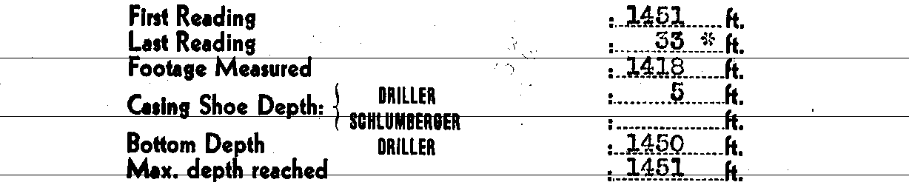
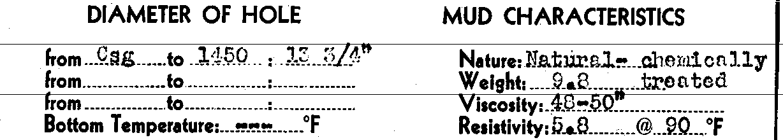
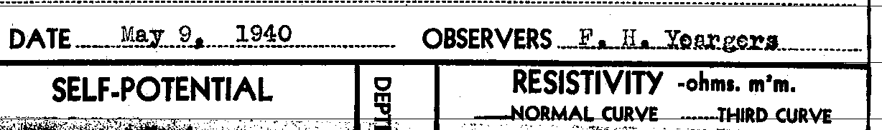
  Resistivity Curve
    Ground surface to 1,000 feet: 3 ohms or greater
    1,000 feet to 2,000 feet: 2 ½ ohms or greater
    2,000 feet and deeper: 2 ohms or greater
  Establish at the base of the sand unit
  100 feet of net shale between USDW & Top of Zone

Slide 16
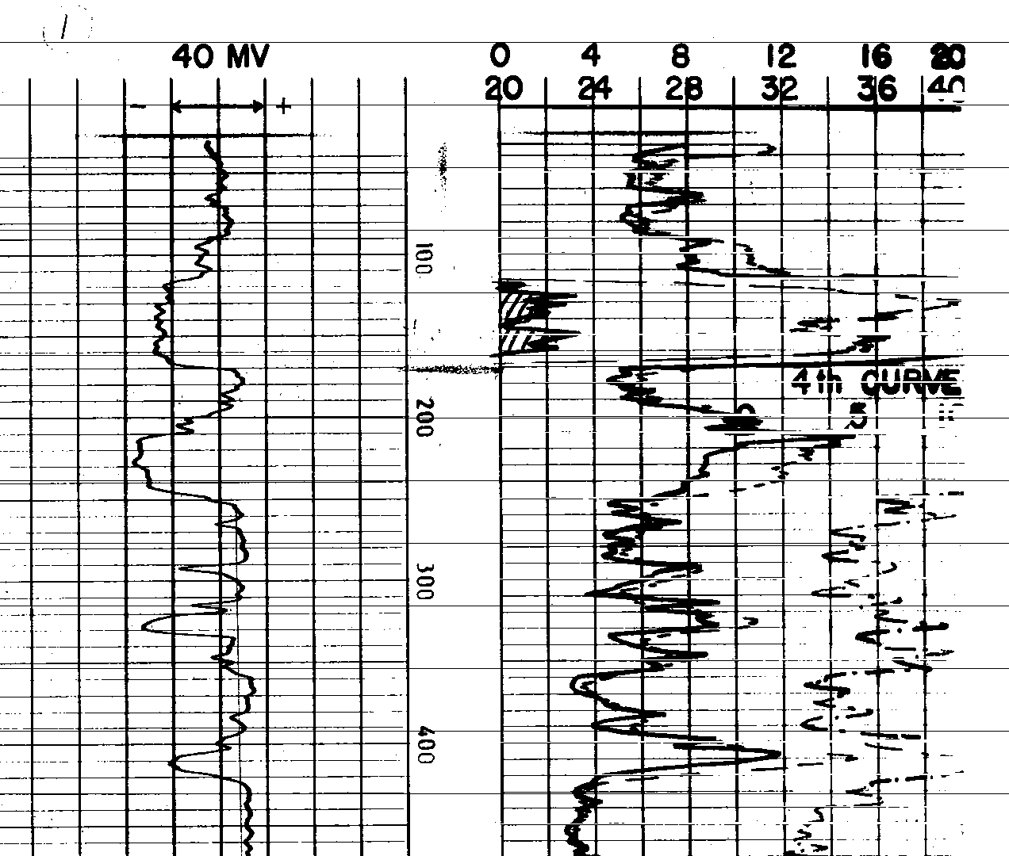
USDW ≥ 3 ohms
from 0’ – 1000’

Slide 17
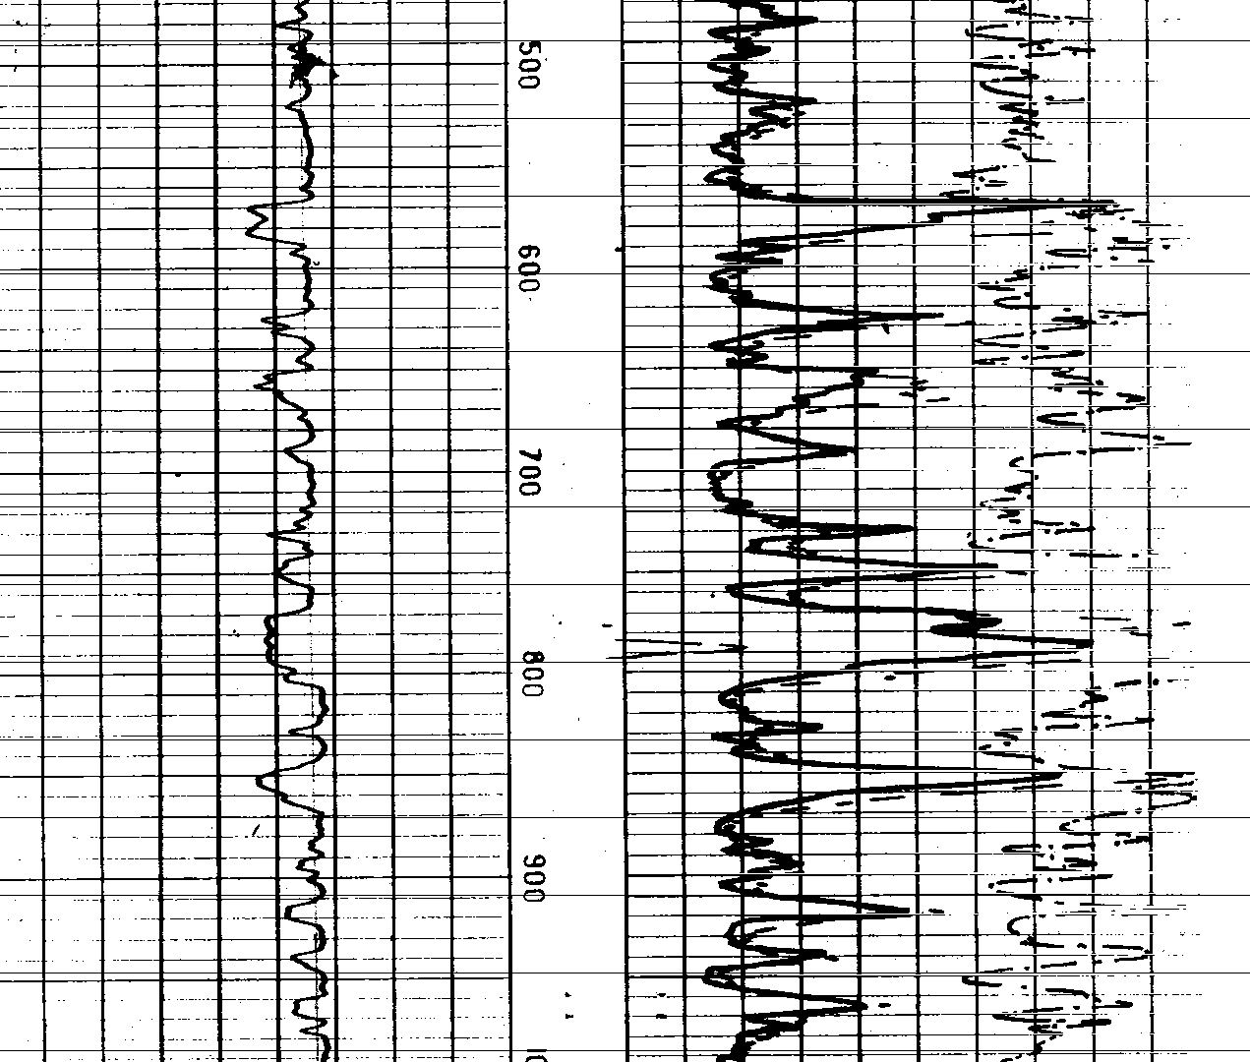

Slide 18
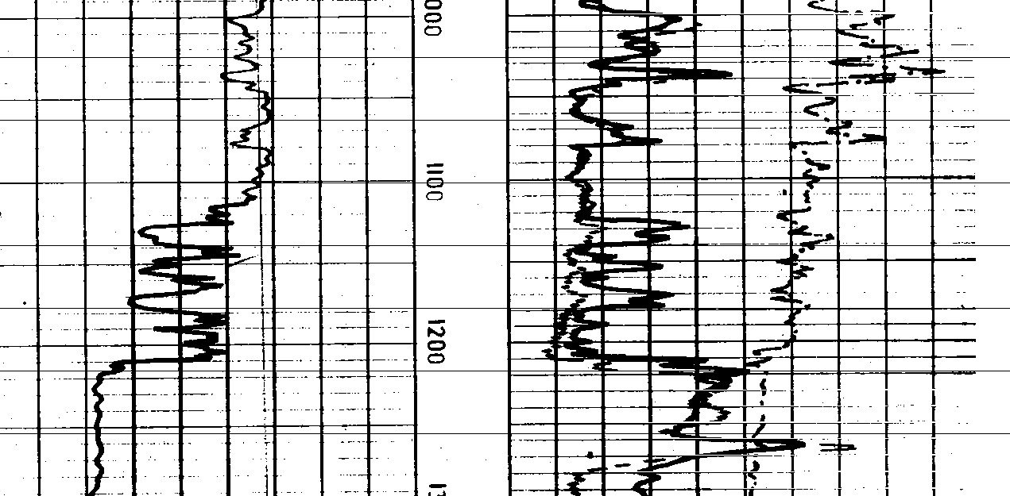
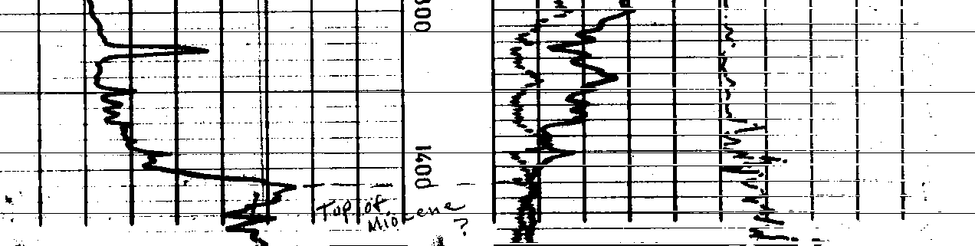
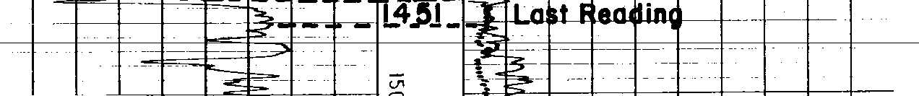
1000’
USDW ≥ 2 ½ ohms
from 1000 ’ – 2000’

Slide 19
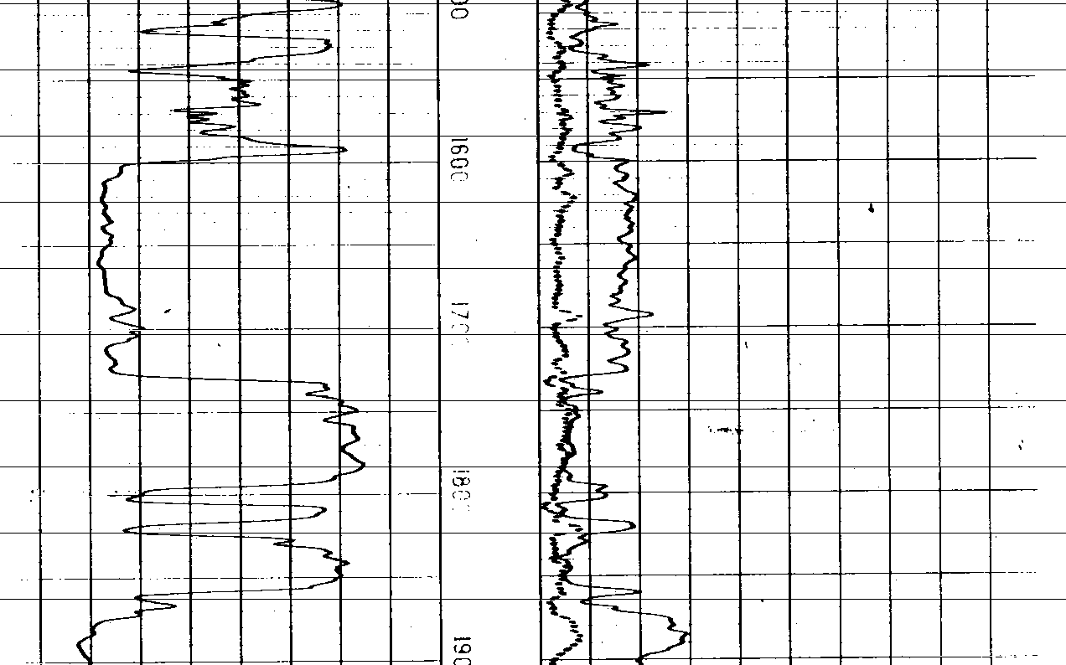
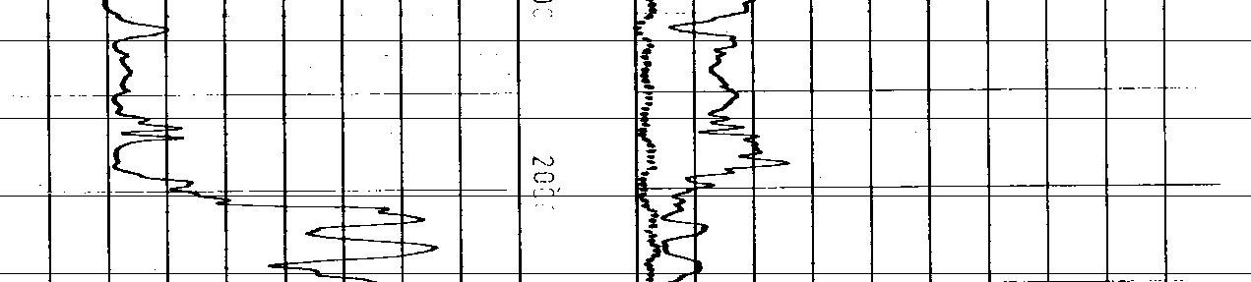
USDW ≥ 2 ohms
2000’ and Deeper
2000’

Slide 20
  USDW should be established at the base of a sand unit.

Slide 21
BASE OF THE USDW AT 1405’

Slide 22
  100 feet of Net Shale between USDW & Top of Zone
20’ (20’ OF NET SHALE)
25’ (45’ OF NET SHALE)

Slide 23
10’ (55’ OF NET SHALE)
45’ (100’ OF NET SHALE)

Slide 24
400 ft.
SHALLOWEST POSSIBLE TOP OF ZONE

Slide 25
SONRIS & Discoverer
Using the DNR database (SONRIS)
to define the base of the USDW

Slide 26
Identifying the Coordinates of an EXISTING well

Slide 27
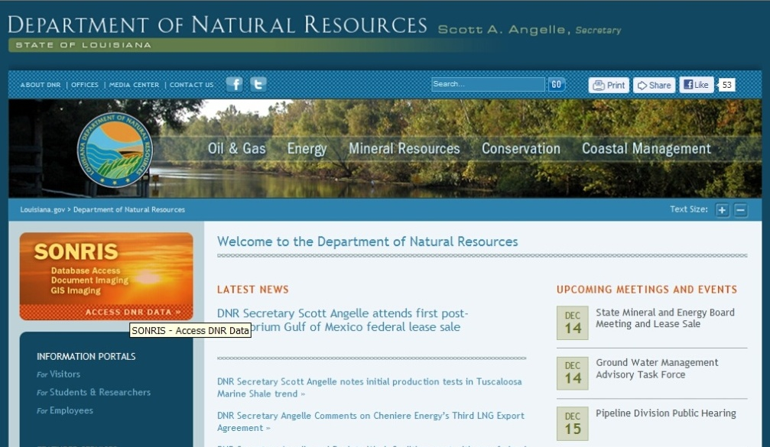

Go to www.dnr.louisiana.gov & click on the SONRIS logo

Slide 28
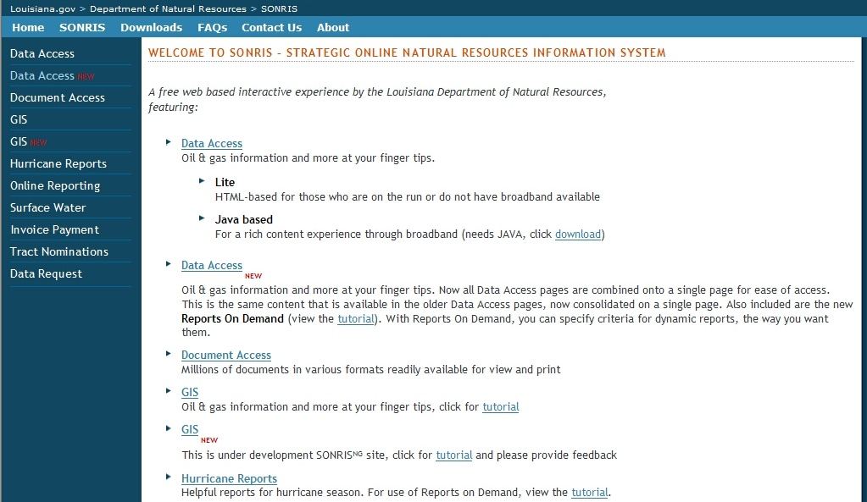
Select Data Access (NEW) from Left Menu

Slide 29
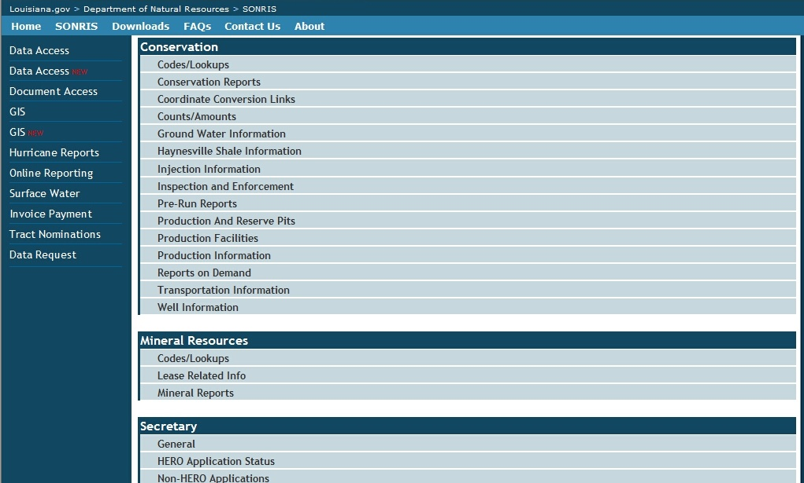
Scroll down to Conservation and select Well Information

Slide 30
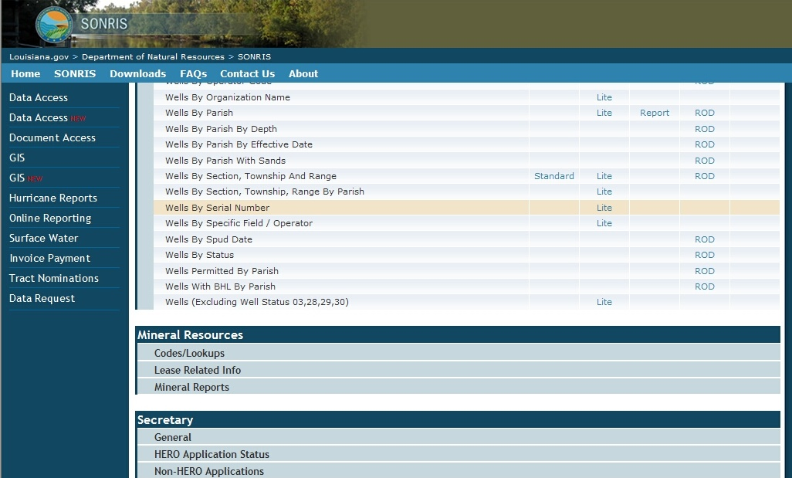
Scroll down to Wells by Serial Number and select Lite link

Slide 31
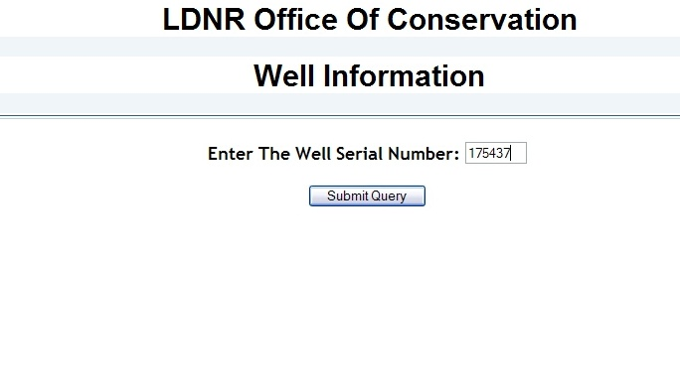
Enter the Serial Number of the well & click Submit Query

Slide 32
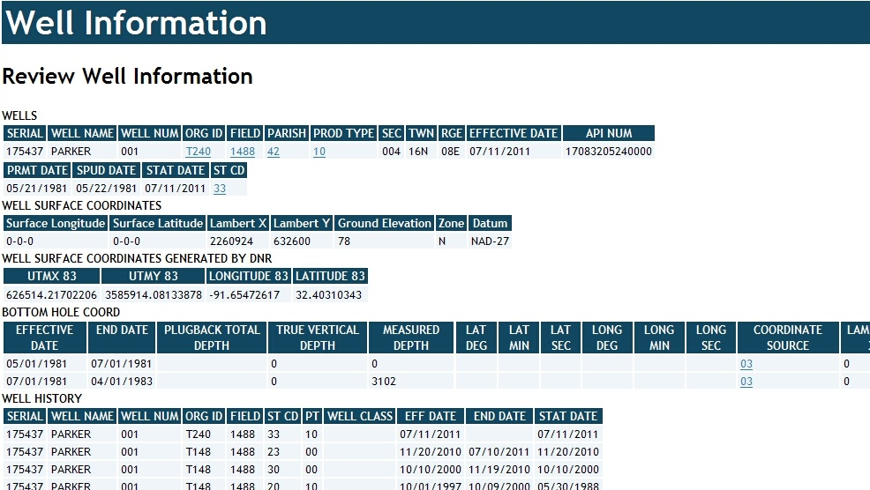
Scroll down to WELL SURFACE COORDINATES &
Locate the Lambert X, Lambert Y, Zone, and Datum fields

Slide 33
USDW Search in Discoverer

Slide 34
Select Data Access (NEW) from Left Menu

Slide 35
Scroll down to Conservation and select Injection Information

Slide 36
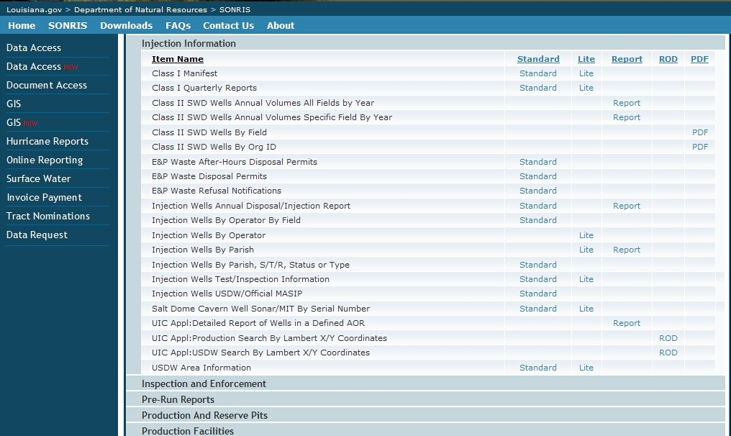
Scroll down to UIC Appl: USDW Search By Lambert X/Y Coordinates & select ROD link

Slide 37
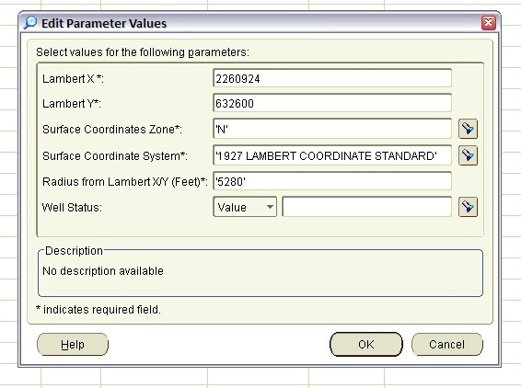
Enter the location’s X,Y Coordinates (do not use commas)

Slide 38
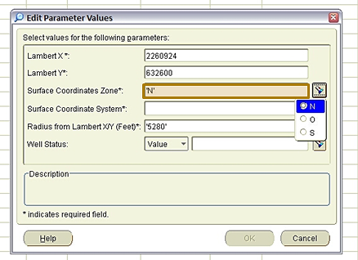
Select the flashlight icon next to the Surface Coordinates Zone field and choose the appropriate Zone- N (North), S (South), O (Offshore)

Slide 39
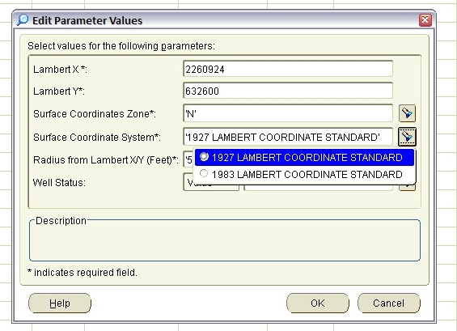
Select the flashlight icon next to the Surface Coordinates System field and choose the System/Datum- 1927 or 1983

Slide 40
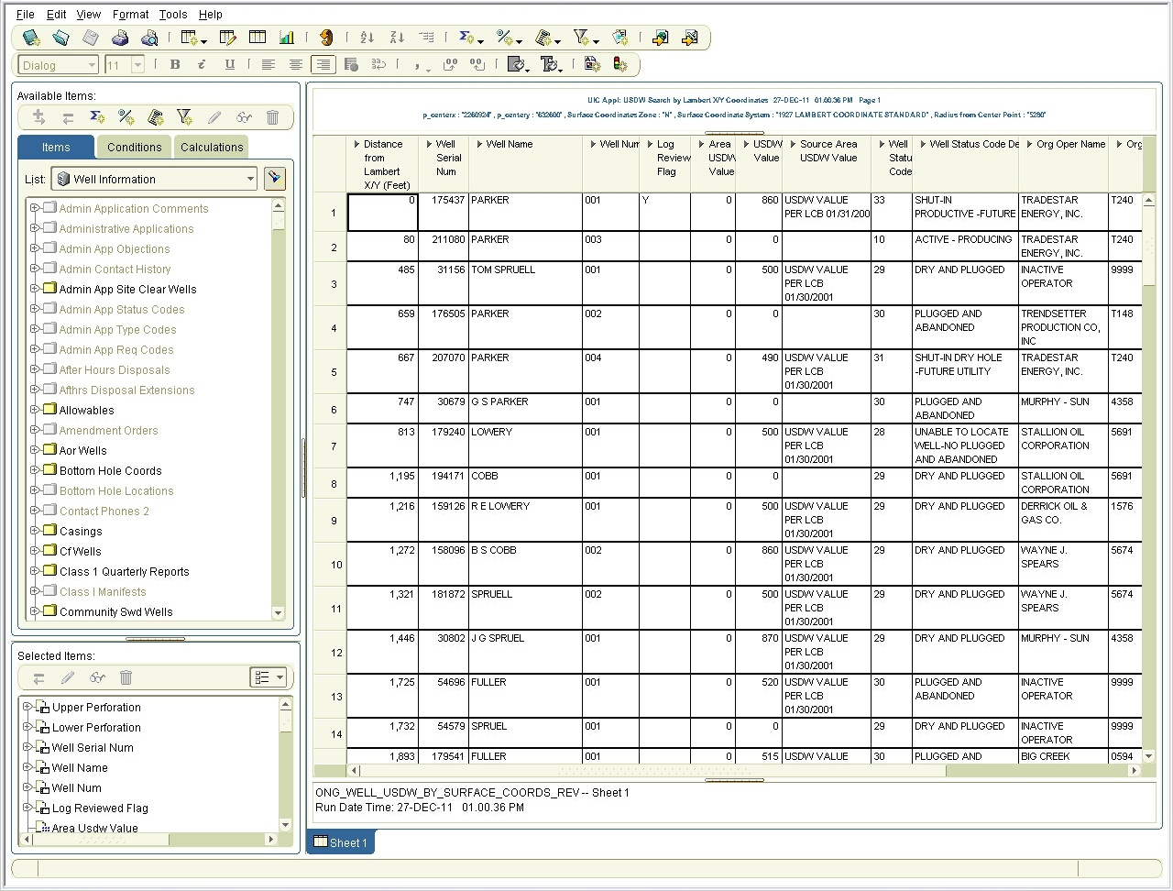

Slide 41
Modifying the Search Criteria
If No Wells are Retrieved in a 1-mile AOR - or –
If a USDW Value cannot be identified from the Wells that are Retrieved

Slide 42
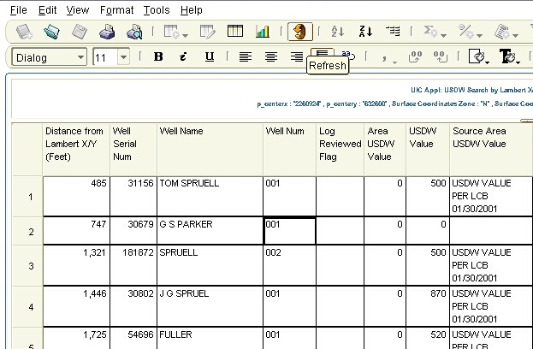
Click on the 10th Icon from the left.
When you mouse-over the icon, it will say Refresh.

Slide 43
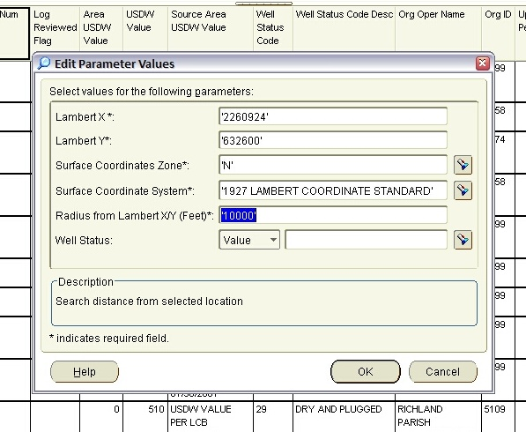

Increase the distance in the Radius (ft) field and
select the OK button.
If a well with an electric log cannot be identified within
2 MILES of the proposed location, please contact IMD.

Slide 44
USDW Search
Exporting Spreadsheet to EXCEL

Slide 45
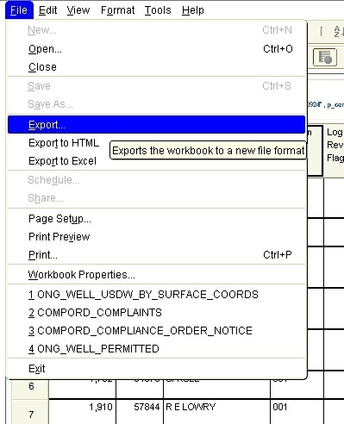
Select File from the Menu bar &
Select Export from the dropdown menu

Slide 46
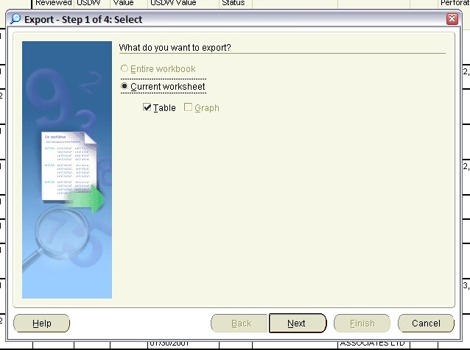
Click on the Next button

Slide 47
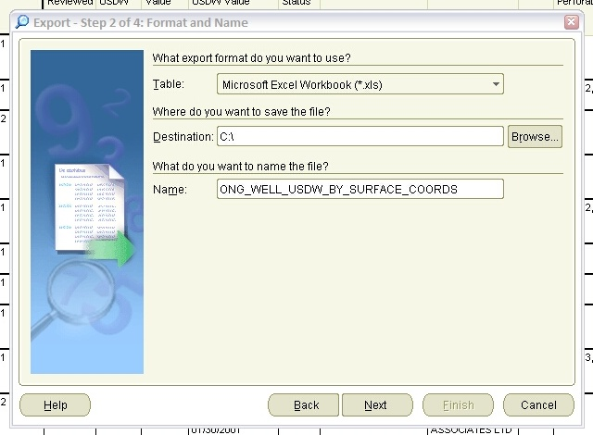
Click on the Browse button to select the location where you want to save the spreadsheet

Slide 48
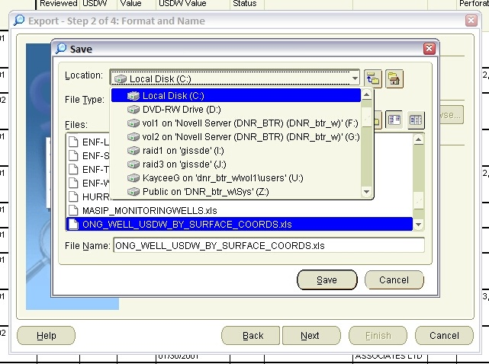
Click on the Location dropdown menu and
select the appropriate drive

Slide 49
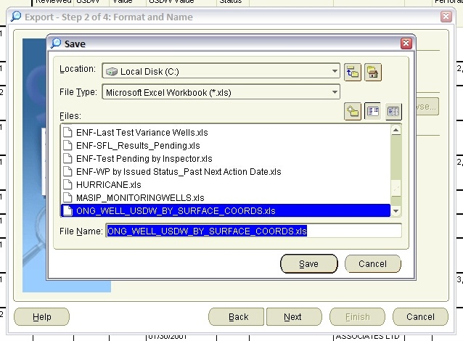
Enter a File Name that is easily identifiable,
and click on the Save button.

Slide 50
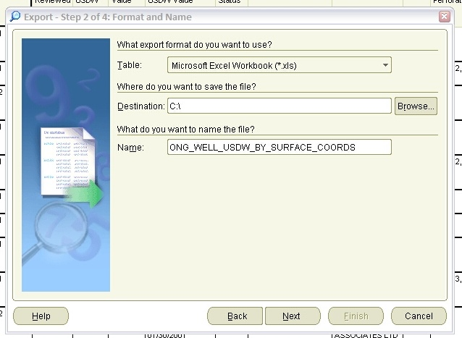
Click on the Next button.

Slide 51
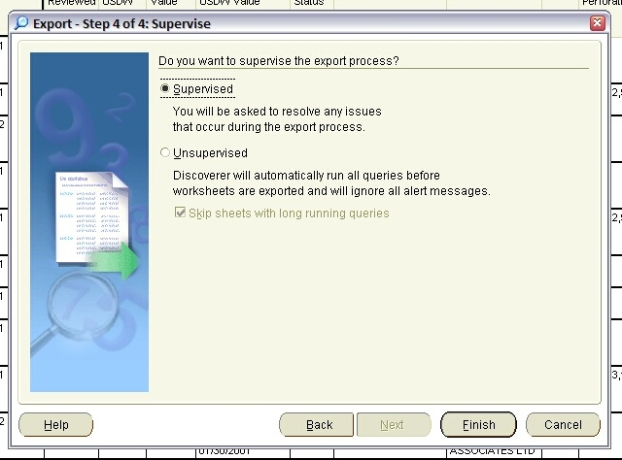
Click on the Finish button.

Slide 52
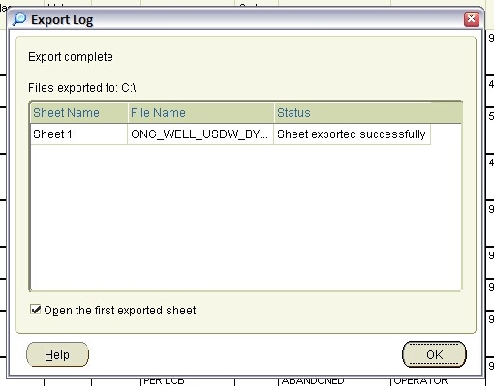
The Export is Complete. Select the OK button

Slide 53
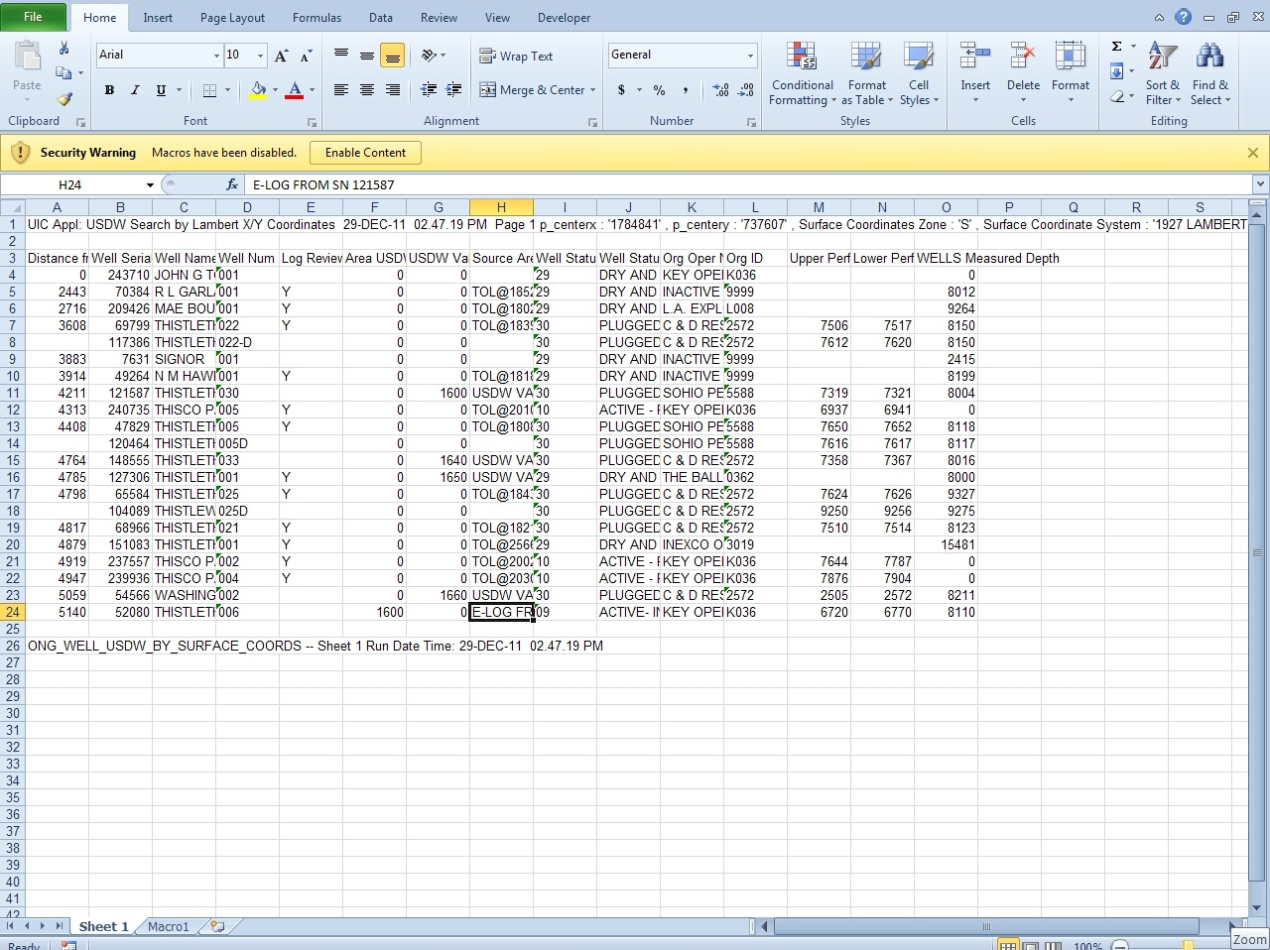

Slide 54
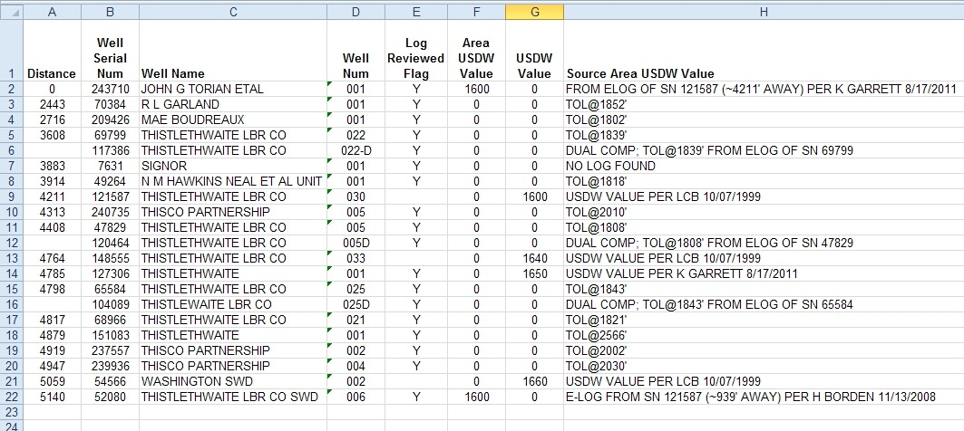
BOLD the Header Row & Apply Word Wrap
Center the values in the Columns
Expand the Column Width

Slide 55
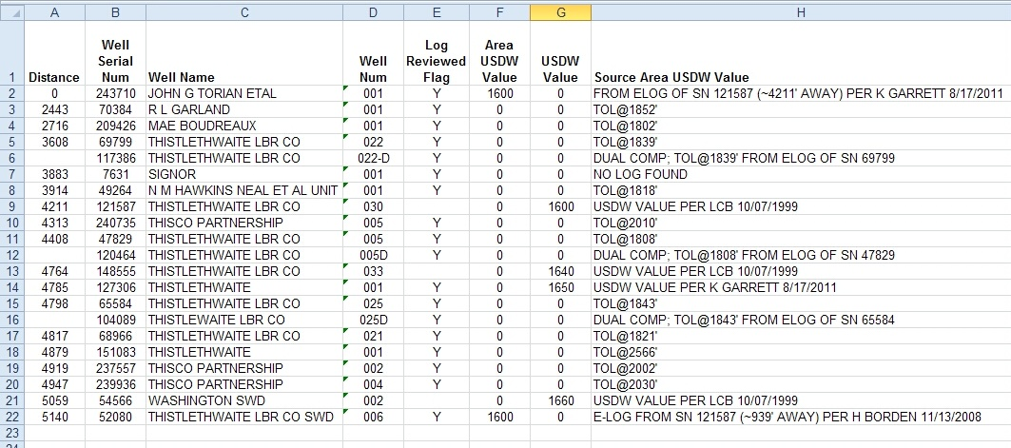
Distance from Lambert X/Y (Feet) Column
Provides the distance of the well from the X/Y coordinate values that were searched. The table is sorted by this Column from closest to farthest. If the search was conducted based on the coordinates of an existing well, then the well in the first row should be the well itself.

Slide 56
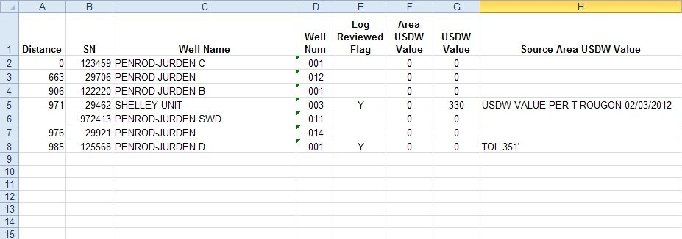
Locating the Most Accurate USDW Value
Although a USDW Value may be confirmed for a well in the AOR, you must search the electric logs of all wells closer to the proposed well to find the most accurate USDW Value.

Slide 57
Log Reviewed Flag Column
Indicates whether the log has been recently reviewed by an IMD Geologist.
  This field was recently added at the request of IMD Geologists so that we could keep track of wells whose electric logs we have reviewed.

Slide 58
Area USDW Value Column
If a value is present, it indicates that a USDW value was determined from an electric log of an offset well. The SN, and sometimes the distance to the well, are usually indicated in the Source Area USDW field.
“0” DOES NOT indicate that a USDW is not present at the wellbore or that a USDW is at the ground surface. It is a default value entered by SONRIS.

Slide 59
USDW Value Column
If a value is present, then it indicates that the value was determined from the electric log of the well itself.
“0” DOES NOT indicate that a USDW is not present at the wellbore or that a USDW is at the ground surface. It is a default value entered by SONRIS.

Slide 60
USDW VALUE PER LCB 10/07/1999
Source Area USDW Value Column
If an entry is present, then it may be in one of the following formats:
  USDW VALUE PER LCB XX/XX/XXXX
  Indicates the Geologist from IMD who identified the value in the USDW Value field and the date it was identified.

Slide 61
FROM ELOG OF SN 121587 (~939’ AWAY) PER H BORDEN 11/13/2008
Source Area USDW Value Column
If an entry is present, then it may be in one of the following formats:
  FROM ELOG OF SN: XXXXX (~XXX’ AWAY) PER H BORDEN XX/XX/XXXX
  Indicates the SN of offset well whose elog was used to determine the value indicated in the Area USDW Value field, the distance of the offset well, the Geologist from IMD who identified the value, and the date it was identified.

Slide 62
NO LOG FOUND
Source Area USDW Value Column
If an entry is present, then it may be in one of the following formats:
  NO LOG FOUND
  Means a search was conducted for a log with that Serial Number, but none was found.

Slide 63
TOL@1802’
Source Area USDW Value Column
If an entry is present, then it may be in one of the following formats:
  TOL @ XXX’
  Is entered when a USDW is not present on the log, and indicates the shallowest depth the log was recorded.

Slide 64
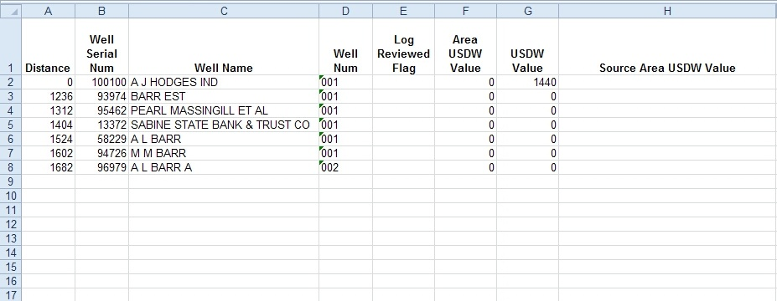
Source Area USDW Value Column
If the USDW Value field contains a value and the Source Area USDW Value field is blank, then it indicates that the USDW Value was determined from an electric log of the well, but it has not been recently confirmed by current standards. The e-log of the well will need to be reviewed.
  If the USDW Value or Area USDW Value fields are blank or contain “0” and the Source Area USDW Value field is blank, then it indicates that a search has not been conducted to identify a USDW for the well.

Slide 65
Electric Log Search

Slide 66
Go to www.dnr.louisiana.gov & click on the SONRIS logo

Slide 67
Select Document Access from Left Menu

Slide 68
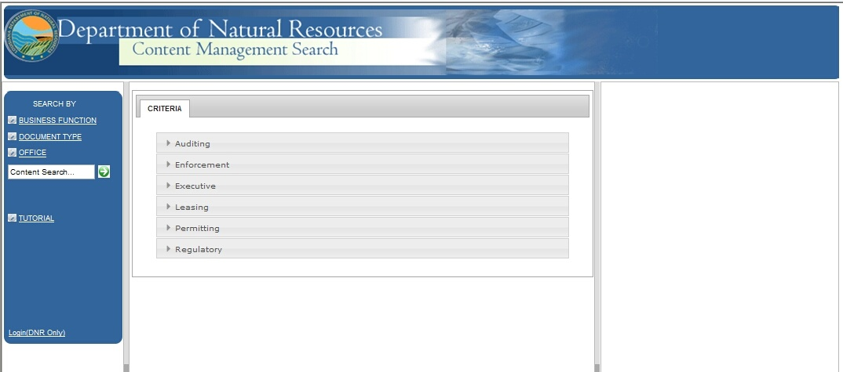
Select Document Type from Left Menu

Slide 69
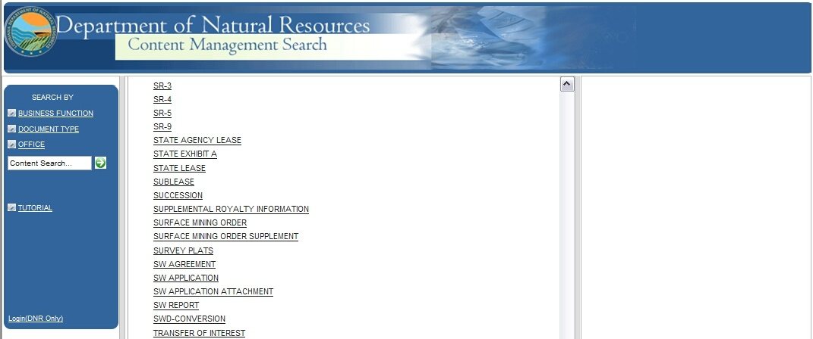
Scroll down and select Well Log

Slide 70
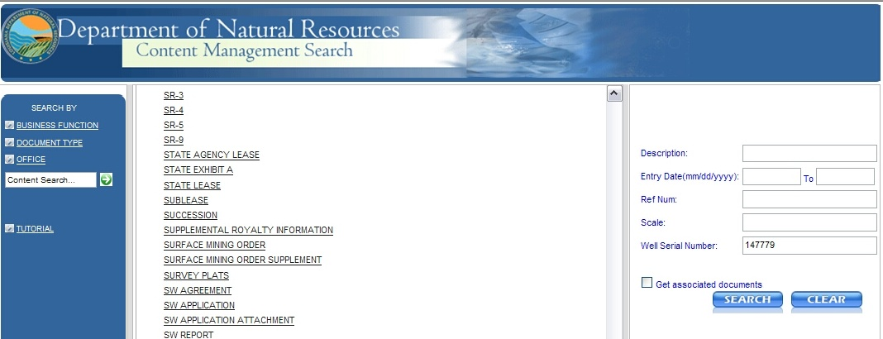
Enter the Well Serial Number in the field to the right and select the Search button
100100

Slide 71
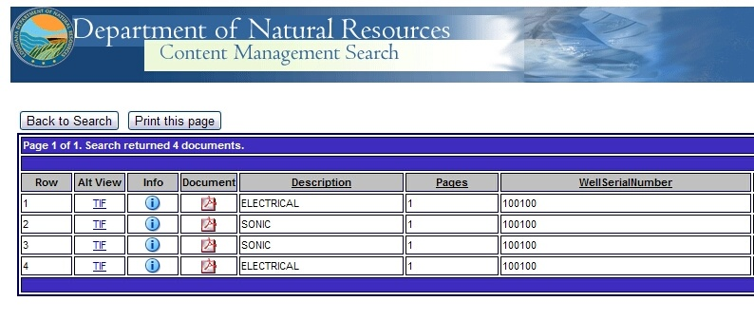
If an electric log is available, a table will show the well log information. Click on the TIF image and Save to your computer

Slide 72
Viewing and Printing Electric Logs

Slide 73
Download a Log Viewing Software
Example provided is
Blueview by Schlumberger

Slide 74
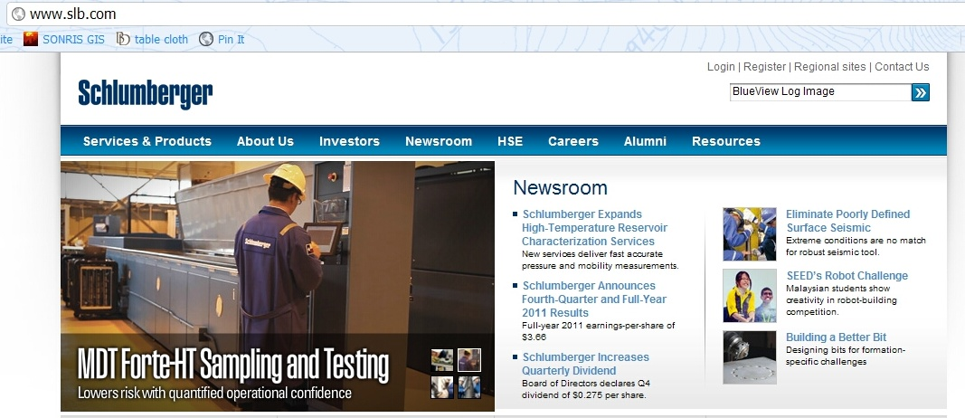
Go to www.slb.com and enter BlueView Log Image in the search field at the top of the page

Slide 75
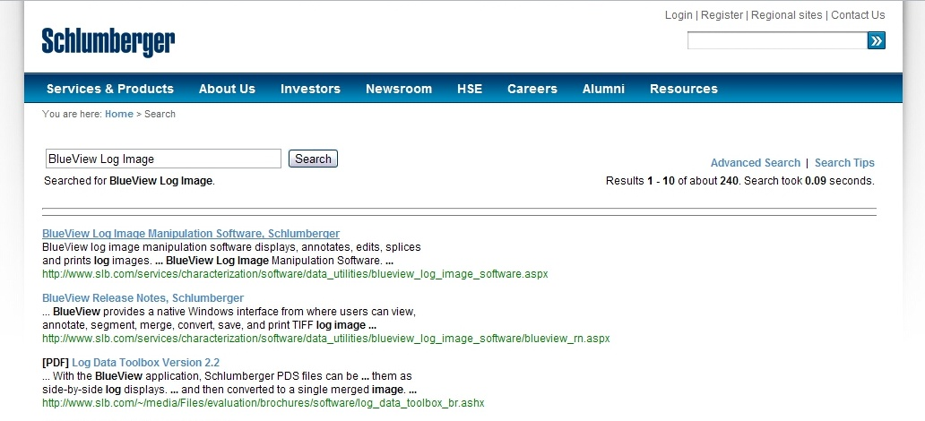
Select the first result
BlueView Log Image Manipulation Software, Schlumberger

Slide 76
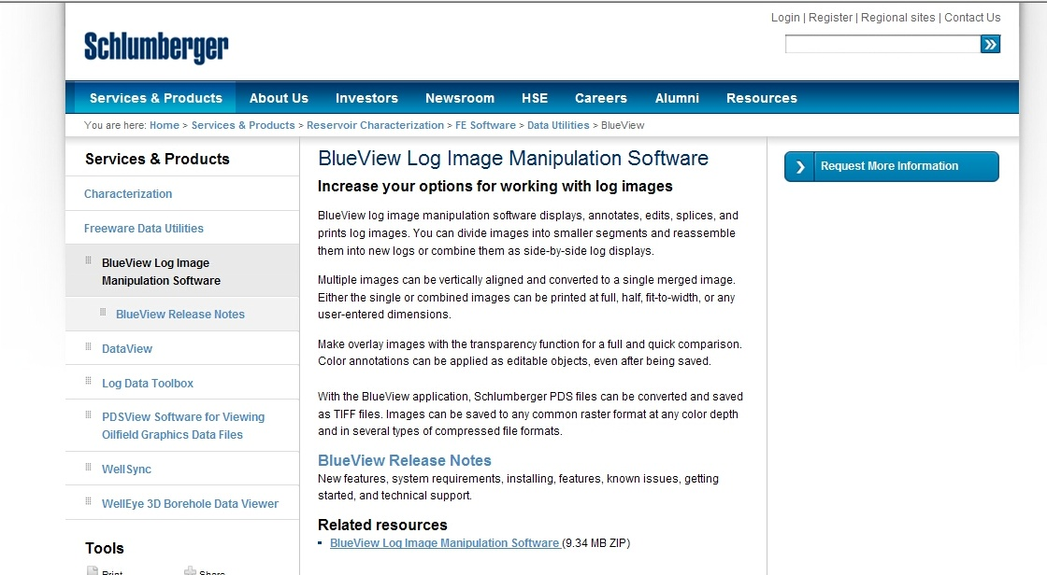
Click on the BlueView Log Image Manipulation Software link under the Related Resources heading

Slide 77
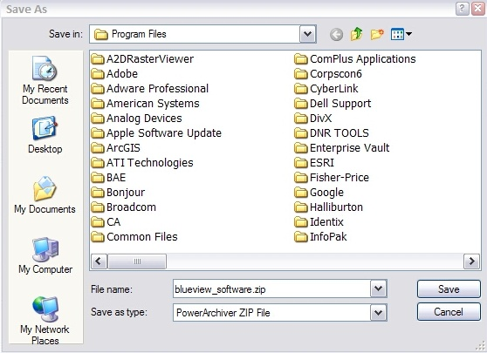
Save the blueview_software.zip file to your computer

Slide 78

Double click on the executable file and follow the download instructions to install BlueView to your computer

Slide 79
Viewing a Log

Slide 80

Once downloaded, locate the Blueview icon on your desktop and double-click to open.

Slide 81

Select File from the top menu, and choose
Open Image File(s) from the drop down menu.

Slide 82

Locate the Elog saved to your computer and
Open it in Blueview

Slide 83

Make sure the FIT button is selected in the menu bar.
Scroll down to view the entire log.

Slide 84
Printing a Log

Slide 85

To print the log, select File from menu bar, and choose Print Preview from the drop-down menu.
Print Ctrl+P

Slide 86

Previewing large images takes a lot of memory.
The program will ask if you want to view the
ENTIRE IMAGE (Yes), or ONLY 3 PAGES (No). Select No.

Slide 87

Preview the log. If the elog width does not fit on the page, adjust the size of the image by selecting the Scale by Percentage button from the menu bar.

Slide 88

Enter a new Percentage in the Scale By (%) field, and select the Print Preview button from the menu bar.

Slide 89

Preview Only 3 Pages by selecting the No button.

Slide 90

When you are ready to Print, select File from the menu bar, and choose Print from the drop-down menu

Slide 91

Select the name of the Printer, select the Preferences button to adjust the printer settings, under the Page Range section choose All, and when ready click the Print button.

Slide 92


Select the Close button to return to the main screen.

Slide 93
IMD Contact List
Teresa Rougon, Geologist Supervisor
(225) 342-5581 teresa.rougon@la.gov
Luzma Mata de Leder, Geologist
(225) 342-8639 maria.leder@la.gov
Kathy McGillis, Geologist
(225) 342-9054 kathy.mcgillis@la.gov

Slide 94
DUAL COMP; TOL@1839’ FROM ELOG OF SN 69799
The field is blank because is it the same distance away as the well above it.
Source Area USDW Value Column
If an entry is present, then it may be in one of the following formats:
  DUAL COMP; TOL@1839’ FROM ELOG OF SN XXXXX
  Is entered when the well is a dual completion and the electric log of the well is filed under the Serial Number of the original completion, followed by the Source Area USDW information for the original well.

Slide 95
USDW Search Results
USDW Value defined in SONRIS within 1-mile Radius
Distance from Lambert X/Y (Feet) Column
Provides the distance of the well from the X/Y coordinate values that were searched. The table is sorted by this Column from closest to farthest. If the search was conducted based on the coordinates of an existing well, then the well in the first row should be the well itself.
Log Reviewed Flag Column
Indicates whether the log has been recently reviewed by an IMD Geologist.
Area USDW Value Column
If a value is present, it indicates that a USDW value was determined from an electric log of an offset well. The SN, and sometimes the distance to the well, are usually indicated in the Source Area USDW field.
USDW Value Column
If a value is present, then it indicates that the value was determined from the electric log of the well itself.

Slide 96
USDW Search Results
USDW Value defined in SONRIS within 1-mile Radius
Source Area USDW Value Column
If an entry is present, then it may be in one of the following formats:
  USDW VALUE PER LCB XX/XX/XXXX, Indicates the Geologist from IMD who identified the value in the USDW Value field and the date it was identified.
  FROM ELOG OF SN: XXXXX (~XXX’ AWAY) PER LCB XX/XX/XXXX, Indicates the SN of offset well whose elog was used to determine the value indicated in the Area USDW Value field, the distance of the offset well, the Geologist from IMD who identified the value, and the date it was identifiedThe SN is usually indicated in the Source Area USDW field.
  NO LOG FOUND, Means a search was conducted for a log with that Serial Number, but none was found.
  TOL @ XXX’, Is entered when a USDW is not present on the log, and indicates the shallowest depth the log was recorded.

