Slide 1
LOGGING REQUIREMENTS
Louisiana Department of Natural Resources
Office of Conservation
Injection and Mining Division

Slide 2
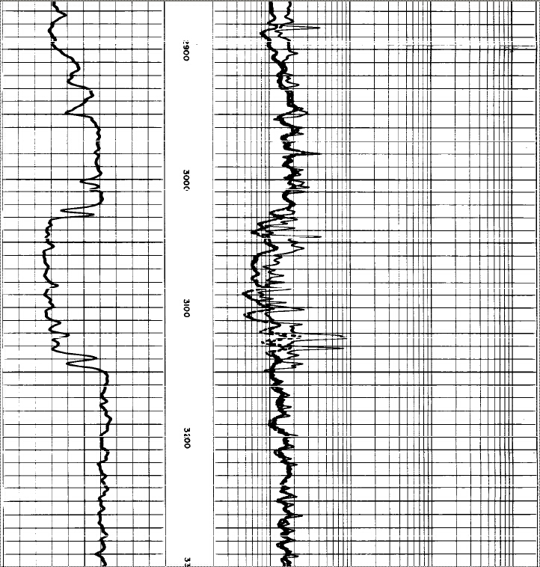
ELECTRIC LOG
What is it?

Slide 3
Electric logs – or open-hole logs as they are
also called – are used to help identify the base of the
Underground Source of Drinking Water (USDW), other
formations of interest and also to locate sand and
shale intervals in order to define an injection or
disposal zone. Some examples are:
Gamma Ray (GR)
Spontaneous Potential (SP)
Resistivity
Density
Neutron Porosity
Caliper, etc.

Slide 4

ELECTRIC LOG
When is it required?

Slide 5
If electric logs of a nearby (within ¼-mile) well
were not run through the lowermost USDW, a
new well must be logged from surface to total
depth (TD) before setting casing.
If an electric log exists from a nearby well that
shows the USDW, the new well only has to be
logged electrically below the surface casing
before the long string is set in order to assist in
determining the injection or disposal zone.

Slide 6
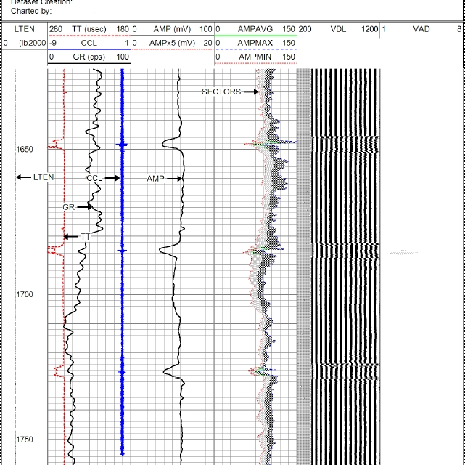
CEMENT BOND LOG (CBL)
What is it?

Slide 7
A cement bond log (CBL) is a type of log that
measures the loss of acoustic energy as it
passes through casing.

Slide 8
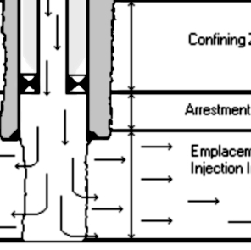
CEMENT BOND LOG (CBL)
What is it used for?

Slide 9
Cement bond logs are used to detect the
presence or absence of external cement
behind casing.

Slide 10
CEMENT BOND LOG (CBL)
When is it required?

Slide 11
Cement bond logs are required to be run on
all new-drills, conversions and zone changes.
Please note that Injection and Mining cannot
accept the portion of a CBL which has been run
“pipe-inside-pipe”.

Slide 12
CEMENT BOND LOG (CBL)
What are we
looking for?

Slide 13
Minimum interval of continuous 60% bonded
cement in a continuous confining shale.
Rule-of-Thumb: < 10mV on amplitude curve
for x-amount of feet.
For heavier casings, can sometimes accept
< 12mV or < 13mV but this is fairly RARE.

Slide 14
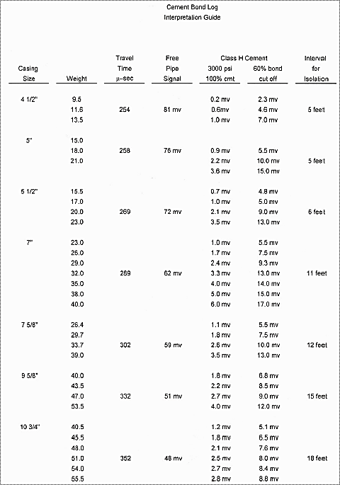
CBL Interpretation Guide:

Slide 15

OTHER LOG TYPES

Slide 16
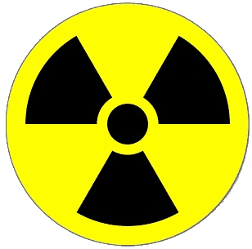
Radioactive Tracer Survey (RTS) – used to detect
RA “tagged” fluid movement through channels
behind casing while on injection.
Also used for locating other RA “tagged” material
such as proppant, frac fluid, gravel pack, cement
squeeze, etc.

Slide 17
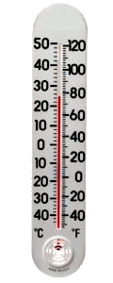
Temperature Log – in Injection and Mining, we
sometimes use this log to detect top of cement
in larger heavier casings.
May also used to locate channels behind casing,
and to determine the height of stimulation due
to acidizing or fracking.

Slide 18

Oxygen Activation Log – used to detect the
movement of water and for locating channels.

Slide 19
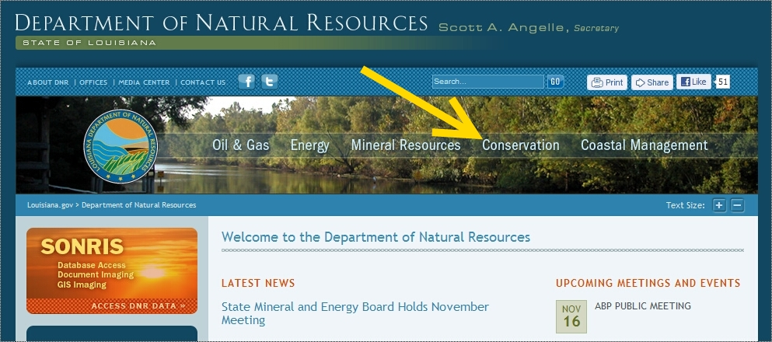
How to Access DNR Logging Guidelines

Slide 20
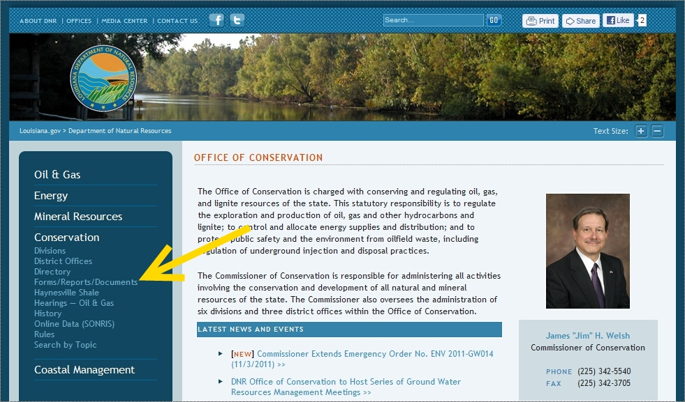

Slide 21
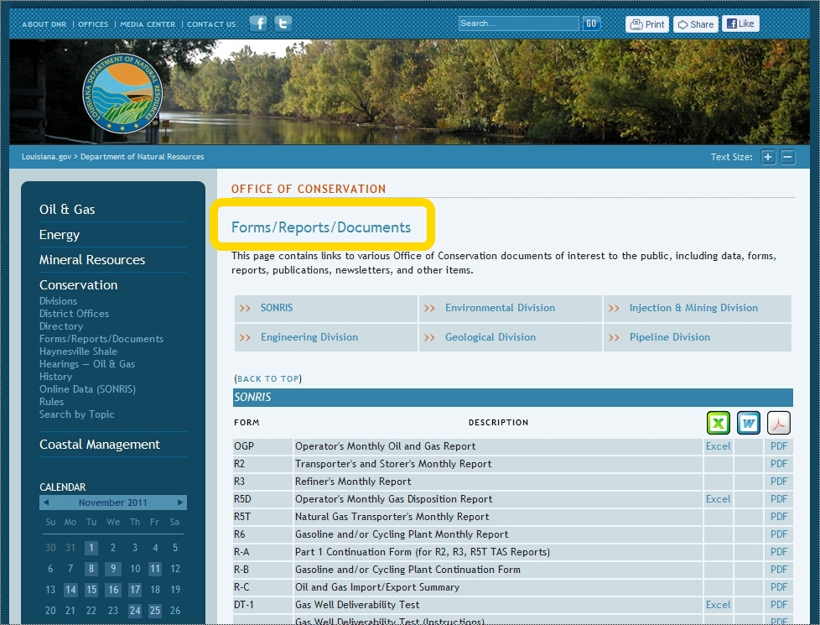

Slide 22
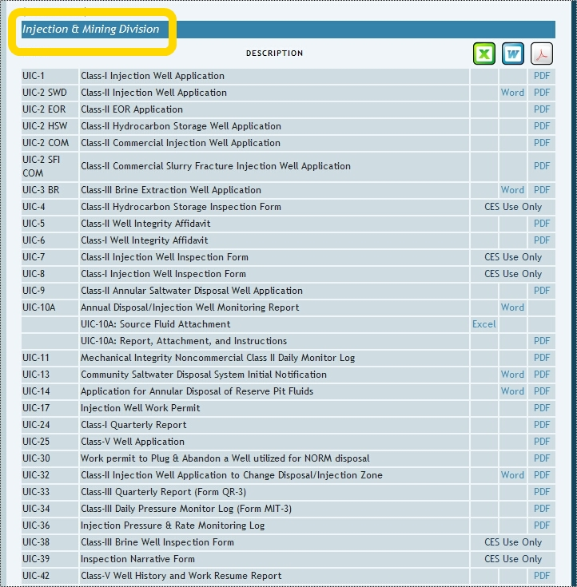

Slide 23
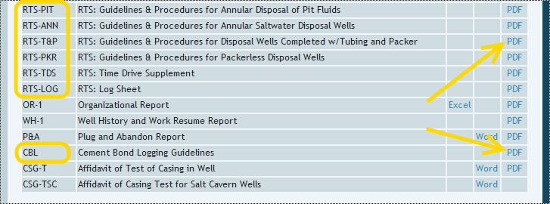

Slide 24
Ready for an example?

Slide 25
***For each of the following examples, for ease, ASSUME
that all open-hole logs and CBLs correlate perfectly!***
First, you will see the proposed information such as USDW, zone and perforations;
Next, you will see the CBL Interpretation Guide;
Then, the open-hole log showing the zone;
Finally, the CBL Free-Pipe Section and the CBL showing the TOZ and BOZ.

Slide 26
Essential info to keep in mind:
USDW: 300ft
Surface Casing: 16” (84 #/ft) @ 500 ft
Long String: 10-3/4” (40.5 #/ft) @ 2000 ft
Proposed Zone: 1276 – 1326 ft
How many feet of isolating cement do we need for:
TOZ: ?
BOZ: ?
Where would you call the bottom of the required
cement interval?
Where is the shallowest allowed packer depth?

Slide 27
Recall this CBL Interpretation Guide:

Slide 28
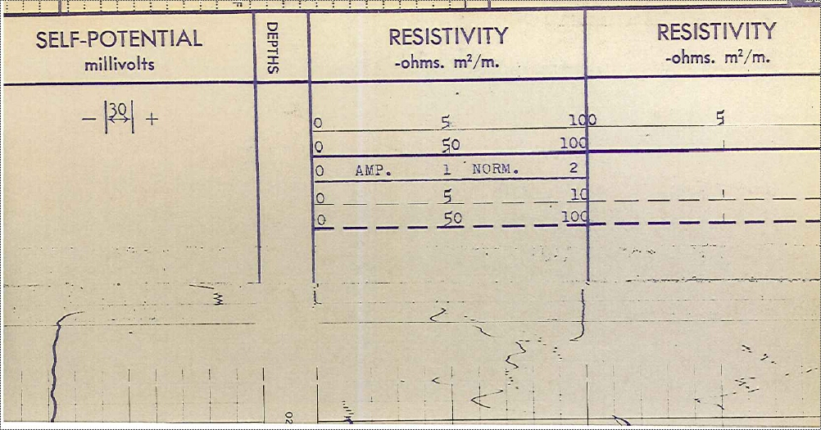
Open-Hole Log scale:

Slide 29
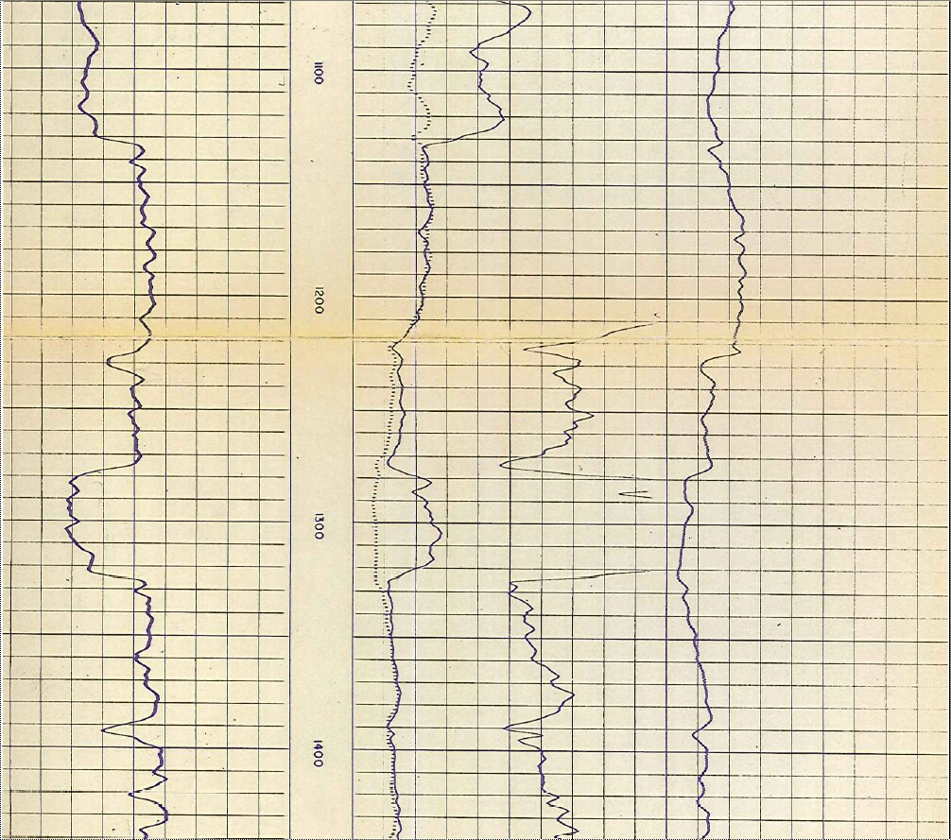
TOZ @ 1275 ft
BOZ @ 1326 ft

Slide 30
Recall this CBL Interpretation Guide:

Slide 31
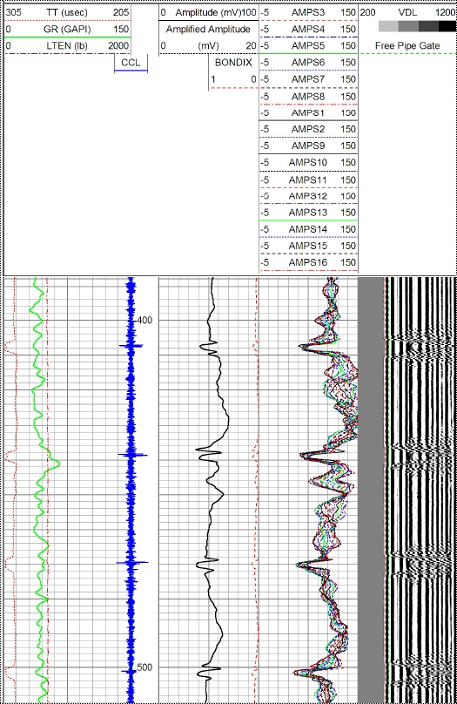
FREE PIPE SECTION –
verifies tool is calibrated:
48mV is considered “free pipe”
(meaning no cement behind the
pipe) for a 10-3/4” casing.

Slide 32
Recall this CBL Interpretation Guide:

Slide 33
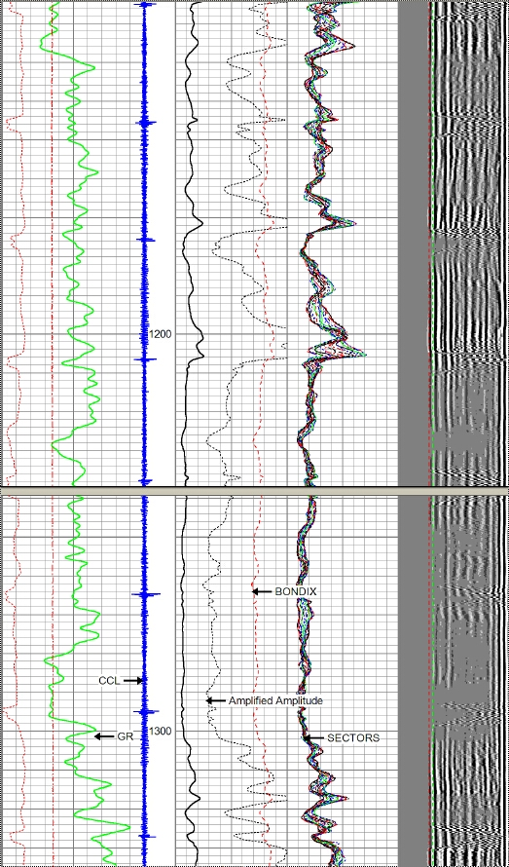
Top of Zone (TOZ)
is at 1275 feet:
Continuous confining
shale runs from
1134 – 1275 feet.
Start at top of shale and
work your way down until
you find the minimum
required (18’) continuous
cement interval.
Minimum interval
of continuous
60% bonded
cement runs from
1212 – 1230 ft.
TOZ @ 1275 ft

Slide 34
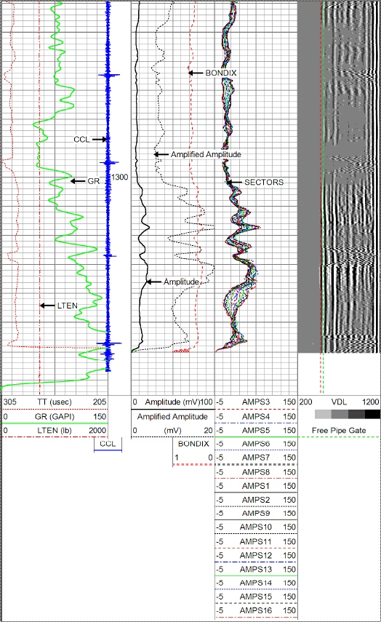
Bottom of Zone
(BOZ) is at
1326 feet:
BOZ @ 1326 ft
There are “indications of cement” at the BOZ – i.e. not “free pipe”.

Slide 35
Your turn to try one!

Slide 36
Essential info to keep in mind:
USDW: 480ft
Surface Casing: 8-5/8” (24 #/ft) @ 815 ft
Long String: 4-1/2” (11.6 #/ft) @ 5045 ft
Proposed Zone: 3020 – 3150 ft
How many feet of isolating cement do we need for:
TOZ: ?
BOZ: ?
Where would you call the bottom of the required
cement interval?
Where is the shallowest allowed packer depth?

Slide 37
Recall this CBL Interpretation Guide:

Slide 38
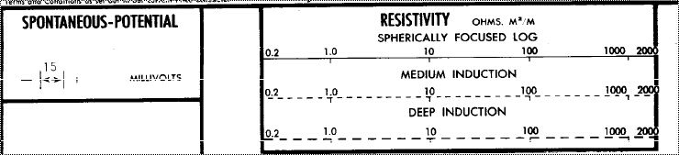
Open-Hole Log scale (practice problem #2):

Slide 39
TOZ @ 3020 ft
BOZ @ 3150 ft

Slide 40
Recall this CBL Interpretation Guide:

Slide 41
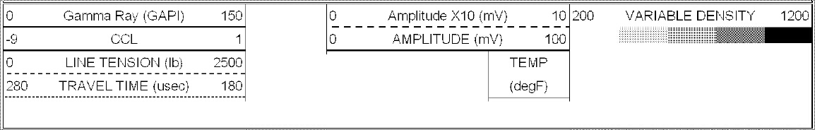
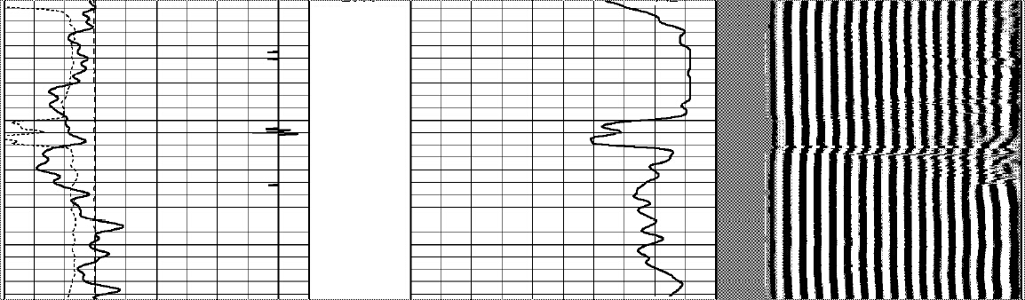
FREE PIPE SECTION – verifies tool is calibrated:
81mV is considered “free pipe” (meaning no cement behind the pipe) for a 4-1/2” casing.

Slide 42
Recall this CBL Interpretation Guide:

Slide 43
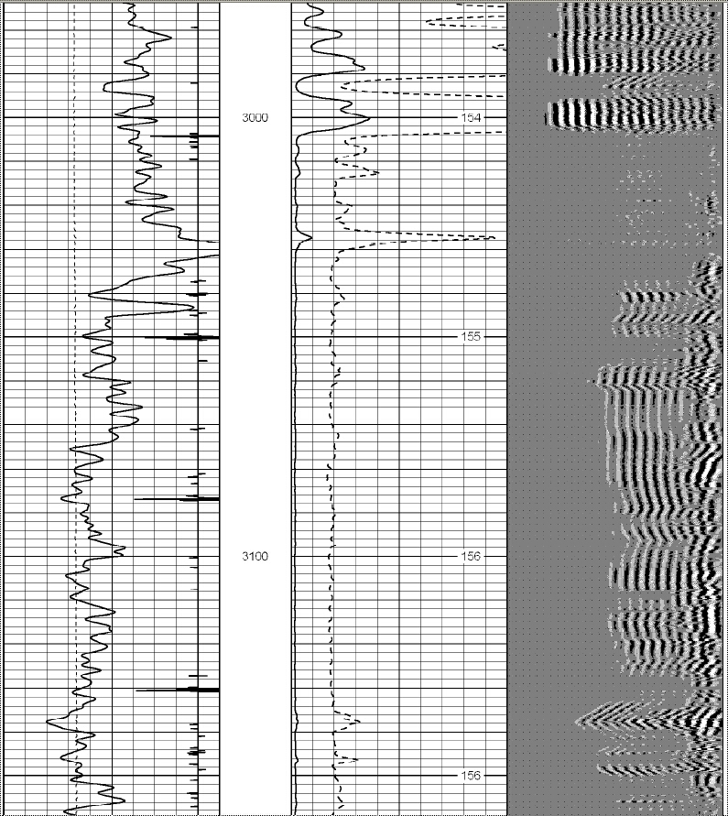
Top of Zone (TOZ)
is at 3020 feet:
Continuous confining
shale runs from
2960 – 3020 feet.
Start at top of shale and
work your way down until
you find the minimum
required (5’) continuous
cement interval.
Minimum interval
of continuous
60% bonded
cement runs from
3004 – 3009 ft.
TOZ @ 3020 ft

Slide 44
Bottom of Zone
(BOZ) is at
3150 feet:
There are plenty of
“indications of cement”
at the BOZ – i.e. not
“free pipe”.
BOZ @ 3150 ft

Slide 45
Let’s try another one!

Slide 46
Essential info to keep in mind:
USDW: 500 ft
Surface Casing: 9-5/8” (36 #/ft) @ 975 ft
Long String: 7-5/8” (26.4 #/ft) @ 3500 ft
Proposed Zone: 2780 - 2960 ft
How many feet of isolating cement do we need for:
TOZ: ?
BOZ: ?
Where would you call the bottom of the required
cement interval?
Where is the shallowest allowed packer depth?

Slide 47
Recall this CBL Interpretation Guide:

Slide 48
Open-Hole Log scale (practice problem #3):

Slide 49
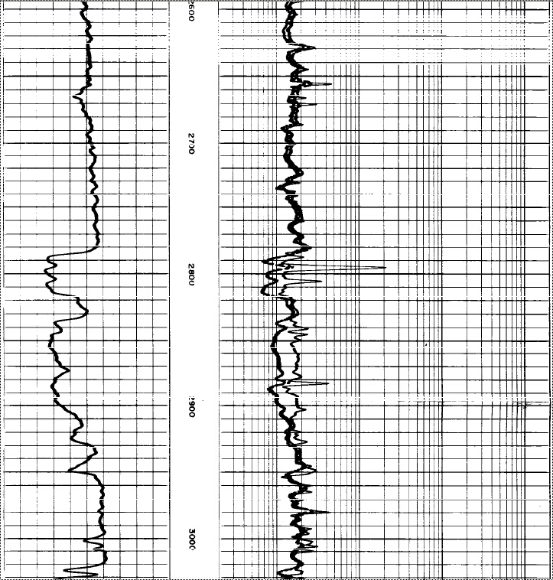
TOZ @ 2780 ft
BOZ @ 2960 ft

Slide 50
Recall this CBL Interpretation Guide:

Slide 51
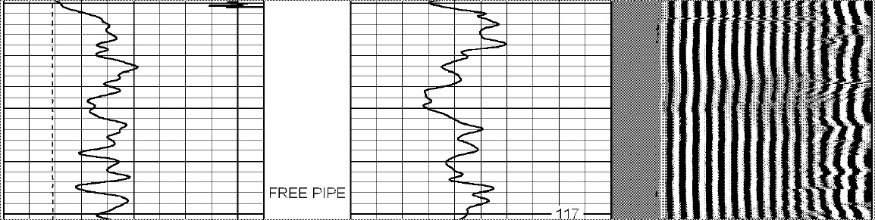
FREE PIPE SECTION – verifies tool is calibrated:
59mV is considered “free pipe” (meaning no cement behind the pipe) for a 7-5/8” casing.

Slide 52
Recall this CBL Interpretation Guide:

Slide 53
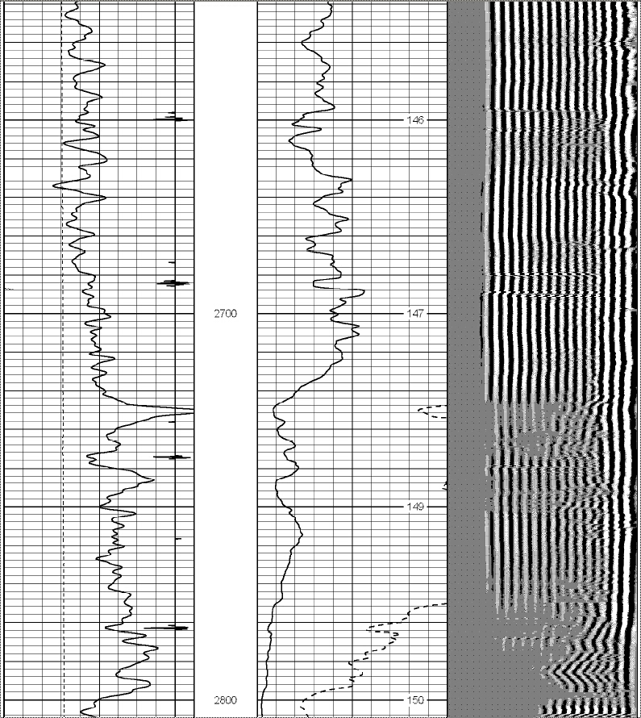
Top of Zone (TOZ)
is at 2780 feet:
Continuous confining
shale runs from
2585 – 2780 feet.
Start at top of shale and
work your way down until
you find the minimum
required (12’) continuous
cement interval.
Minimum interval
of continuous
60% bonded
cement does not exist.
Must perf/squeeze/CBL.
TOZ @ 2780 ft

Slide 54
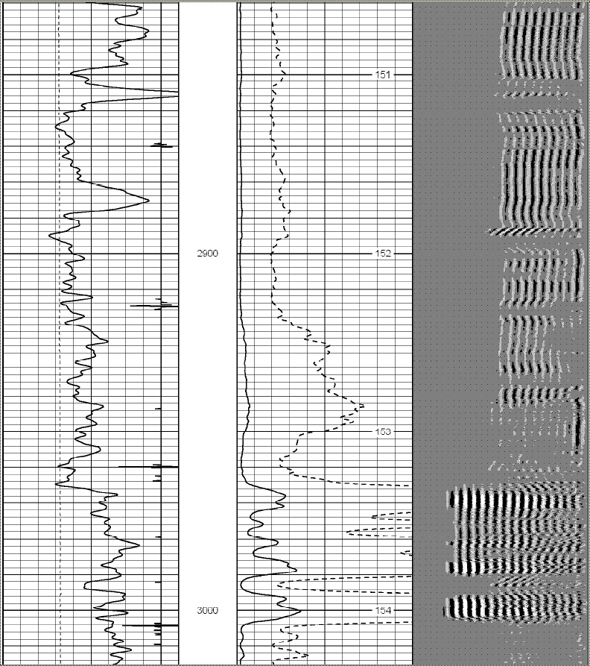
Bottom of Zone
(BOZ) is at
2960 feet:
BOZ @ 2960 ft
There are plenty of
“indications of cement”
at the BOZ – i.e. not
“free pipe”.

Slide 55
Questions?

