Slide 1
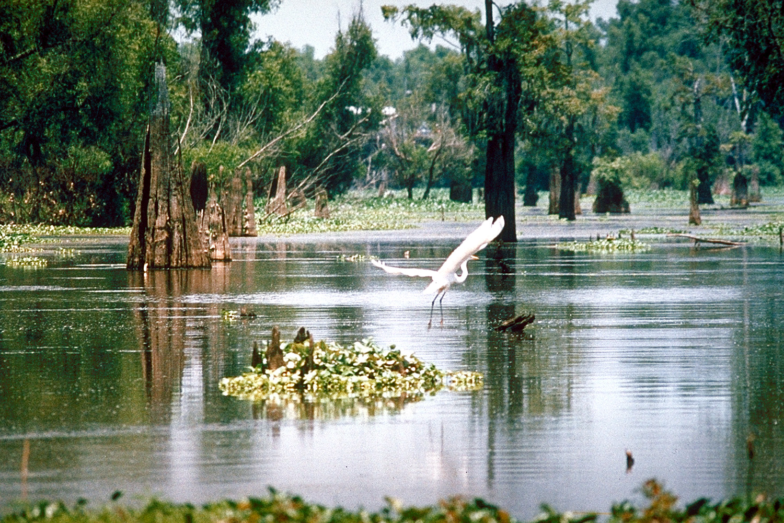
Office of Coastal Management
Coastal Use
Permitting

Slide 2
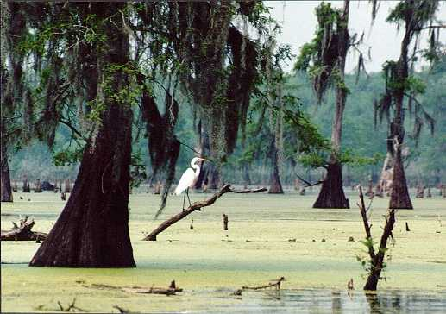
Authorizing Legislation
CZMA - Coastal Zone Management Act (P.L. 92-583, 1972) Amended in 1976 (P.L. 94-370)
  Federal legislation creating the US Coastal Zone Management program. Provides guidelines that States can use to promulgate regulations
SLCRMA - State and Local Coastal Resources Management Act (R.S. 49:214:21 et seq Act 1978, No. 361)
  State legislation creating the Louisiana Coastal Resources Program (LCRP). Established policy, defined the coastal zone and created regulatory process.
LAC Title 43 - rules

Slide 3
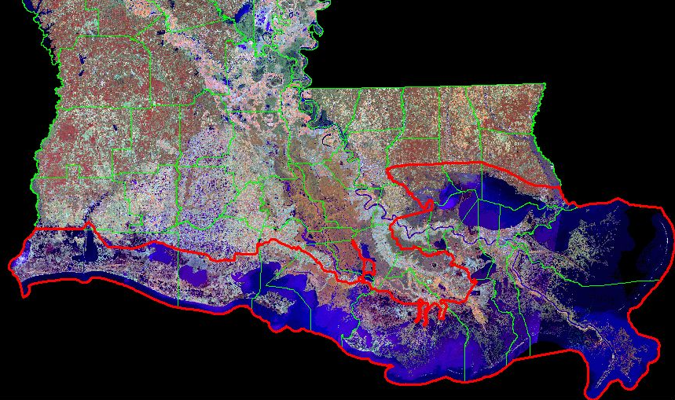
The Louisiana Coastal Zone

Slide 4
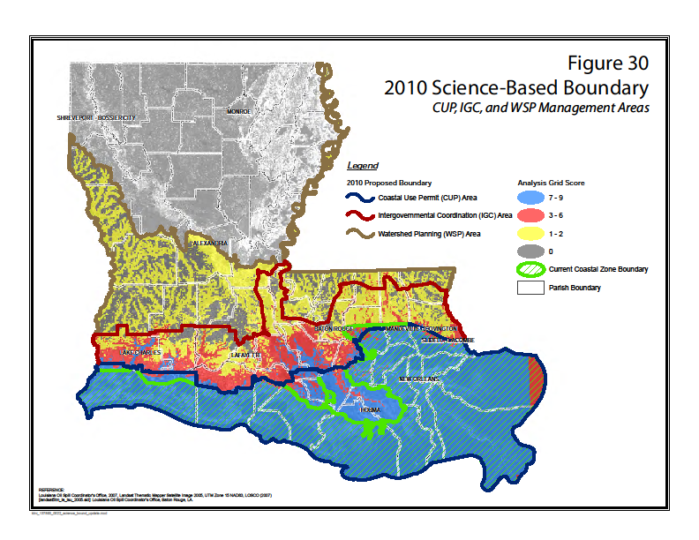
The Louisiana Coastal Zone

Slide 5
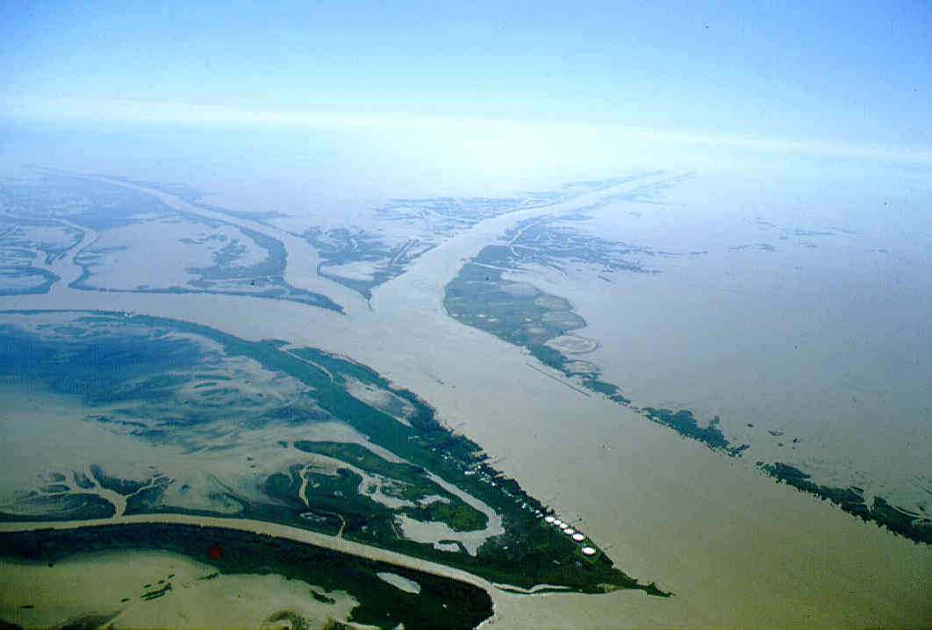
Principal Regulatory Agencies
U.S. Army Corps of Engineers
- Five Districts Statewide
- Filling of waters of the US (Section 404 of the Clean Water Act)
- Impacts to navigable waters (Section 10 of the Rivers and Harbors Act)
Department of Natural Resources, Office of Coastal Management
- Only in the State’s Coastal Zone
- Regulates impacts to coastal waters (LCRP)
Department of Environmental Quality
  Statewide Water Quality Certifications
  Regulates discharges into state waters (Section 404 of the Clean Water Act)

Slide 6
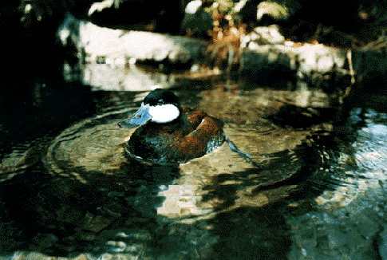
The JPN System
Provides a single point of contact (OCM) for work within the LA Coastal Zone
  All correspondence for applications within CZ go through OCM
Provides for a single public notice to cover OCM, COE and DEQ
  Applicant has one notice date
Saves time/money and improves efficient transfer of information
  OCM reviews application for completeness prior to distribution to partner agencies

Slide 7
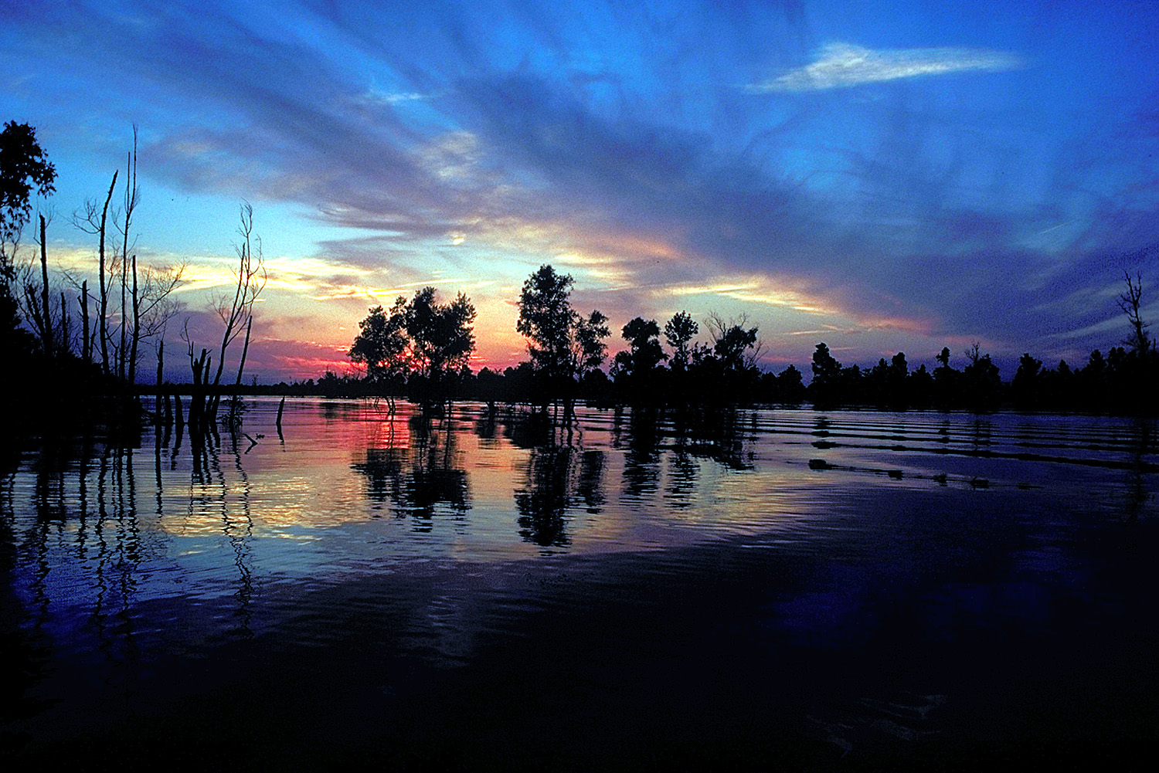
Interagency Coordination
Comments are solicited from the following agencies:
LDWF DEQ CRT
USACE DHH CPRA
NOAA Fisheries EPA
DOTD USFWS
Levee Boards Local Parishes
State Land Office
Pre-Application/GR Meetings
Encouraged

Slide 8
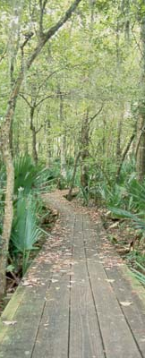
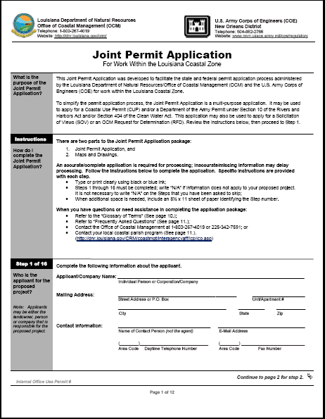
Joint Permit Application (JPA)

Slide 9
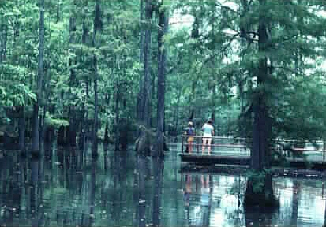
Plat Information
Vicinity Map
  Project location clearly marked on map with landmark features and scale large enough to identify location within the state
Plan View
  Existing and proposed structures/features
  Location and dimensions of all aspects of the proposed work (including structures, excavation and fill
  Mean high/low water levels
  Graphic scale
Cross Section
  Mean high/low water levels, water depth
  Depth of dredging/Height of fill
  Elevation of proposed structures/features

Slide 10
Online Permitting
Allows for online completion, submission and modification of JPA (pre- and post-issuance)
Allows for electronic distribution, online commenting and real-time notification of comments
Allows for online payment of fees
Allows for online tracking of applications with real time status updates

Slide 11
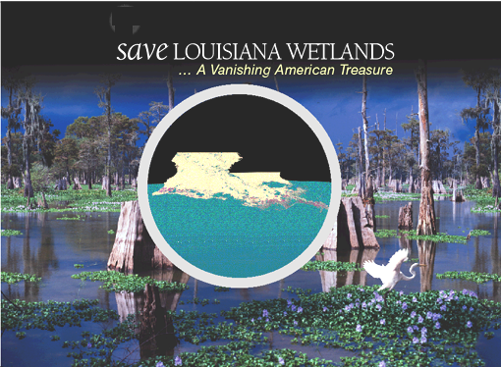
OCM’s Regulatory Role
Balance Development and Conservation
Balance Multiple Uses and Limited Coastal Resources

Slide 12
OCM Exemptions
Navigation Aids
Single Family Residence or Camp
Normal Maintenance and Repair
Agriculture, Forestry, Aquaculture
Hunting, Fishing, Trapping
In fastlands or on lands above 5’ MSL
Emergency Uses
All other uses require a Coastal Use Permit or determination from OCM

Slide 13
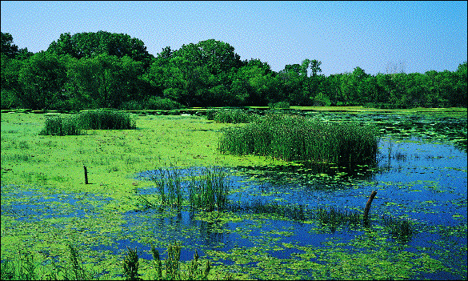
Permitted Activities
Oil and Gas Activities – well sites, pipelines, production facilities, gas storage facilities (~60% of all applications)
Commercial Activities – Walmart, mom and pop stores, boat docks, marinas, subdivisions
Municipal Activities – utilities, roads, drainage, levees
Industrial activities – refineries, steel mills, coal storage facilities, grain facilities

Slide 14
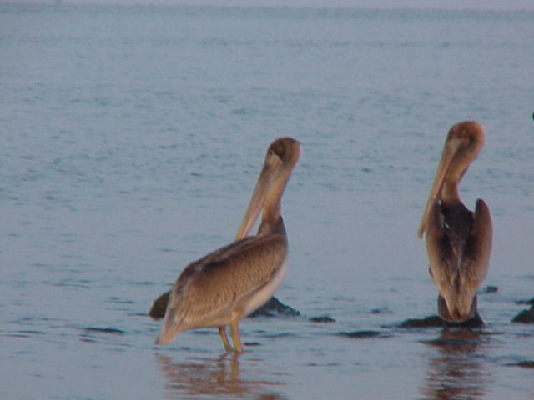
OCM Objectives
AVOID
Can adverse impacts to coastal resources be avoided by relocating or redesigning project?
MINIMIZE
Can adverse impacts to coastal resources be minimized by utilizing less damaging construction techniques?

Slide 15
Technical Review
Thorough review of a proposed coastal use and its impacts and benefits, which includes:
Impact assessment
  habitat type, extent of direct, indirect, secondary and cumulative impacts
Identification of sensitive features
  oyster leases, restoration projects and Master Plan features, endangered species, Scenic Rivers
Justification and Alternatives Analyses
Mitigation of unavoidable impacts

Slide 16
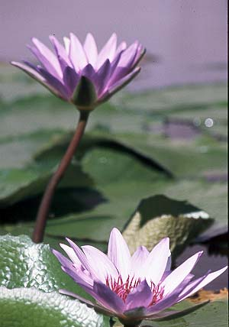
Coastal Use Guidelines
All uses must be in conformance with all applicable Guidelines in order to be considered for approval
§701.A-G Guidelines applicable to all uses
  General factors necessary to evaluate project (type, nature and location, feasible alternatives, economic need, coastal water dependency)
§701.H Maximum Extent Practicable “MEP” modifier criteria
§701.I Promote Concurrent Uses while eliminating conflicts
§703-§719 cover specific types of uses such as surface alterations, linear features, sediment transport mechanisms, mineral related activities

Slide 17
Alternatives and Justification
(NAJ)
Alternate locations and/or methods must be addressed by applicant to avoid and/or minimize adverse impacts to coastal resources
Justification demonstrating the need and/or public demand for the goods and/or services must be provided by applicant
Availability of less damaging alternatives and/or inadequate justification can result in denial of permit
If least damaging feasible site is used and applicant has provided sufficient documentation to demonstrate a need or demand, permit can be issues as long as the applicant provides adequate mitigation
A willingness by the applicant to mitigate does not relieve OCM of the responsibility of addressing alternatives and justification

Slide 18
Mitigation
Compensatory mitigation is legislatively required replacement, substitution, enhancement or protection of ecological values to offset anticipated losses of ecological values caused by a permitted activity
Is based on the “habitat value” to be lost NOT on the acreage of the project impacts
Can be accomplished by individual mitigation projects, purchasing credits from an approved mitigation bank, contribution to the Coastal Restoration Trust Fund
Landowner has first right to require mitigation be performed on their property, however timely request must be made or rights are waived.
Cause of most permitting delays due to coordination requirements and lack of available options

Slide 19
OCM Initiatives
Public Notice Procedures
  Email distribution of notices to mailout list
  Rework of notice format sent to paper for publication
  Resulted in reduced cost and more efficient transfer of information
Beneficial Use of Dredged Material
  4 options, no ranked order, must select one option
  Went from 22% to 100%
  Constructed projects will require OCM monitoring for success

Slide 20
OCM Initiatives
NAJ Guides
  Categories of Uses (subdivisions, marinas, pipelines, municipal activities, ports, commercial/industrial sites)
  Tiered approach – less impact, less information needed
Permit Conditions and Compliance
  Conditions added in order to bring project in compliance with LCRP. If conditions not met, the project is in non-compliance
Spill Prevention Compliance Statement
  Required for all exploration and production facilities (excluding pipelines)

Slide 21
OCM Contacts
Karl Morgan, OCMPMD Administrator
karl.morgan@la.gov
1-225-342-6470
Christine Charrier, OCM/PMD – Permits Program Manager
christine.charrier@la.gov
1-225-342-7953
Kelley Templet, OCM/PMD – Mitigation Program Manager
kelley.templet@la.gov
1-225-342-3124

Slide 23
