Slide 1
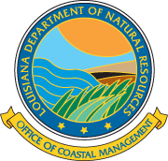
OCM’s Compensatory Mitigation Program
Kelley Templet
Mitigation Section
Office of Coastal Management
Department of Natural Resources

Slide 2
What is Mitigation?
Wetland impacts must be avoided to the maximum extent practicable and unavoidable impacts must be sufficiently justified and the justification must be approved by OCM prior to mitigation considerations.
Mitigation:
All actions taken to avoid, minimize, restore, and compensate for loss of ecological values due to an activity.
Compensatory Mitigation:
Compensatory mitigation is the replacement, substitution, enhancement or protection of ecological values to offset anticipated losses of ecological values caused by a permitted activity.
Notes:
Basically: Replace the habitat that is lost.

Slide 3
Why is mitigation required?
It’s the law. R.S.49:214.41 (Louisiana Coastal Resources Program Legislation)
Plan ahead!
If wetlands (or other coastal habitats) are to be impacted, mitigation will be required. Mitigation can be expensive.
Notes:
The Permittee asks: Why do you make us mitigate?

Slide 4
Needs, Alternatives and Justification (NAJ):
Justification and alternatives analyses are required for all projects adversely impacting vegetated wetlands and/or coastal waters and MUST be considered prior to any discussions regarding mitigation of adverse impacts. The applicant must consider options that will lead to avoidance and/or minimization of wetland impacts. Such options could include changes to:
Project Design
Project Location
Alternative Methods of Implementation
Notes:
Smaller Project Footprint
Re-location
Use Different Equipment

Slide 5
Components of the Mitigation Process
Once it has been established that permanent adverse impacts have been avoided, minimized, and/or justified (NAJ), the mitigation process begins.
Wetland Assessment (WVA):
Any permanent impacts to coastal ecosystems are assessed and quantified using the WVA for ecological value losses. The WVA is OCM’s habitat evaluation tool which quantifies impacts and benefits to wetlands. The WVA, which incorporates information from the field investigation, mapping/GIS analysis, and historical records, is used to quantify impacts and assess the amount of mitigation required. This method is intended to provide a timely, predictable, and transparent tool for all parties to evaluate the options available in order to make economic decisions regarding proposed projects.
The WVA method was originally developed for wetland restoration and planning projects in coastal Louisiana, and is a tool used to evaluate potential changes in ecosystem benefits.
Notes:
Habitat Evaluation Tool
WVA came from CWPPRA
MCM Discussion

Slide 6
Landowner Notification for >1 acre of impacts:
Under the existing Regulations, the applicant and affected landowner(s) are notified in writing, that mitigation for impacts to vegetated wetlands will be required. The landowner is given the first opportunity to have the mitigation performed on his/her property if a viable plan is proposed. In this letter OCM requires that the landowner provide , within thirty (30) days of the date of said letter, a statement, in writing, which includes one or more of the following:
Waiver of the option to request compensatory mitigation on your property;
Acceptance of the applicants compensatory mitigation proposal;
An explanation as to why the applicant’s mitigation proposal is not acceptable and suggest an alternate compensatory mitigation proposal which would be acceptable; or
Propose a “landowner-authored” mitigation plan in the event the applicant has failed to contact the landowner or provide a compensatory mitigation plan for review.

Slide 7
Mitigation Letters are Sent out to the Applicant and Affected Landowner(s) with the following Compensatory Mitigation Options:
After habitat impacts have been quantified, through the WVA process, the applicant and any impacted landowner(s) coordinate as to which compensatory mitigation is preferred. The following options are currently available :
An individual mitigation plan/project;
The ability to purchase mitigation bank credits; or
The ability to make a contribution to the Mitigation Trust Fund.
Notes:
On-site or Off-Site
Number of Banks (In-Kind and In-Basin)
In-Lieu Fee Program

Slide 8
Review of Individual Mitigation Plan/Project Option Includes:
Proposals should be within close proximity of impacts (hydrologic basin)
Sufficient acreage (determined through the WVA process)
In kind (same habitat as impacts)
Sustainable for the required maintenance period (20 years for marsh, 50 years for BLH)

Slide 9
Review of Mitigation Bank Option:
The purchasing of Mitigation Bank Credits will be reviewed and determined by the OCM and CEMVN.

Slide 10
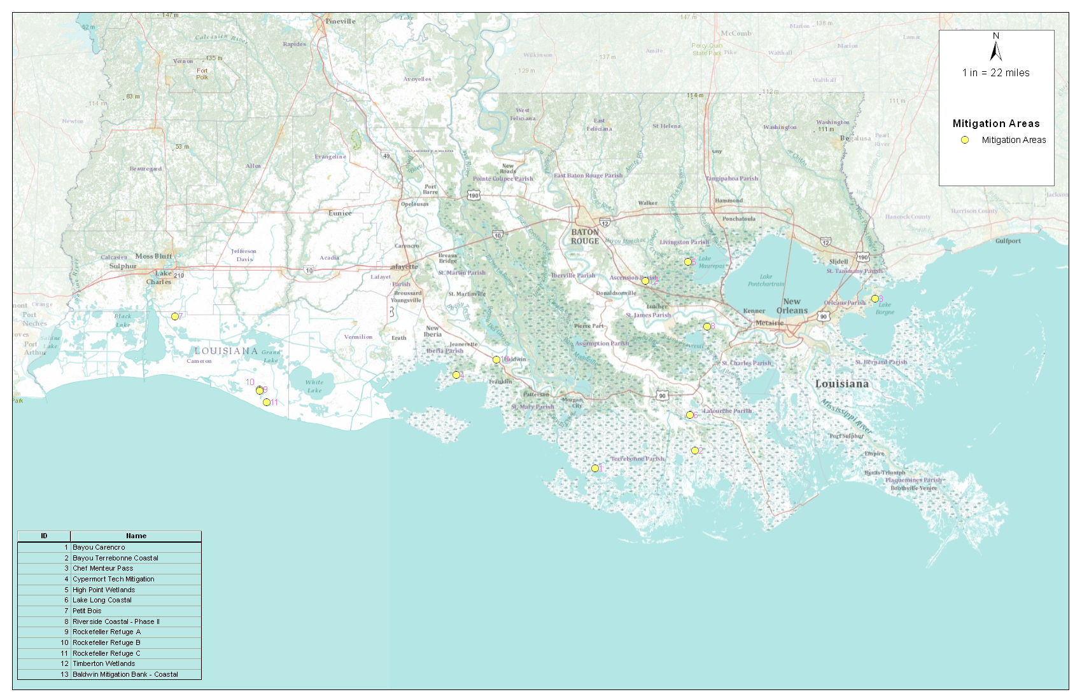
Mitigation Banks in the
Coastal Zone/Conservation Plan

Slide 11
Mitigation Banks in the Coast Zone / Conservation Plan
            Baldwin
            Bayou Carenco
            Bayou Terrebonne
            Chef Menteur
            Cypremort Teche
            High Point Wetlands
            Lake Long Coastal
            Petit Bois Wetlands
            Riverside Coastal
            Rockefeller Refuge (A,B,C)
            Timberton Wetlands
BLH 6
Cypress Swamp 7
Fresh Marsh 3
Intermediate Marsh: 1
Brackish Marsh: 2
Saltwater Marsh: 1

Slide 12
Mitigation Bank | Parish | Basin | BLH | Cypress | Fresh Marsh | Intermediate Marsh | Brackish Marsh | Saltwater Marsh
Baldwin Mitigation Bank-Coastal | St. Mary | Terrebonne | X | N/A | N/A | N/A | N/A | N/A
Bayou Carencro Bankline Mitigation Project (P19960223) | Terrebonne | Terrebonne | N/A | N/A | N/A | X | N/A | N/A
Bayou Terrebonne Mitigation Bank | Terrebonne | Terrebonne | X | X | X | N/A | N/A | N/A
Chef Menteur Pass Mitigation Bank | Orleans | Pontchartrain | N/A | N/A | N/A | N/A | X | N/A
Cypremort Teche Mitigation Bank | St. Mary | Teche-Vermilion | X | X | X | N/A | N/A | N/A
High Point Wetlands Mitigation Area | Livingston | Pontchartrain | N/A | X | N/A | N/A | N/A | N/A
Lake Long Coastal Mitigation Bank | Lafourche | Terrebonne | X | X | X | N/A | N/A | N/A
Petit Bois Wetlands Mitgation Bank | Cameron | Mermentau | X | X | N/A | N/A | N/A | N/A
Riverside Coastal Mitigation Lands, L.L.C. | St. Charles | Barataria | N/A | X | N/A | N/A | N/A | N/A
Rockefeller Refuge Mitigation Bank | Cameron | Mermentau | N/A | N/A | N/A | N/A | X | X
Timberton Wetlands Mitigation Bank | Ascension | Pontchartrain | X | X | N/A | N/A | N/A | N/A
Notes:
Only One (1) Brackish/Salt Marsh Mitigation Bank
Only One (1) Fresh/Intermediate Marsh Mitigation Bank
There are No Marsh Mitigation Banks west of the Atchafalaya River
There are limited Swamp and Bottomland Hardwood Mitigation Banks in most coastal basins and lack of competition.

Slide 13
In-Lieu Fee Program Update
In-Lieu Fee (ILF) Instrument is in the final stages of review by the CEMVN.
OCM anticipates finalizing the Instrument in the next few months .
Once the Instrument has been approved by the CEMVN, OCM will implement the new ILF Program.
Once the ILF Program is implemented, OCM will utilize funds collected for required compensatory mitigation , for the construction of marsh creation projects . OCM will meet annually with the IRT to discuss potential project development and selection.

Slide 14
Status of Revisions to Mitigation Rules and
Regulations
OCM has completed an initial review of the existing rules and regulations for Mitigation (§724) and has begun a draft of revisions.
The revisions are presently going through the internal review process.
Once the internal review process is complete , the Notice of Intent should be published sometime in September, 2012, and the revisions will continue through the Administrative procedures process.
The Final Rule should be published sometime in December 2012.
The revised Mitigation Rules and Regulations should be implemented in January, 2013.

Slide 15
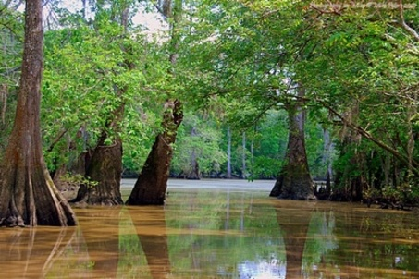
Questions?
Kelley Templet
Mitigation Program Manager
Email: kelley.templet@la.gov
Phone: 225-342-3124

