Slide 1


Status Report on the Re-evaluation of the Louisiana Coastal Zone Boundary
Dr. John Day
December 9, 2009

Slide 2
PROJECT OVERVIEW
Technical and Analytical Support Services to the Office of Coastal Management for Re-evaluation of the Inland Boundary of the Louisiana Coastal Zone.
Task 1 – Data Acquisition and Background Review
Task 2 – Development of Methodology, Data Compilation and Analysis
Stakeholder input
Task 3 – Data Interpretation and Report Preparation
Notes:
2

Slide 3
1975 Boundary Criteria
Regional Topographic Correlative Criteria
Geology = Pleistocene/Recent contact
Elevation = 5 and 25-ft contours
Soils = hydric/non-hydric boundary
Vegetation boundary = wetland/non-wetland
One hundred year flood and tidal inundation level
Point Location Correlative Criteria
Salinity = inland intrusion
Range or inland occurrence of brackish water clam, blue crab, fish (e.g., Striped mullet), birds (migrating waterfowl), mammals (e.g., Eastern mole), reptiles (e.g., Fence lizard)

Slide 4
2009 Boundary Criteria
Vegetation
Current elevation
Predicted subsidence/sea level rise
Inundation - storm surge
Watershed boundaries
Boundaries of existing coastal programs

Slide 5
Methodology
An updated inland Coastal Zone Boundary should encompass:
all areas subject to coastal processes; and
all uses which have the potential to impact coastal waters
The degree of management needed will vary by location and use
Therefore, a tiered approach is proposed, with each tier defined by science based parameters and criteria to determine regulatory and non-regulatory policies and management scenarios
Notes:
5

Slide 6
Proposed Tiered Approach
TIER 1: Regulation by means of the Coastal Use Permitting Procedure
TIER 2: Regulatory oversight by means of the Consistency Determination Procedure
TIER 3: Non-regulatory management through incentive programs and planning initiatives
Notes:
6

Slide 7
Tiering Criteria Based on Area and Use
Some of the factors that affect tiering criteria include
Potential effect on coastal waters
Nature of proposed land or water use
Federally excluded lands (e.g., fastlands, federally-owned lands)
Deepwater port, harbor, or terminal district
Current land use
Elevation (sea level rise, storm surge)

Slide 8
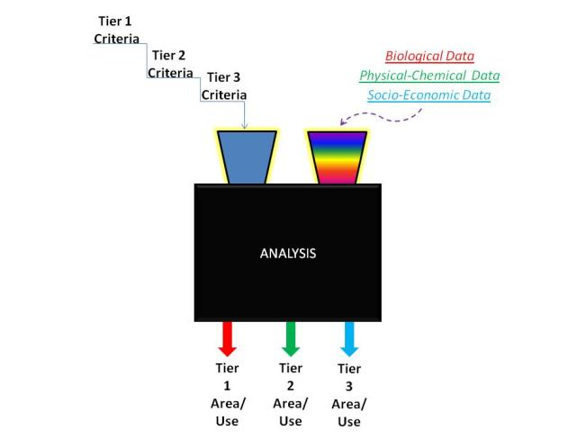
Scientific Methodology

Slide 9
CZB Decision Matrix
State of LA?
Watershed that touches the coast?
Area of other LA coastal programs?
Area of inundation per MOMS/ADCIRC?
Affected by sea level rise (<8 ft)?
Below the Pleistocene Terrace?
Intermediate, brackish, saline marsh?
Freshwater wetland in certain circumstances?
Contiguous to marsh in the current coastal zone
Adjacent to water body with tidal influence

Slide 10
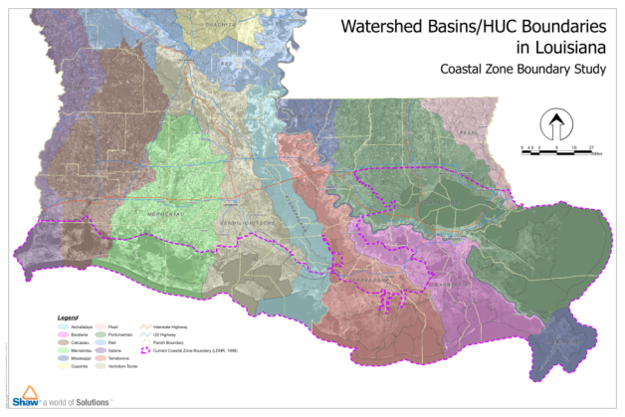
Watershed that Touches the Coast
Activities within these watersheds can have a direct impact on coastal waters

Slide 11
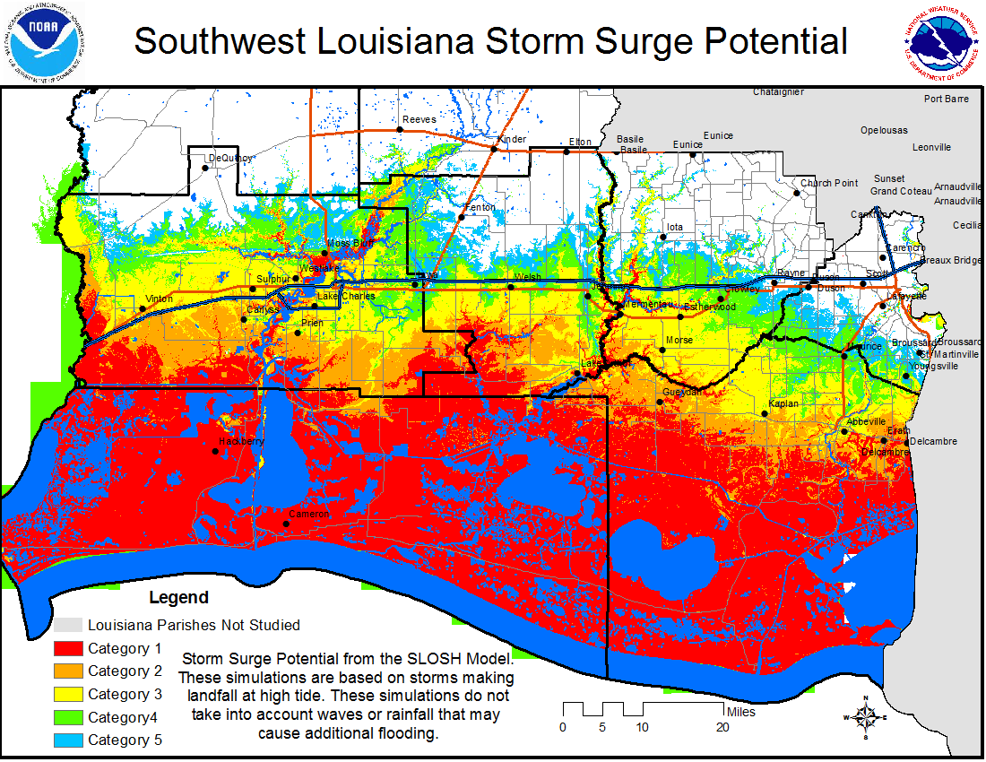
Area of Inundation per Hydrologic Modeling (e.g., MOMS, ADCIRC)
Worst case scenario of storm surge
Will encompass areas subject to coastal processes in extreme events

Slide 12
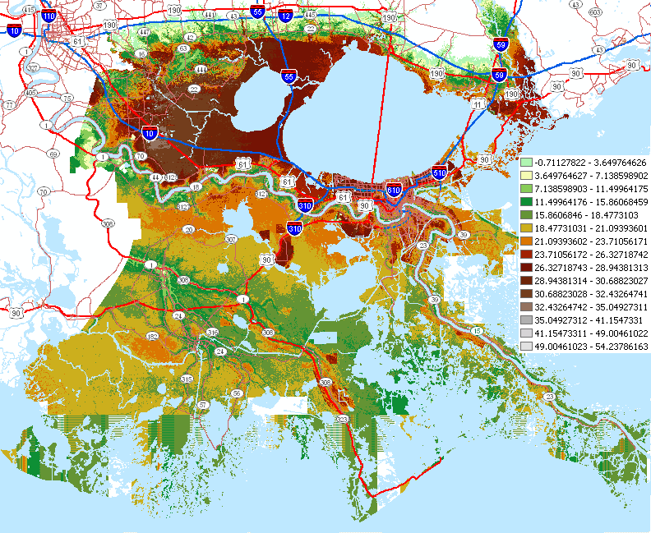

Slide 13
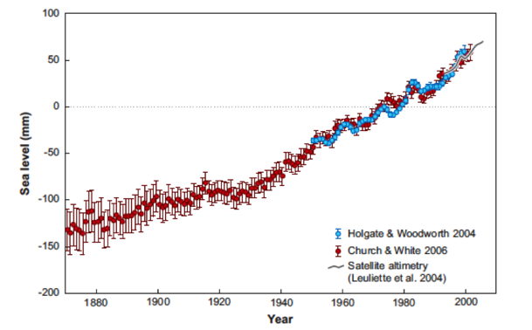
Historical Global Sea Level Rise Additional 3 ft by 2100

Slide 14
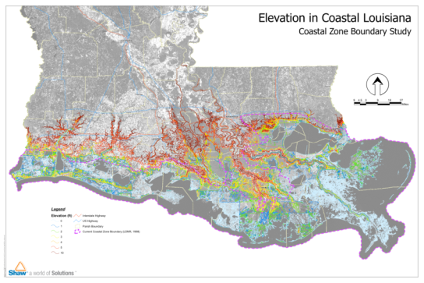
Area Vulnerable to Sea Level Rise
3 ft expected sea level rise over next century
Area below 5 ft may become wetland
What’s 8 ft now will be 5 ft by end of century

Slide 15
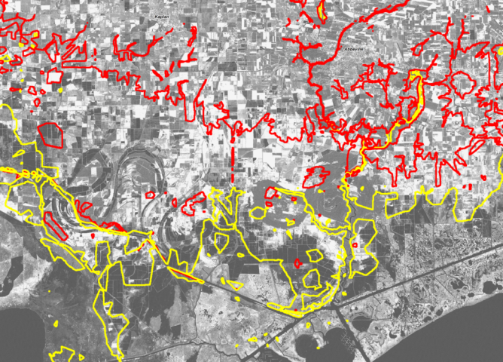
Chenier Plain

Slide 16
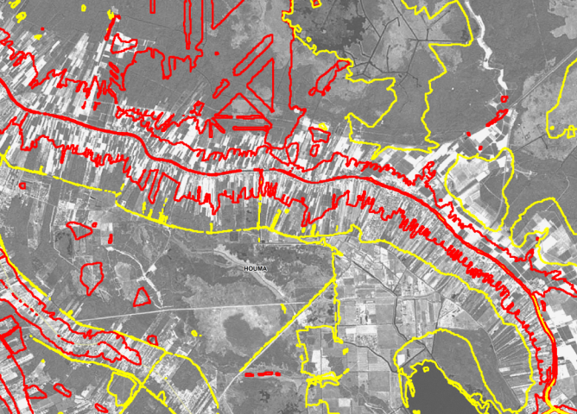
Bayou Lafourche

Slide 17
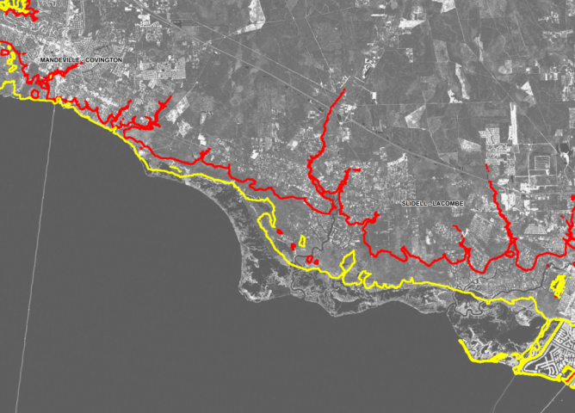
North Shore

Slide 18
Adjustment of CZB
Political boundaries (e.g., parish boundary)
Geographic boundaries (e.g., road)
Watershed boundaries (12-digit watershed code per NRCS)
Socioeconomic factors
Energy and infrastructure, marine commerce, coastal recreation, cultural factors, etc.

Slide 19
Questions?
http://dnr.louisiana.gov/crm/
Dr. Terry Howey
Coastal Resources Administrator
Terry.Howey@LA.GOV

