Slide 1
Hydraulic Fracturing Regulatory Processes in Louisiana
James H. Welsh
Commissioner of Conservation
1

Slide 2
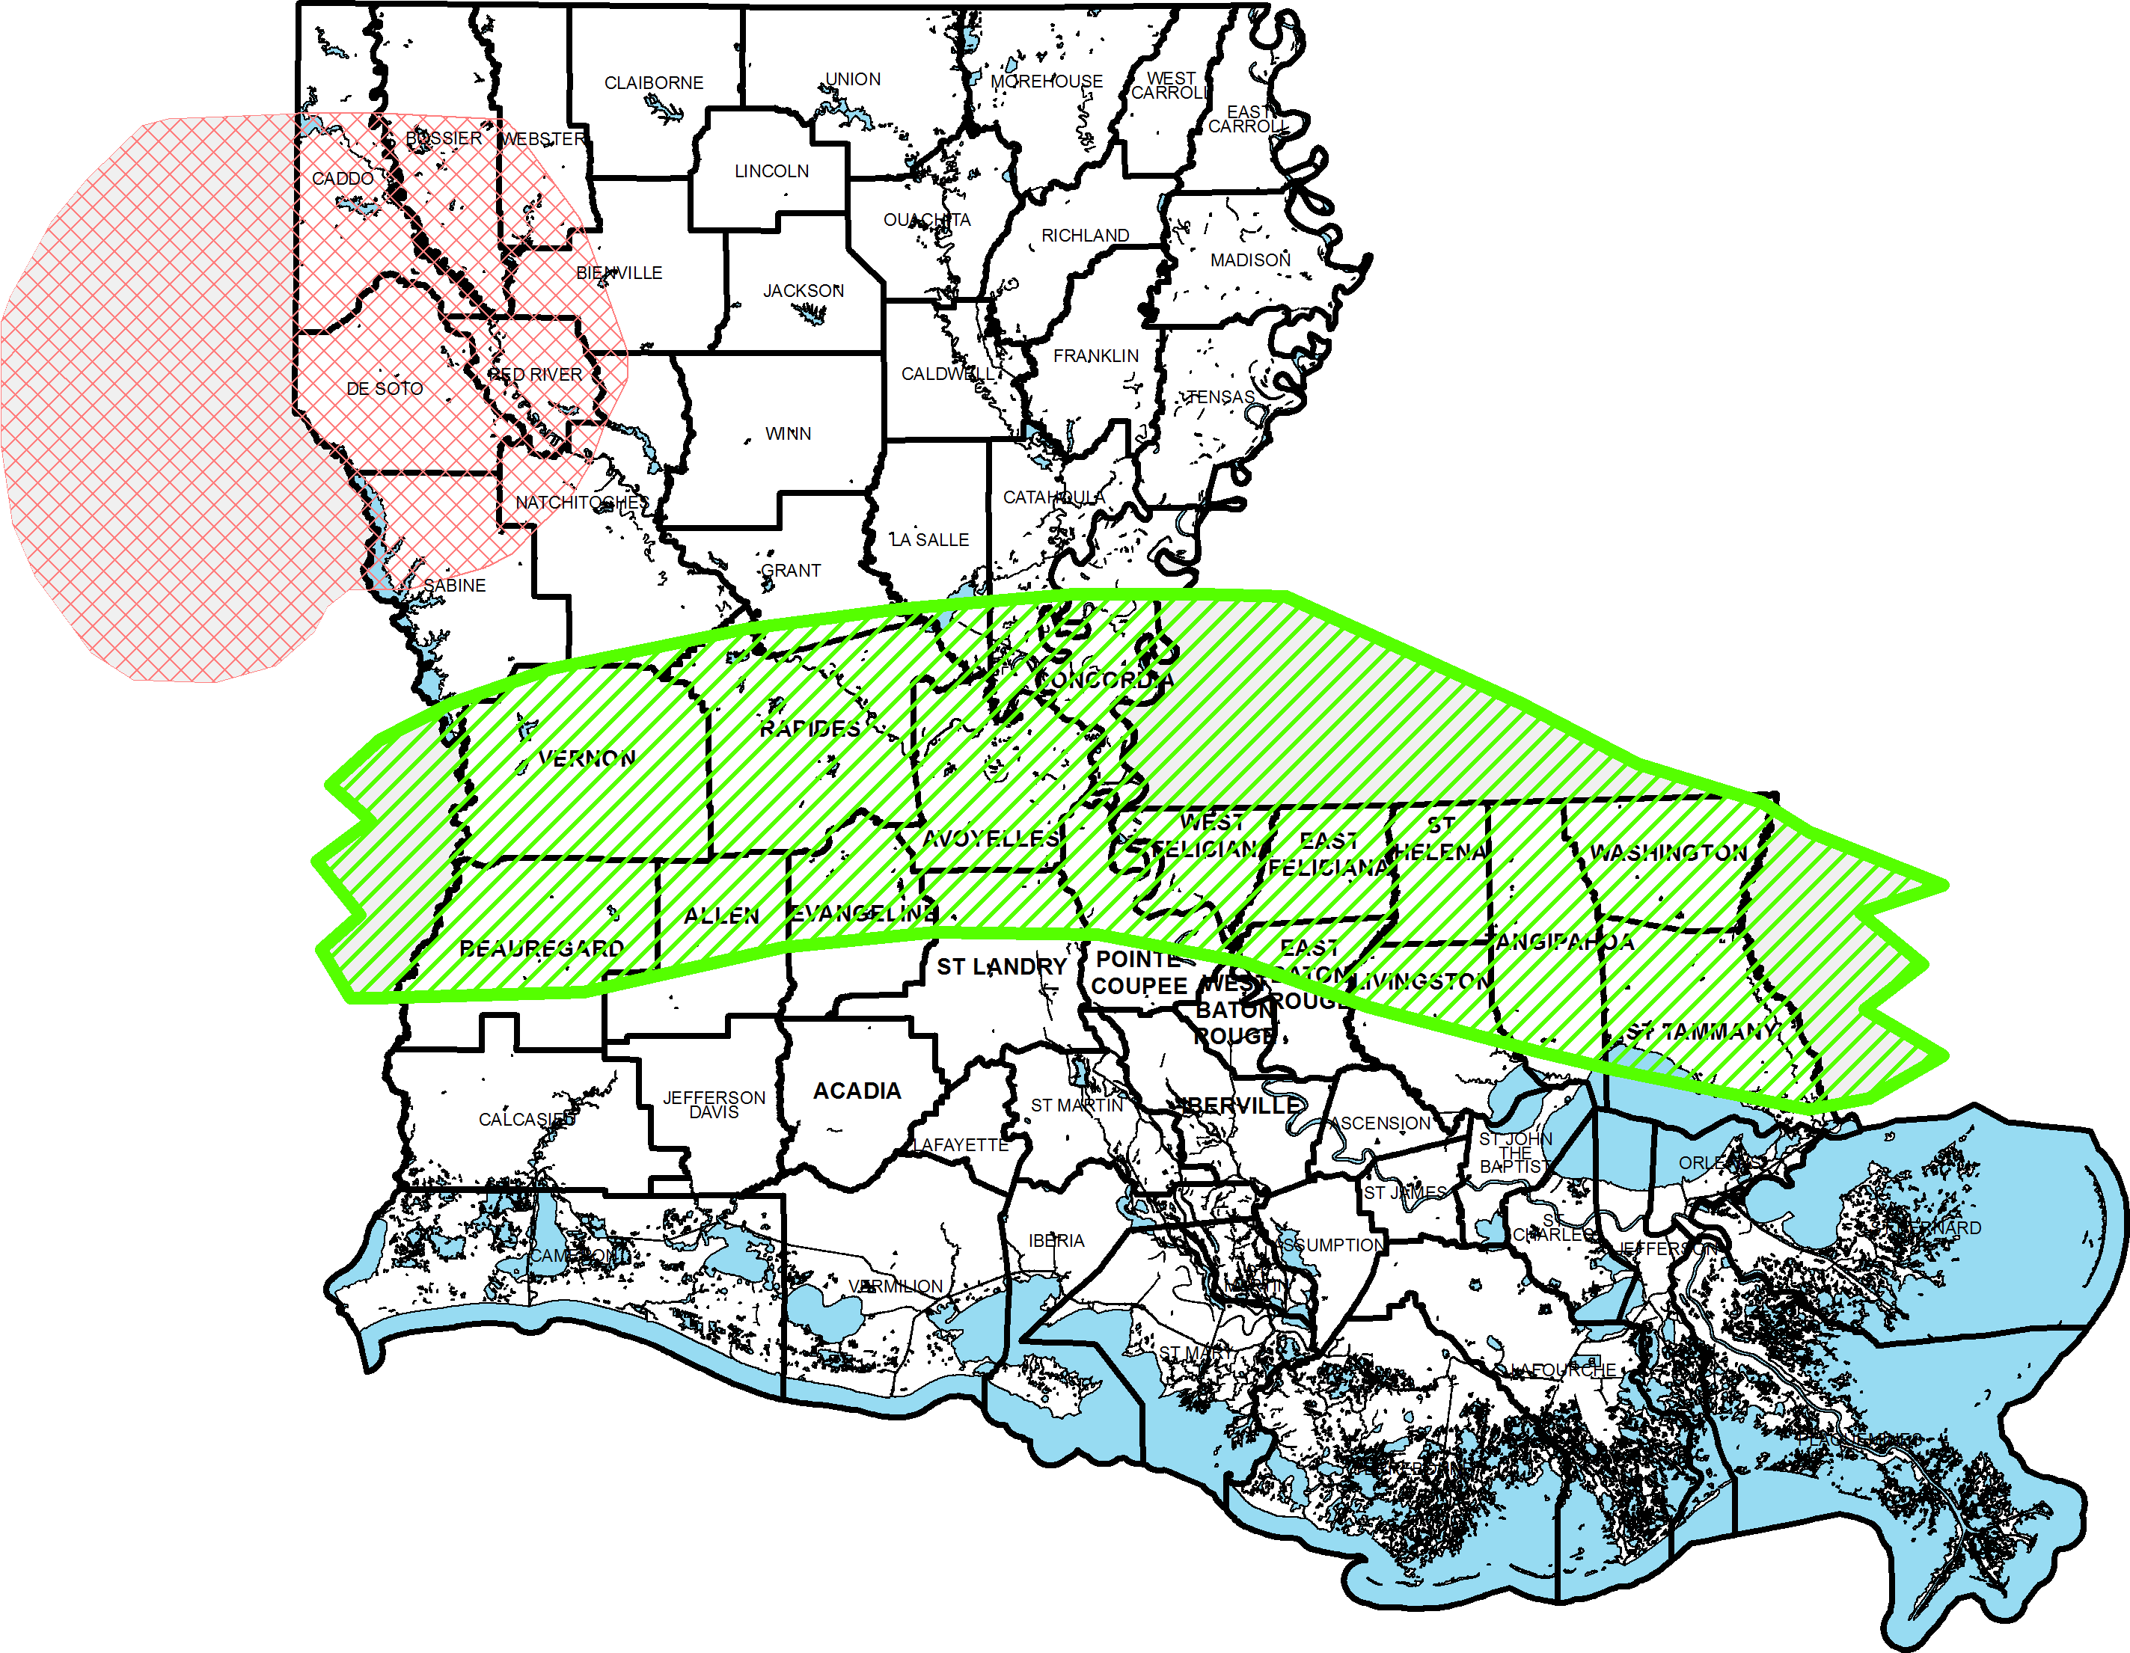
Areas of Current & Potential Activity
^{BROWN DENSE}
^{Haynesville Shale}
^{Tuscaloosa Marine Shale}

Slide 3
Regulatory Goals
Resource Conservation / Sustainability
Waste Minimization
Pollution Prevention
Transparency
Awareness / Surveillance

Slide 4
Regulatory Processes
Water Source Management / Evaluation
Work Permits
Well Construction Requirements
Waste Management / Disposal Requirements
Fracturing Fluid Disclosure
Inspection & Enforcement

Slide 5
Water Sources – Surface Water
Use of surface water is encouraged.
Cooperative Endeavor Agreements may be created through DNR – Office of Mineral Resources (OMR) for the use of running surface water. (Act 955 of 2010)
Application process involves assessing the environmental/ecological impacts and economic benefits of surface water use.

Slide 6
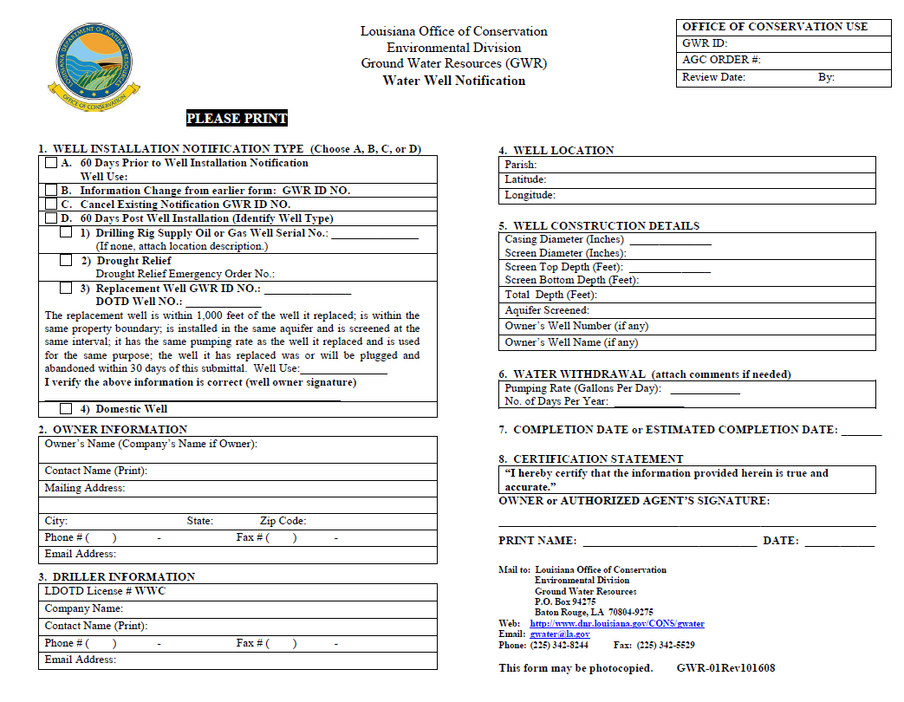
Water Sources – Ground Water
Notice is required prior to installation of new wells and prior to a change in use of existing wells for evaluation purposes.
Orders may be issued to collect information, conduct metering, impose well spacing requirements, or limit production.
Information may be used to establish areas of groundwater concern.

Slide 7
Water Sources – Other
Certain E&P Wastes may be used as a frac fluid component in limited cases.
Promotes both waste minimization and resource conservation.

Slide 8
Water Sources – Reporting
Water sources and volumes must be reported for wells that are hydraulically fractured.
Reporting is accomplished by filing Supplemental Page 3 of the Well History and Work Resumé Report (Form WH-1) following well completion.

Slide 9
Water Use Statistics
Reported Usage from 10/1/2009 to 2/23/2012
Water Usage Data for 1959 Haynesville Shale Natural Gas Wells
Source | Volume (Gallons)
Frac Groundwater | 1,230,712,693
Frac Surface Water | 8,223,152,516
Drilling Rig Groundwater Supply | 879,649,632
Drilling Rig Surface Water Supply | 157,839,504
Other Groundwater | 155,545,829
Other Surface Water, | 39,007,638
Frac Stages | 22,338
Total Frac Water Used (gallons) | 9,453,865,209
Volume per Frac Stage (gallons) | 423,219
Average Frac Stages per Well | 11.4
Average Water Use per Well (gallons) | 5,454,777
Average Frac Water Use per Well (gallons) | 4,825,863
9

Slide 10
Work Permits
A work permit application (Form DM-4R) must be approved prior to conducting fracturing operations.
Process allows for OC inspection of operations.

Slide 11
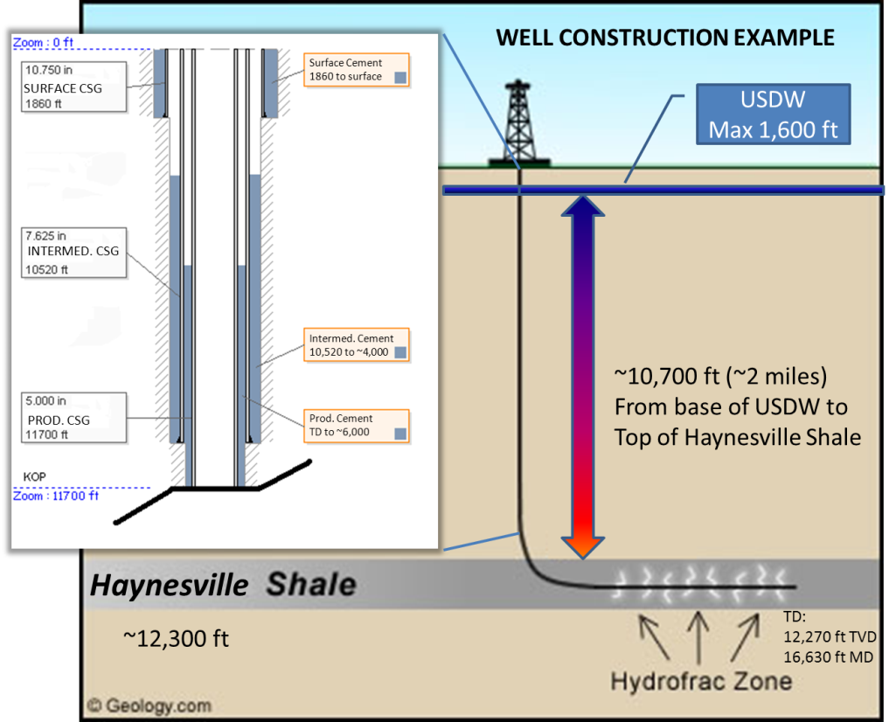
Well Construction Requirements
Use of multiple cemented casing strings
Minimum setting depth to protect USDW
Post-installation pressure testing

Slide 12
Waste Management
E&P Waste regulations ensure proper disposal to minimize environmental impacts of resource development.
Manifest and reporting systems ensure transparency and accountability.
Waste Management options include:
Onsite disposal
Well injection
Commercial disposal
Recycling in limited cases

Slide 13
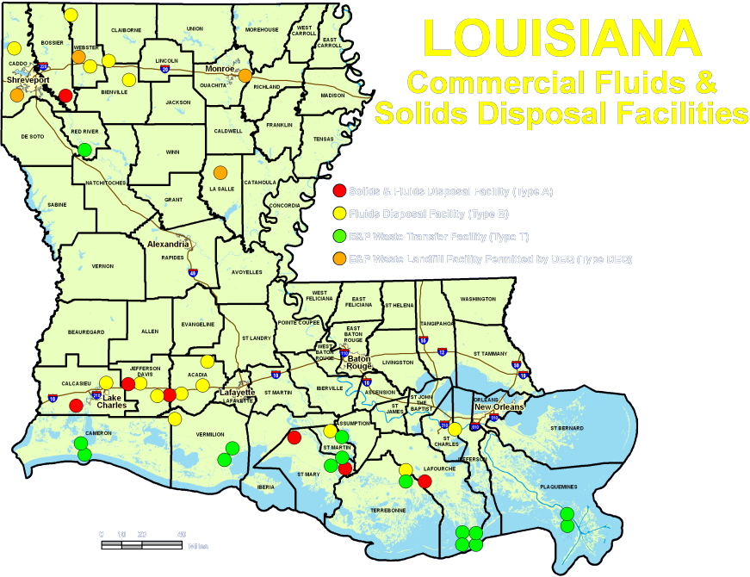

Slide 14
Fracturing Fluid Disclosure
Types and volumes (in gal.) of hydraulic fracturing fluid
List of additives used
List of chemical ingredients subject to requirements of 29 CFR 1910.1200(g)(2)
Maximum ingredient concentration within the additive
Ingredients and concentrations of proprietary chemicals are not required.
Required information may be reported to Frac Focus website.

Slide 15
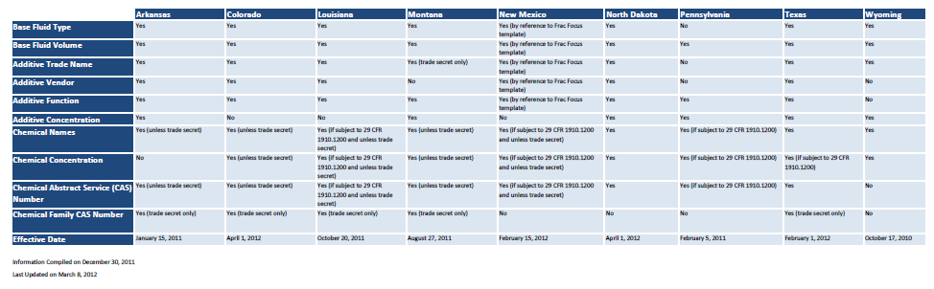
Fracturing Fluid Disclosure Requirements by State

Slide 16
Inspection & Rule Enforcement
Periodic visual inspections of wells are conducted during all phases of development
Regulatory violations result in the issuance of Compliance Orders to the responsible party requiring corrective actions.
Possible enforcement actions include
Levy of Civil Penalties
Suspension of authority to sell oil
Withholding permits
“Orphaning” Declaration

Slide 17
STRONGER Review
STRONGER, Inc. is a nonprofit multi-stakeholder organization which measures state oil and gas waste management programs against a set of Guidelines developed and agreed to by all the participating parties.
A Louisiana Review focusing on hydraulic fracturing regulatory practices was conducted in November 2010; Findings were issued in March 2011.
Positive Assessments of Louisiana’s Regulatory Framework:
Proactive conservation of groundwater resource use.
Waste water recycling program.
Public outreach and education.
Waste disposal regulations.
Areas for Improvement:
Updated Casing and Cementing Requirements. (IN PROGRESS)
More systematic training of Inspectors. (IN PROGRESS)
Require the reporting of hydraulic fracturing information including component constituents of frac fluid. (COMPLETED)

Slide 18
Potential Future Rule Changes
Frac Fluid Disclosure
Disclosure requirements tied to “Right to Know” federal law instead of OSHA safety communication rules.
Casing and Cementing
Clear design objectives
Formation Integrity Tests
Cement evaluation following prolonged drilling
Liner seal testing
Cement top verification in limited circumstances

