Slide 1
Ground Water Resources Commission Meeting
Wednesday, August 18, 2010

Slide 2
Mr. John Adams
DNR Office of Conservation
Adoption of Meeting Summary
April 7, 2010

Slide 3
Mr. Gary Snellgrove
DNR Office of Conservation
Statewide Water Management
Plan Update

Slide 4

Statewide Water Management Plan
Months 1 & 2
RFP Advertisement,
Receipt & Evaluation
Month 8
Issue Draft Comprehensive Report and Receive Public Comment
Months 3-7
Award Contract
Contract execution (ongoing)
Months 9 - 11 Publish FINAL REPORT
Research, Evaluate, Study, Compile statistics, Identify best management practices, Prioritize, Outreach
Timeline

Slide 5
Statewide Water Management Plan
E&E 7/22/10 Update – On Schedule:
Task 1 (95%) – Historic Data Review
Task 2 (65%) – Water Use Statistics
Task 3 (40%) – Well Registration / Notification Review
Task 4 – Aquifer Sustainability Recommendations
Task 5 – Rec. Cost/Benefit & Prioritization
Task 6 (40%) – Funding Opportunities
Task 7 (35%) – BMPs & Cost Analysis
Task 8 – Draft Report Public Hearing (Nov/Dec 2010)
Task 9 – Exec. Summary & Final Report (Feb 2011)

Slide 6
Dr. Christel Slaughter
SSA Consultants, LLC
Ground Water Commission Members
Final Report

Slide 7
Ground Water Resources Commission Master Plan Preparation: Commissioners’ Interviews Summary and Feedback
SSA Consultants
Christel C. Slaughter, Ph.D. and Will Williams, Ph.D.

Slide 8
Commissioner Engagement
In an effort to create a comprehensive statewide Ground Water Master Plan and process, Lieutenant Governor Angelle requested interviews with each Commissioner
Objective: determine scope and breadth of the plan and level of involvement desired for each of the Commissioners

Slide 9
Commissioner Feedback: Functioning of the Commission
Commissioners stated that they were pleased with the direction of the Ground Water Resources Commission
Felt involved and informed
Detailed agendas provide for robust discussion at quarterly meetings
Staff provides timely and solid information

Slide 10
Commissioner Structure and Role
Observations
Nineteen members is a large commission
Pleased with Scott Angelle’s openness and attitude
Many Commissioners have been involved with water issues for over a decade
No budget or authority – should be monitoring the Conservation Department; should be voting to give recommendations to DNR

Slide 11
Commission Meetings
Commissioners generally like the meetings rotated around the state to allow for more public participation
Broad agreement that there is good representation of interested parties on the Commission
Interest and some concern over the Advisory Task Force and its relationship to the Commission

Slide 12
General Feedback
Some expressed concern that not all relevant parties would be involved in the planning process
More than one Commissioner stated that he did not want to simply be handed a draft plan and asked for feedback at that point; early involvement is critical to success

Slide 13
General Feedback
Surface water issues are uppermost in the minds of many Commissioners
Learning from both successful, progressive states (Arkansas), as well as states who have had difficult “Water Wars” (Oregon, Georgia, and South Carolina) will be important to success
Many favor a phased-in approach with incentives for compliance and fees for usage

Slide 14
General Feedback
There is not complete consensus on how fast the state should move; some Commissioners believe that the situation is urgent while others believe that a calculated, phased-in approach would be more prudent
Many Commissioners believe that public education efforts will be critical for sustained success in conservation efforts

Slide 15
General Feedback
There is some indication that additional staff or resources for inspection, testing, and monitoring may be needed in the future

Slide 16
Role of the Commission and the State Versus Local Jurisdiction
In areas surrounding the SPARTA aquifer and in the Ruston area, giving the state and the Ground Water Resources Commission statewide authority is controversial
More than one Commissioner stressed the importance of Louisiana retaining statewide authority to regulate, tax, and impose fees on ground and surface water in order to preserve and ensure the sustainability of this resources

Slide 17
Plan Elements and Emphasis
Because the Commission is part-time, the plan elements and recommendations cannot be vague – in essence they must be “black and white” in order to be implemented
Commission must find ways to track progress over the next few years and if it is to be successful it will look back in 10 years and be proud of what was accomplished

Slide 18
Commissioner Expectations Regarding the Statewide Plan
Commissioners are committed to the concept of the statewide plan but expectations about content and process vary widely
Some Commissioners would like for the plan to be specific and even prescriptive in nature about what the state should adopt to maintain and sustain water resources
Some Commissioners would like to see regional plans included as well as a master plan for the state
Some Commissioners want more a broad framework for the state that will provide a blueprint for the future

Slide 19
Groups and Individuals to be Included in Developing the Master Plan
Environmental groups and NGO’s
Sabine River Authority
Capital Area Ground Water Conservation
Industrial users
Agricultural representatives/USDA/NRCS
USGS and the Department of the Interior
Police Jury Association
Louisiana Municipal Association
League of Women Voters
Arkansas Sparta Group

Slide 20
Draft Plan Development
Commission Member Workshop
Provides GWRC membership additional opportunity for direct input and involvement in the development of the draft plan.
Written Questionnaire
Alexandria, La. Venue
September Date TBA

Slide 21
Lt. Governor Scott A. Angelle
Attorney General Opinions Briefing
Surface Water Use

Slide 22
Lt. Governor Scott A. Angelle
ACT 955 and 994 Summary

Slide 23
Mr. Rick Heck
DNR Office of Mineral Resources
DNR Running Surface Water
Cooperative Endeavor Agreement
Update

Slide 24
Louisiana Department of Natural Resources
ACT 955 of 2010
SURFACE WATER MANAGEMENT
USING
COOPERATIVE AGREEMENTS
FOR
WITHDRAWAL OF RUNNING WATER OF THE STATE
August 4, 2010

Slide 25
SURFACE WATER MANAGEMENT
THE FRAC-ING PROCESS TO PRODUCE HAYNESVILLE SHALE GAS WELLS REQUIRES THE UNPRECEDENTED USE OF ENORMOUS AMOUNTS OF WATER.
WITH THIS NEED COMES A REAL POTENTIAL FOR CHAOS AND CONFLICTS OVER UNCONTROLLED WATER USE.
ACT 955 WAS PASSED TO PROVIDE LOUISIANA’S FIRST RUNNING SURFACE WATER MANAGEMENT TOOL TO PROVIDE ORDERLY SAFE ACCESS TO THIS VALUABLE RESOURCE. .

Slide 26
SURFACE WATER MANAGEMENT
WHY WAS LEGISLATION ENACTED?
In response to several requests the Attorney General issued a memorandum opining that “Under Louisiana Law, persons with the possible exception of riparian landowners, are not authorized to remove State owned surface water without obtaining the prior written approval of the State and without paying fair value.”
In addition, in subsequent legal opinions the Attorney General opined that such waters are owned by the State in its capacity as a public person and holds it in trust for the people of the State.

Slide 27
SURFACE WATER MANAGEMENT
WHY WAS LEGISLATION ENACTED?
(Continued)
The Attorney General opined that such waters are “a thing of value that belongs to the people of the State of Louisiana”. He further opined that such waters must be purchased pursuant to the laws governing the sale of State property if it is to be used for anything other than a public purpose and that La. Const. Art.VII Section 14 applies (State can’t donate property, or things of value)

Slide 28
SURFACE WATER MANAGEMENT
WHY WAS LEGISLATION ENACTED?
(Continued)
The Attorney General has opined that agreements for the sale of surface water must:
Be a writing in the form of a contract or cooperative endeavor agreement;
Be approved by the secretary of Natural Resources, and the Attorney General;
And be for a fair value.

Slide 29
SURFACE WATER MANAGEMENT
WHY WAS LEGISLATION ENACTED?
(continued)
To provide clear and specific statutory authority meeting applicable constitutional mandates to provide for the sale of running waters of the state for commercial purposes.
Applicable Constitutional Mandates
La. Const. Art. VII, Section 14: “Except as otherwise provided by this constitution, the…property, or things of value of the state or any political subdivision shall not be…donated to or for any person, association, or corporation, public or private.
La. Const. Art. IX, Section 1: “The natural resources of the state, including air and water,….shall be protected, conserved, and replenished insofar as possible and consistent with the health, safety, and welfare of the people….”

Slide 30
SURFACE WATER MANAGEMENT
WHO IS INCLUDED IN THE NEW LAW?
Commercial users who are not riparian owners, who seek to withdraw water from the running surface waters of the state. A riparian owner is one whose land touches the source of the surface water.

Slide 31
SURFACE WATER MANAGEMENT
WHO IS NOT INCLUDED?
Uses or groups specifically exempted from the law
Riparian Owners
Public And Private Water Systems
Agricultural Users

Slide 32
SURFACE WATER MANAGEMENT
What is the Process ?
(Continued)
The statute authorizes the Secretary of DNR to develop an application and to enter into Cooperative Endeavor Agreement for withdrawal of running surface water.
The Mineral And Energy Board must develop the agreement Form.
The Attorney General must approve the agreement Form.

Slide 33
SURFACE WATER MANAGEMENT
In review of proposed withdrawal agreements, what must be considered?
Would the proposed contract follow good management practices?
Is the proposal based upon sound scientific data?
Is the proposal consistent with the required balancing of environmental and ecological impacts with the economic and social benefits found in Art. IX, Sec. 1 of the Louisiana Constitution.

Slide 34
SURFACE WATER MANAGEMENT
In review of proposed withdrawal agreements, what must be considered? (Continued)
Both potential and real effects on the sustainability of the water body, on navigation, and on the environment and ecology balanced against the social and economic benefits of the contract for withdrawal.
Whether the proposed use is consistent with Louisiana’s Comprehensive Master Plan for a Sustainable Coast.

Slide 35
SURFACE WATER MANAGEMENT
Which Uses Get Priority ?
First, Human consumption via a public water system, or private water system that provides domestic potable water service; and
Second, Agricultural uses that provide sustenance to animals or irrigation to plants; and
Third, Commercial or industrial activity.

Slide 36
SURFACE WATER MANAGEMENT
What Impacts Must be Considered by the Secretary in Reviewing a Proposed Withdrawal Agreement?
stream or water flow energy
sediment load and distribution
navigation
aquatic life
other vegetation or wildlife

Slide 37
SURFACE WATER MANAGEMENT
PROTECTION OF THE RESOURCE
The secretary is required to make sure each withdrawal agreement provides for the secretary’s authority to protect the resource and to maintain sustainability and environmental and ecological balance.
The secretary may take action to protect the resource including:
Suspension or termination of the withdrawal of water.
Other necessary actions.

Slide 38
IMPLEMENTATION OF ACT 955
Upon signing of act 955 into law the chairman of the ground water commission, Scott Angelle, established a task force to :
Draft a cooperative endeavor agreement.
Draft the application for the cooperative endeavor agreement
Contact existing commissions and water districts to gather information
Gather federal, other state and local government requirements for implementation

Slide 39
IMPLEMENTATION OF ACT 955
The Chairman distributed draft Application and Agreement forms to stakeholders for review on July 15, 2010.
The comments received from Stakeholders were considered by the Task Force and where appropriate incorporated into the draft Agreement before you today for consideration and approval.

Slide 40
Mr. John Adams
DNR Office of Conservation
US Dept. of the Interior
Cooperative Watershed Mgt. Program

Slide 41
US DOI Cooperative Watershed Management Program
Public Law 111-11, Sections 6001-03
Update
Became Law Spring 2009
Program Currently Under Development
Funding Currently Not Appropriated
Chris Piehler, DEQ – State Contact Person

Slide 42
Ground Water Resources Program Update
42

Slide 43
Mr. Gary Snellgrove
DNR Office of Conservation
Evolution of the Water Well Driller Program
Katrina & Rita Water Well damage – LRA Funding Update
Haynesville Shale Frac Water Supply Implementation Update
Statewide Water Well Notification Audit & Enforcement Update
Public Outreach and Education
43

Slide 44
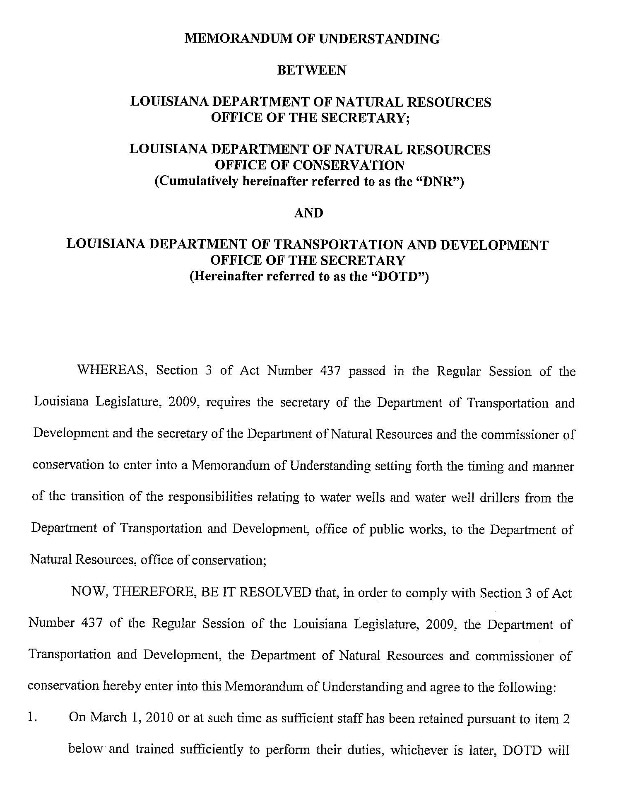
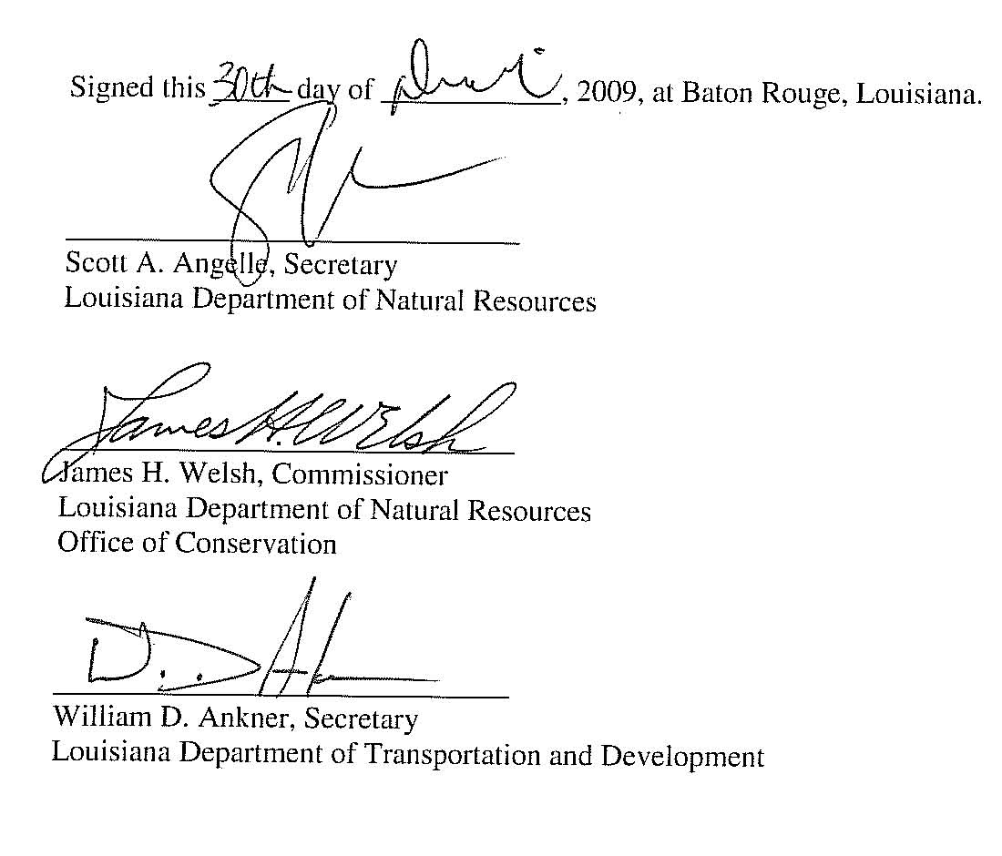
Evolution of the Water Well Driller Program
Recent Major Milestones:
Draft Proposed Regulations
Sept. 20, 2010 State Register Publication
Database Merge
Data Use Demonstration
44

Slide 45
Mr. Rizwan Ahmed
DNR Information Technology
Water Well Registration & Notification
Database Merge

Slide 46
Hurricanes Katrina & Rita Water Well Damage Assessment
LRA moves to Office of Community Development-Disaster Recovery Unit
Pre-Application Approved
Application in Progress

Slide 47
Mr. Patrick Forbes
Office of Community Development
Disaster Recovery Unit
Katrina / Rita Damaged Water Well
P&A Funding Request Update

Slide 48
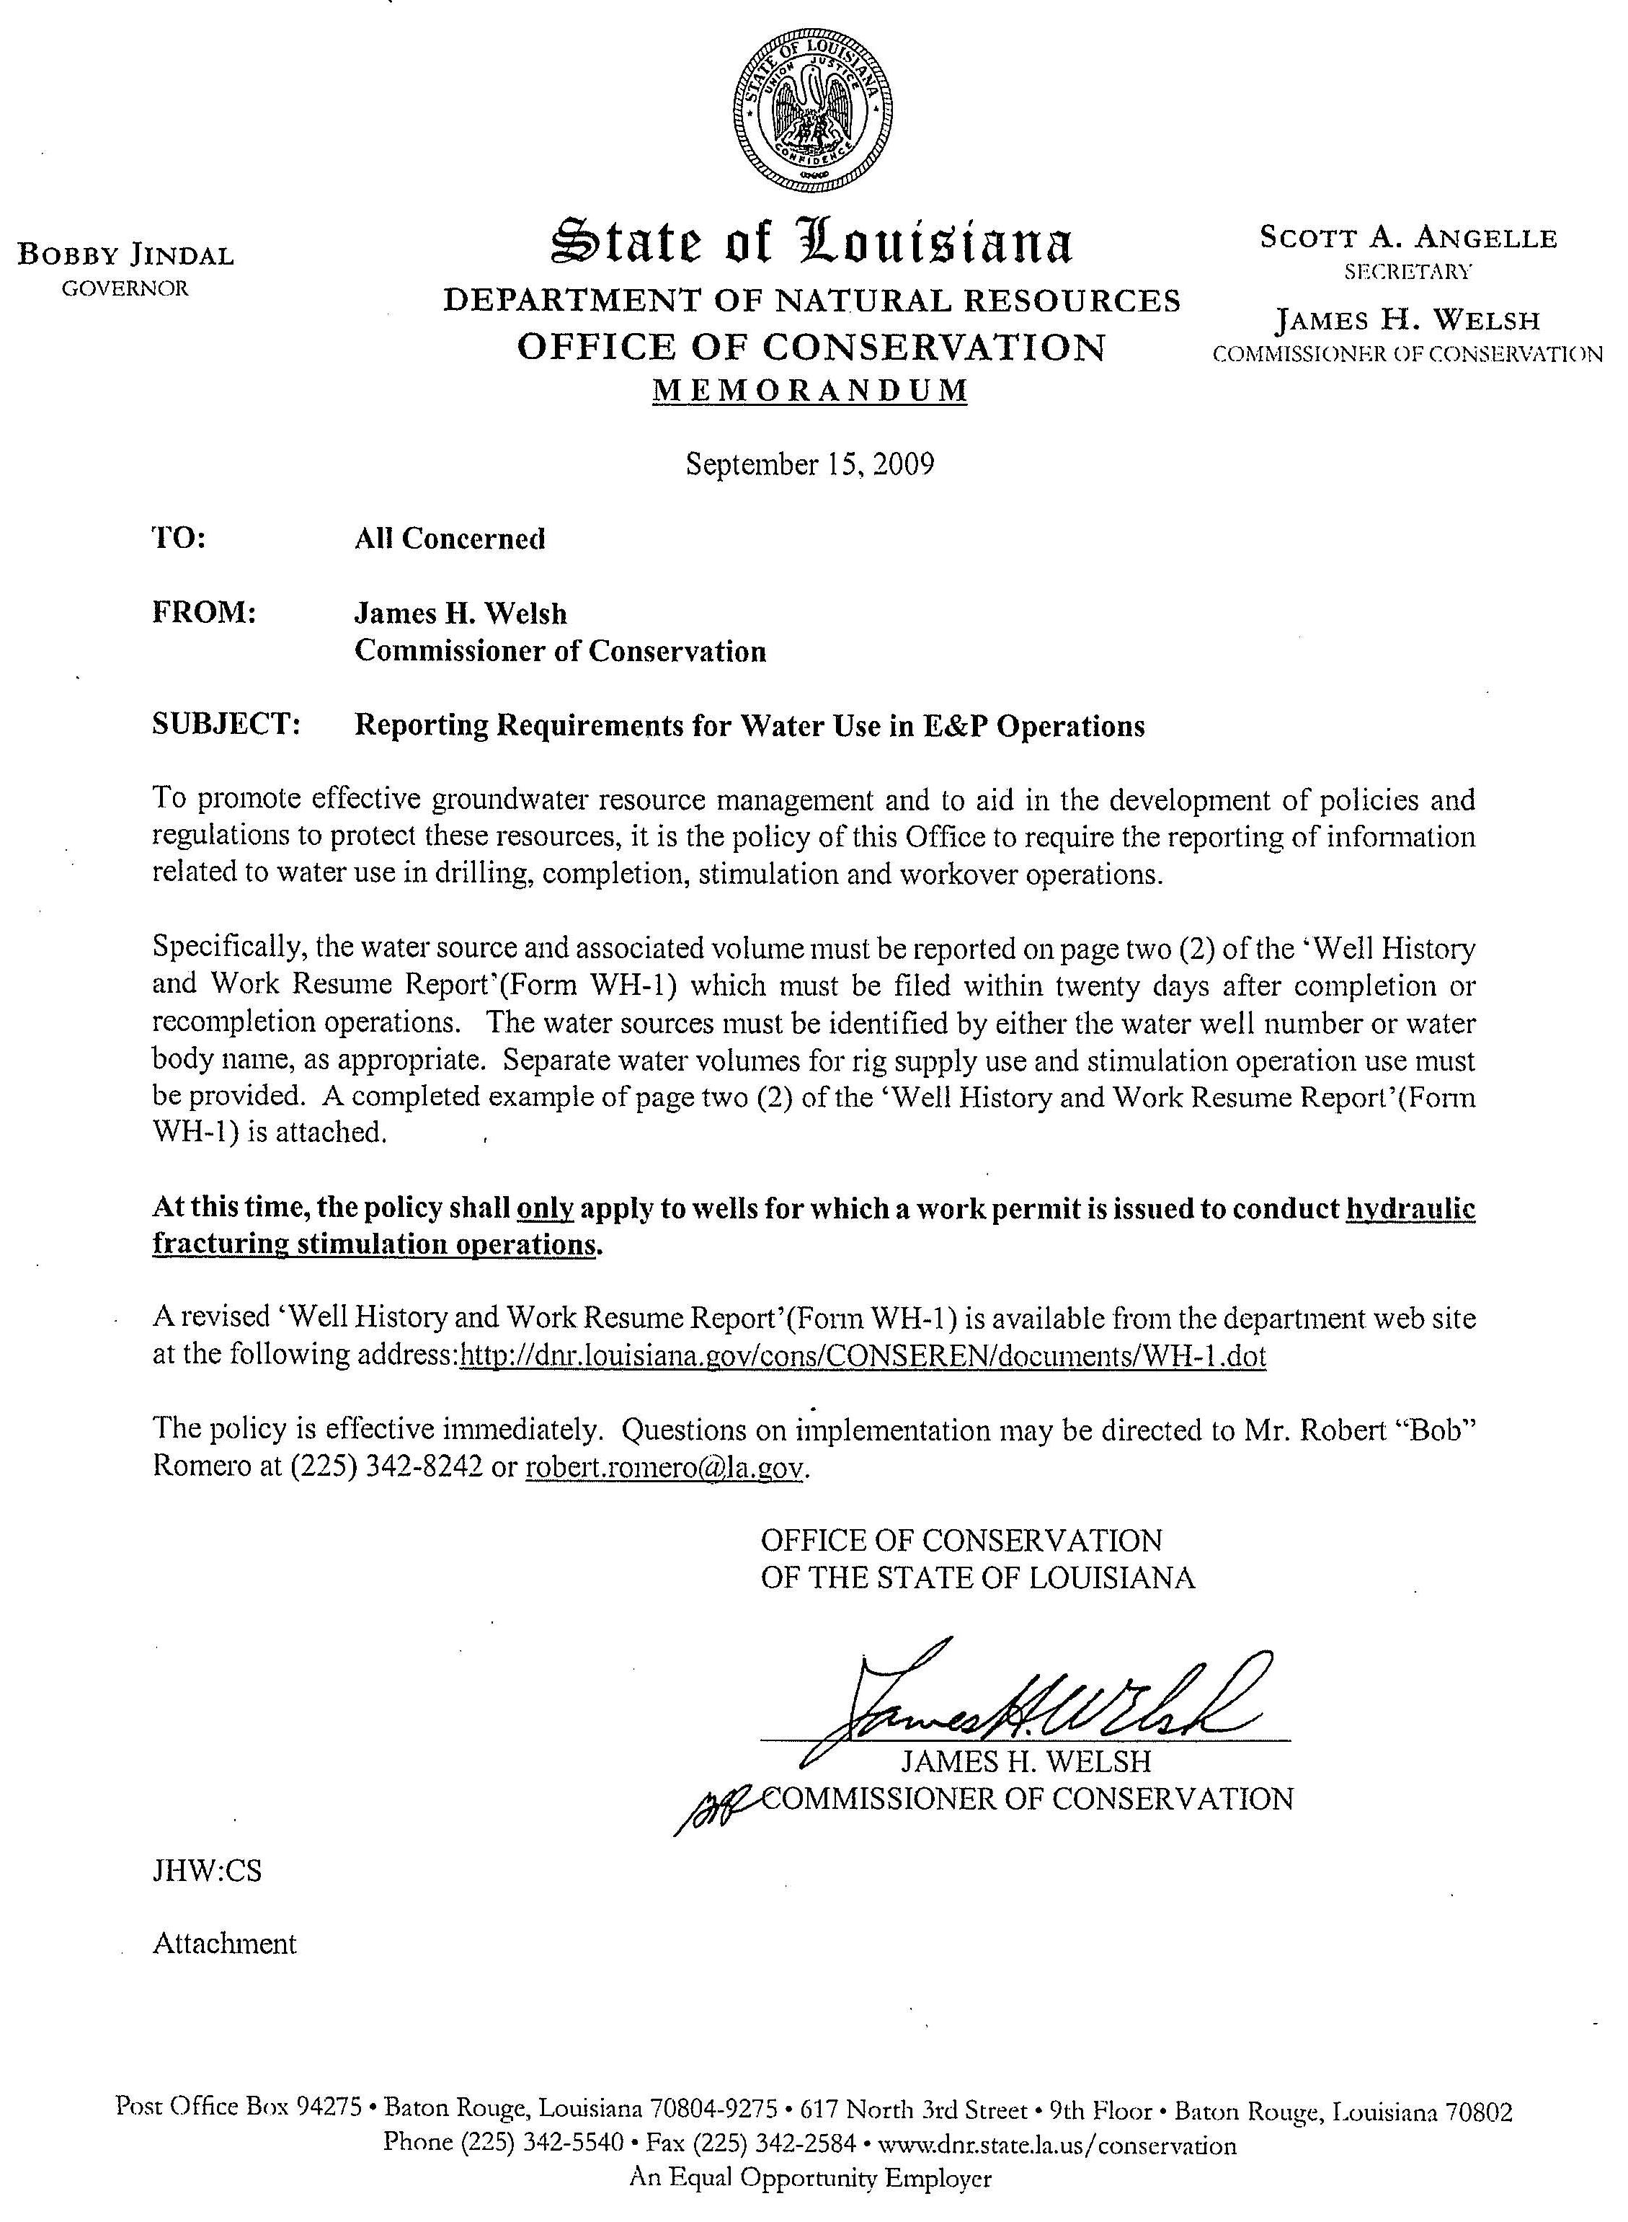
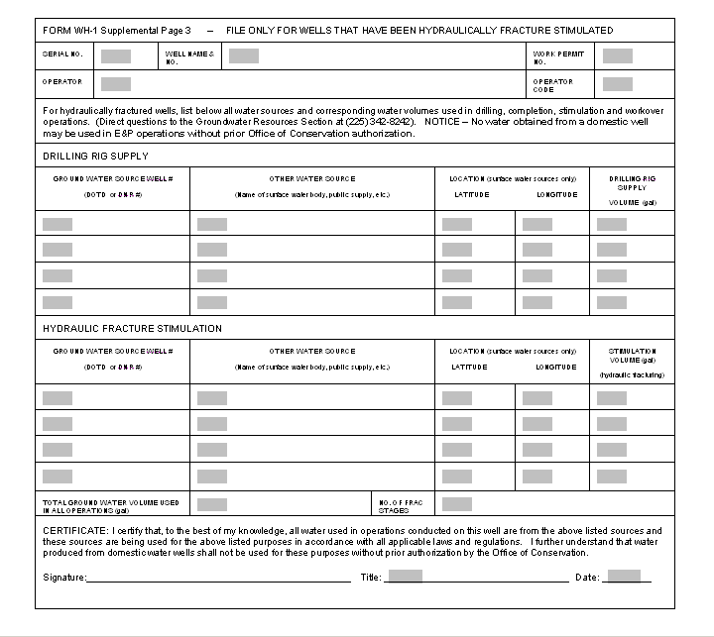
Haynesville Shale Frac Water Mandatory Drilling & Frac Water Supply Source and Volume Reporting

Slide 49
Haynesville Shale Frac Water
Mandatory Drilling & Frac Water Supply Source and Volume Reporting
Actions of the Commissioner:
Requires operators to report water sources and volumes
Issued on September 15, 2009
Enforceable effective October 1, 2009
Revised form on March 1, 2010
Provides valuable groundwater resource management tool
Statistics

Slide 50
Haynesville Shale Natural Gas Well Development
Drilling and Stimulation Operations
Reported Water Usage from 10/1/2009 to 7/14/2010 WH-1 Information
Source | Volume (Gallons)
Frac Groundwater | 235,238,109
Frac Surface Water | 1,471,054,979
Drilling Rig Groundwater | 177,985,046
Drilling Rig Surface Water | 21,595,878
Other Groundwater | 3,534,331
Other Surface Water | 10,001,189
As of 7/14/2010
423 Reporting wells
793 Total work permits

Slide 51
Statewide Well Notification Audit and Enforcement
Initiated a comprehensive statewide audit schedule
Two year plan to audit all ground water wells drilled in Louisiana after July 1, 2001
To date, 44 parishes audited
Current status of implementation
2009 Schedule
January | February | March | April | May | June | July | August | September | October | November | December
Caddo, Red River, Bossier, DeSoto |  |  |  |  | Calcasieu, Cameron | Jeff Davis, Vermillion | Acadia, Lafayette | Allen, Evangeline, St. Landry | Bienville, Webster | Claiborne, Jackson, Lincoln | Ouachita, Morehouse, Union
CARIZZO – WILCOX (Haynesville) |  |  |  |  | CHICOT |  |  |  | SPARTA

Slide 52
Statewide Well Notification Audit and Enforcement
Comprehensive statewide audit schedule continued…
2010 Schedule
January | February | March | April | May | June | July | August | September | October | November | December
EBR, E. Feliciana, WBR, W. Feliciana | Livingston, St. Helena, Tangipahoa, Washington | St. Tammany | E. Carroll, Madison, Richland, W. Carroll | Catahoula, Concordia, Franklin, Tensas | Caldwell, Grant, LaSalle, Natchitoches, Sabine, Winn | Beauregard, Vernon | Avoyelles, Pointe Coupee, Rapides | Assumption, Iberia, Iberville, St. Martin, St. Mary | Ascension, St. Charles, St. James, St. John | Jefferson, Lafourche, Terrebonne | Orleans, Plaquemines St. Bernard
SOUTHEAST LOUISIANA |  |  | MS RIVER ALLUVIAL |  | OTHER
Annual Statewide Schedule - Beginning 2011 and proceeding annually
January | February | March | April | May | June | July | August | September | October | November | December
Bienville, Bossier, Caddo, Desoto, Red River, Webster | Claiborne, Jackson, Lincoln, Morehouse, Ouachita, Union | Acadia, Calcasieu, Cameron, Jeff Davis, Vermillion | Allen, Beauregard, Evangeline, Lafayette, St. Landry | EBR, E. Feliciana, Livingston, St. Helena, WBR, W. Feliciana | E. Carroll, Franklin, Madison, Richland, Tensas, W. Carroll | Caldwell, Grant, LaSalle, Natchitoches, Sabine, Winn | Avoyelles, Catahoula, Concordia, Rapides, Vernon | Assumption, Iberia, Iberville, Pointe Coupee, St. Martin | Ascension, St. Charles, St. James, St. John, Tangipahoa, Washington | Orleans, St.Tammany | Jefferson, Lafourche, Plaquemines, St. Bernard, St. Mary, Terrebonne

Slide 53
Statewide Well Notification Audit and Enforcement Results
Parish Actions
Caddo 71
Red River 28
Bossier 65
DeSoto 53
Calcasieu 83
Cameron 24
Jefferson Davis 88
Vermilion 161
Acadia 114
Lafayette 91
Allen 31
Evangeline 40
St. Landry 95
Bienville 60
Parish Actions
Webster 43
Claiborne 33
Jackson 23
Lincoln 47
Ouachita 39
Morehouse 97
Union 27
East Baton Rouge 33
East Feliciana 24
West Baton Rouge 5
West Feliciana 8
Livingston 36
St. Helena 24
Tangipahoa 126
Washington 65
St. Tammany 471
53

Slide 54
Statewide Well Notification Audit and Enforcement Results
Parish Actions
East Carroll 65
Madison 48
Richland 69
West Carroll 64
Catahoula 12
Concordia 11
Franklin 57
Tensas 17
Caldwell 20
Grant 7
LaSalle 0
Natchitoches 22
Sabine 29
Winn 17
54

Slide 55
Areas of Ground Water Concern
Water Well Owner
Monthly Water Use

Slide 60
Louisiana USGS Sparta Aquifer
Ground Water Monitoring Wells
Water Level Recovery Trends

Slide 61
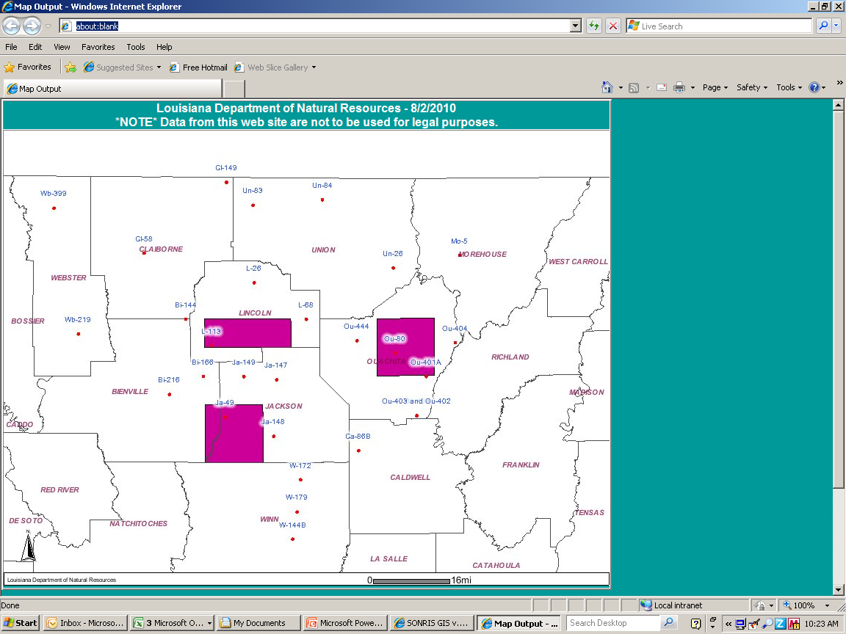
USGS Sparta Aquifer Water Level
Post-AGC Order Monitoring Well Evaluation
L-113
Ou-80
Ou-401A
Water Level Increase*
Recovery in Feet
9+
9.0-6.0
6.0-3.0
3.0-0
†
‡
‡
† - Water Level is flat since 2000
‡ - Water Level declining from 2000
- Decline lessened since 2005
- Decline increased since 2005
Water level data from 2000-2010
Well affected by outside factor

Slide 62
Public Outreach and Education
Ground Water Conservation
1) Middle School Curriculum Guide
2) Water Company Monthly Billing
3) LSU AgCenter / NRCS Partnership
4) Public Service Announcement

Slide 63
Public Outreach and Education
July 2010 Commissioner’s Ground Water Resources Management Report
July 1, 2009 – June 30, 2010
A) Performance Indicators & Statistics
B) Enforcement Activity
C) Sparta AGC Water Use Reports
D) Haynesville Shale Water Use Data
E) Public Outreach and Education
F) Other Accomplishments

Slide 64
Next Meeting Date
Wednesday, October 6, 2010
11:00 AM
TBA

